Slide 1
Ministry Financial Plan
2019⎼2021 Biennium

Slide 2
Topics
FY 2017⎼18 Results
FY 2018⎼19 Projections
Proposed Financial Plans
FY 2019⎼20
FY 2020⎼21
Notes:
Good Morning. I am Todd Poppe, WELS Chief Financial Officer & Treasurer. This is the eight convention that I have had the honor and pleasure of presenting the proposed ministry financial plan to you, the convention delegates. I am pleased to report that God continues to bless WELS with the financial gifts needed to maintain current ministry levels. As He has done in many prior years, we pray that His blessings far exceeds what we humble servants are projecting.
Topics to be covered during this presentation include a high-level overview of the results for fiscal year 2017-18 and projections from February of this year for the fiscal year 2018-19 which ended about a month ago. These results and projections have been previously been provided to the synod and are included in the BORAM, but we will review them at a high level to provide context for the financial plan proposed for this biennium.
Lastly, but most importantly for you, is the proposed plan for fiscal years 2019-20 and 2020-21 which the convention will be asked to approve.

Slide 3
Definitions
Operating Fund—ministry expenses funded by resources that have no restrictions such as Congregation Mission Offerings; gifts, grants, and bequests without donor imposed restrictions; interest and other revenue; and tuition and fees at the schools
Special Funds—gifts that donors have restricted the ministry the gift can be used for OR that have been designated by the ministry for a specific purpose
Financial Stabilization Fund—holds for a year or more unrestricted gifts and revenues that are challenging to project, like bequests, then transfers them to Operating Fund.
Notes:
Before getting into the detail there are a couple of terms that you will hear me use when taking about results and projections. The first is operating plan or budget. The operating plan includes… Special Funds refer to ministry expenses that are funded by… Financial Stabilization Fund is used, along with Congregation Mission Offering to fund the ministry expenses in the operating plan. To fund operating expenses in a reliable manor, the Financial Stabilization Fund holds… Prior to instituting the Financial Stabilization Fund, most years WELS was required to reduce ministry expenses mid-year or mid-biennium to balance the budget. Praise God, mid-year budget reductions have practically been eliminated since the fund was established.

Slide 4
FY 2017⎼18 Results
Operating, special, and financial stabilization funds had a collective $300,000 deficit
WLS & MLC: financially strong; LPS: financial strength increasing; MLS: minimal reserves
Support Service Subsidiaries:
Northwestern Publishing House—new business model to stem deficits
WELS Church Extension Fund—$1 million grant to Home Missions
WELS Foundation—$500,000 grant to WELS Ministries
WELS Investment Fund—growing investment portfolio
Notes:
So, if you were a delegate to the 2017 convention you heard that reserves would need to be drawn down by a couple of million dollars each to fund the ministry plans proposed for the biennium. Actual result for fiscal year 2017-18 were much better than expected. Some reserves were used to fund ministry but overall, WELS Operating, Special Funds and Financial Stabilization Fund reserves decreased only $300,000. This $300,000 decrease includes the synodical council authorizing the spending of $400,000 for the top three items on the 2017 convention’s unfunded priority list. $150,000 to Martin Luther College for student assistance; $200,000 for mission starts and enhancements and $50,000 to the Publication Coordinating Committee for new projects. God be praised for these blessings.
Our seminary and college of ministry are financially strong. The financial strength of Luther Preparatory School in Watertown Wisconsin is growing. Michigan Lutheran Seminary in Saginaw MI has minimal reserves but they have turned around operating results and are expecting reserves and financial position to continue to improve.
The support service subsidiaries, which all operate without synod support, are also strong. Northwestern Publishing House implemented a new operating model to stem future deficits from its retail store operations. WELS Church Extension Fund, WELS saving and loan unit, again had a surplus and was able to prudently provide a special $1 million grant to Home Missions for new mission starts. If you are not already an investor in WELS Church Extension Fund, I urge you to check our their investment offering and learn about the exciting ways their grant and loan programs support Home Missions and new congregations. WELS Foundation, the unit that manages deferred giving instruments like charitable remainder trusts, charitable gift annuities, donor advised funds, endowments and other estate gifts provided a $500,000 grant to WELS operating fund from bequests and operating surpluses. The WIF Investment Funds provides several diversified investment vehicles to meet the needs of WELS ministries, congregations and WELS affiliated ministries long-term investment needs. WIF is currently managing nearly $225 million in investments.

Slide 5
FY 2018⎼19 Projections
Congregation Mission Offerings less than planned
Expenses less than plan
Operating reserves down $850,000
Special Fund reserves up
WLS, MLC, and LPS performing better than plan; MLS is stabilizing
Support Service Subsidiaries in line with or better than plan
Notes:
Back in February, the projections for the current year, fiscal year 2018-19 were similar to the results for the prior year, that is better than what was planned. That doesn’t mean that all areas are better than plan. The plan assumed that congregation missions offering would grow slightly. It turned out that offerings decreased more a percent and subscriptions for 2019 were also down about a percent. The plan called for operating reserves held in the financial stabilization fund to be drawn down $1.8 million. Back in February, underspending and some better than planned sources of support pointed to a draw down of $850,000. While the operating fund results for fiscal year 2018-19 are still being worked, it now appears that the use of reserves will be less than that. Likewise Special Funds reserves are also up from plan due to lower than planned expenses and increase gifts, like the $1 million grant from WELS Church Extension Fund to Home Missions, Vietnam outreach, For the Generations to Come and Christian Aid and Relief. Praise God!
The schools are also doing better than planned and the financial condition of MLS is stabilizing. The support services subsidiaries are also in line with or doing better than plan.

Slide 6
Proposed Ministry Financial Plan
February 2018 planning calendar and key assumptions approved
CMO: subscriptions met in 2018; +0.5% in 2019⎼21
Other Support: flat
Wages: +3.0% annually
Health Care: +10.0% annually
Pension: +6.0% annually
Insurance, Utilities, & Other: 2.0% - 7.0% annually
Ministry Growth: $2.8 million
Notes:
With the context of the prior two year, we can move into the proposed ministry financial plan for the next biennium. Financial planning and analysis never really stops, but the formal 2019-2021 biennium planning kick-off was in February 2018. nearly a year and a half ago. Planning starts with assumptions based on historical trends and available information. Congregation Mission Offerings were assumed to meet the amount committed for 2018 and then grow slightly the years thereafter. Other sources of support where expended to be flat. Wages would grow at the rate of inflation and health care costs would follow market trends. The WELS Pension plan would return to normal growth rates following several years of double digit increases to strengthen the plan’s funded position. Insurance, utilities and other costs were also expected to rise due to inflationary pressures. In addition, the Synodical Council add $2.8 million for ministry growth after coming off several years of better than planned financial results.

Slide 7
Preliminary Support Levels
Home Missions: $5,736,000 (+3.2%); $5,924,000 (+3.3%)
World Missions: $6,786,000 (+3.5%); $7,029,000 (+3.6%)
Ministerial Education: $8,373,000 (+2.9%); $8,560,000 (+2.2%)
Congregation & District Ministry: $5,761,000 (+3.3%); $5,953,000 (+3.3%)
Ministry Support: $3,453,000 (+3.9%); $3,585,000 (3.8%)
Notes:
The result of these preliminary assumptions was increased operating support for all ministry and support services. Was needed just to maintain ministry levels. (Review the amounts and changes, note ME is less than other areas due to its senior employees and expense mix; Ministry support is up due to the bringing into the operating budget the WELS Archives which were previously funded by a special grant from WLS

Slide 8
Planning Directive
Synod support flat
Synod support increased to cover inflationary changes
Synod support increased to cover inflationary changes, plus $100,000 or 10% for ministry initiatives
Ending balance in Financial Stabilization Fund: $5.2 million
Notes:
Seeing the needed levels of the operating support and the draw down of the financial stabilization fund that was needed just to maintain ministries, the Synodical Council directed that each area of ministry develop three different plans. The first plan was what would be reduced if their level of synod support was flat but costs increased about 3.5%. The second plan was to maintain ministry levels and the third plan would grow ministry. Under this last scenario, the financial stabilization fund would be drawn down to $5.2 million or $3.8 million less than the targeted minimum for the fund. The Synodical Council understood that this level of draw down of the financial stabilization fund was not prudent, but based on results being better than historically planned they wanted to be in apposition to wisely allocate additional resources to ministry if it was practical to do so.

Slide 9
Preliminary Ministry Financial Plan
Developed by Area of Ministry/School/Department
Reviewed by CFO and President
President reviews preliminary plan with President’s Advisory Council
Congregational Services: +$50,000 for new initiatives
Conference of Presidents: +$50,000 large-district DP assistance
Home and World Missions: -$50,000 each to cover above two priorities
World Missions: +$50,000 annually from special funds for Ukraine
MLS: +$135,000; WLS, MLC, & LPS: -$135,000 collectively
Notes:
With these planning scenarios each area of ministry was given about four months to prepare their ministry plans with their boards and commissions that would them be reviewed by Financial Services and WELS President. Following the review of the area of ministry plans, the plans were consolidated and reviewed by the President’s Advisory Council. Working off the what is needed to maintain ministry scenario, adjustment were made:

Slide 10
Synodical Council Review
November 2018: Synodical Council reviews preliminary plan
Ministry opportunities exceed resources available
Growing concerns about tuition rate increases and student debt levels
Flat sources of operating support
Schwan Foundation funding uncertainties
Financial Stabilization Fund draw downs: FY20 $2.4 million; FY21 $3.2 million
Financial Stabilization Fund balance of $7.8 million projected by the end of biennium
Synodical Council requests plans be modified to hit the minimum target balance of $10 million in the Financial Stabilization Fund
Notes:
In November 2018, the preliminary ministry financial plan was presented to the Synodical Council for their consideration. The preliminary plan maintained ministry levels but there was so many more ministry opportunities that couldn’t be addressed at the synod support level provide by the Synodical Council back in February. In addition, concerns about tuition increased and student debt levels were growing. They heard that operating support would be flat and there were growing uncertainties about the support that would be provided by the Marvin Schwan Foundation. The operating support needed to maintain ministry would draw down the financial stabilization fund by $2.4 million the first year and $3.2 million the second year as costs increase but support was flat. The result was an ending balance in the financial stabilization fund of $7.8 million or $2.2 million less than the target minimum. Recall that back in February that Synodical Council authorized planning that drew the financial stabilization fund done even further with the hope that support levels would increase. After reviewing the proposed plan, the Synodical Council requested the ministry plans be adjusted to keep the projected ending balance in the financial stabilization fund at the $10 million minimum target.

Slide 11
Ministry Financial Plan Revisions
Congregation Mission Offerings: -$1,260,000
Special funds transfers: $170,000
Vicar project: $275,000
Support forecast improvements: $789,000
WELS Foundation transfer: -$350,000
HRA savings: $580,000
Limit wage increase to 2%: $691,000
Notes:
Between November of 2018 and this February, President Schroeder, working with his advisory council, diligently worked on plan revisions to meet the Synodical Council directive. During that period we learned that congregation mission offerings would be lower than included in the initial plans. The initial plan assumed the congregation mission offering would be met in 2018 and that subscriptions for 2019, 2020 and 2021 would increase one half of one percent each year. Offering for 2018 were .7% less than subscriptions and 2019 subscriptions were nearly 1 percent less than 2018 receipts. Even with continued expectations of modest growth in future years the cumulative effect was a reduction in anticipated support of $1,260,000. To meet the directive of the Synodical Council and address this new challenge, areas of ministry cut costs where they could. The President’s Office and the Technology areas transferred $170,000 from designated Special Funds to operations. The cumulative surplus in the Vicar project, primarily from fewer Vicars requiring health care of $275,000 was transferred to operations. Several improvements, including increase interest income totaling nearly $800,000 were identified which more than offset a lower grant from the WELS Foundation due to the step drop in financial markets that occurred at the end of 2018. Increased savings of $580,000 from the health reimbursement account program implemented in 2016. Reducing the wage increase from 3 to 2 percent for each year of the biennium netted savings of $691,000.

Slide 12
Ministry Financial Plan Revisions
Underspending and reductions: $500,000
Area of ministry reductions
Board for Home Missions: -$250,000
Board for World Missions: -$250,000
Board for Ministerial Education: -$250,000
Revised Financial Stabilization Fund Ending Balance: $10,006,000
Notes:
Underspending and planned spending reductions of $500,000 were identified in ministry support areas. Home Missions, World Mission and Ministerial Education synod support levels were each reduced by $250,000. The net result was a projected ending balance in the financial stabilization fund of $10,000,000. The Synodical Council reviewed and tested these proposed adjustments when they met this past February and approved the associated plan for consideration by you.

Slide 13
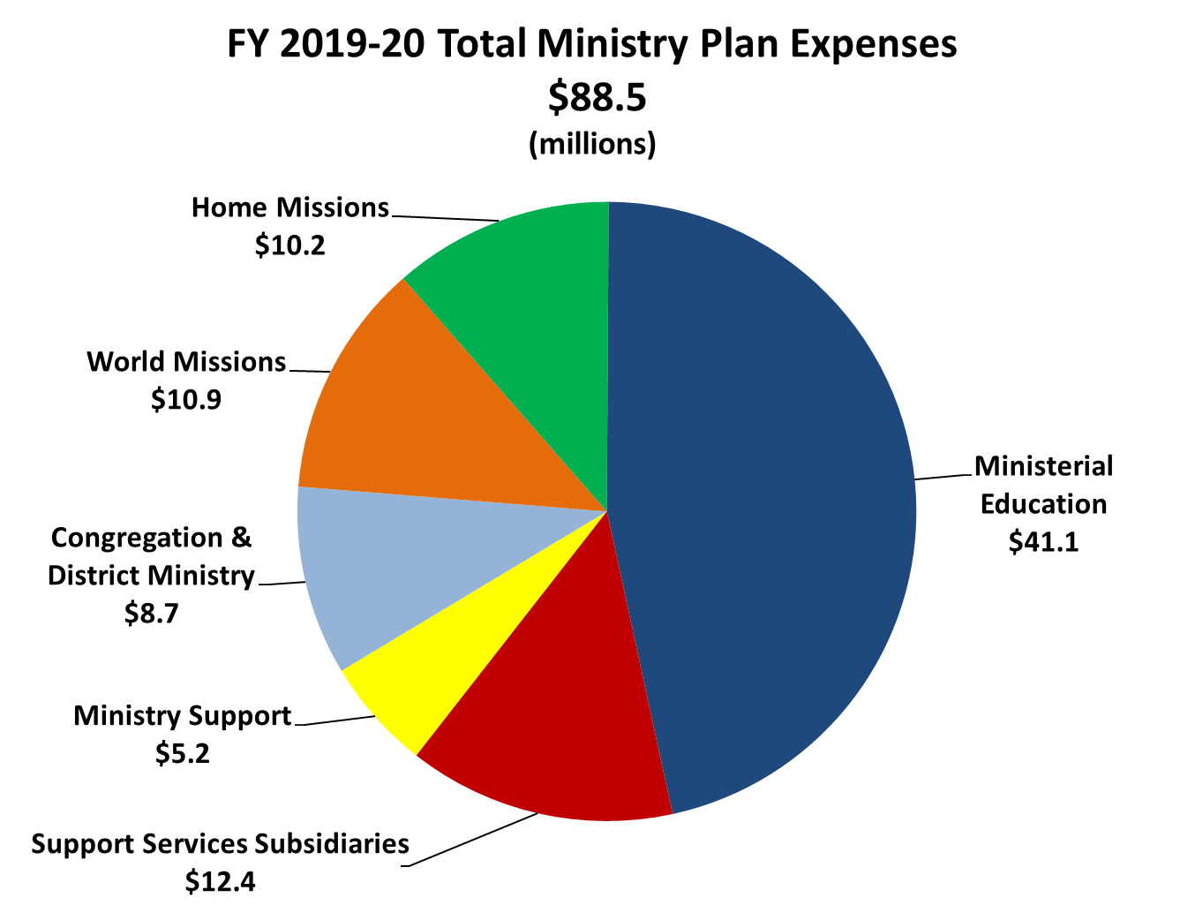
Notes:
The proposed expense plan, totals $88.5 million for fiscal year 2019-20. Synod support allocations to areas of ministry will be reviewed on a later slide.

Slide 14
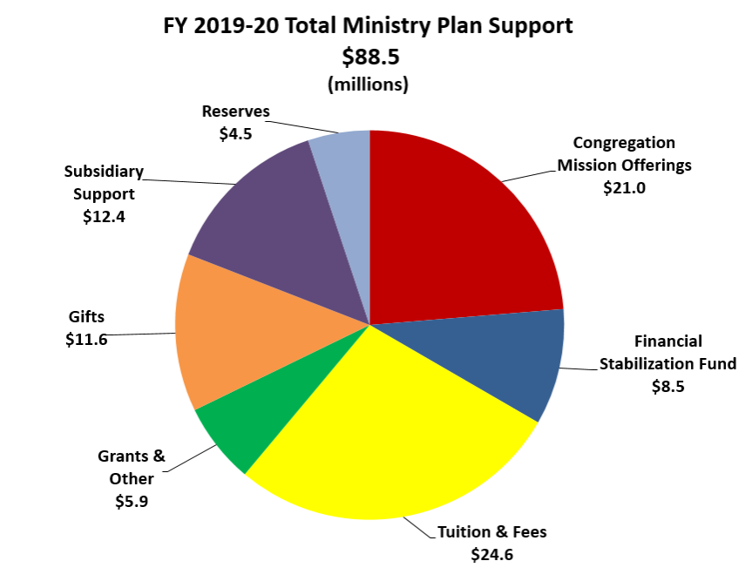
Notes:
The ministry plan for fiscal year 2019-20 will be funded by the following sources.

Slide 15
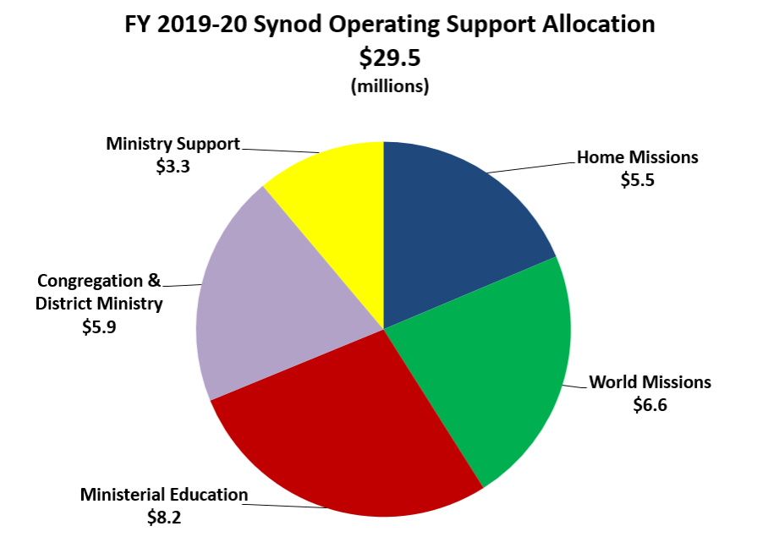
Notes:
Synod Operating support is allocated as follows in the plan

Slide 16
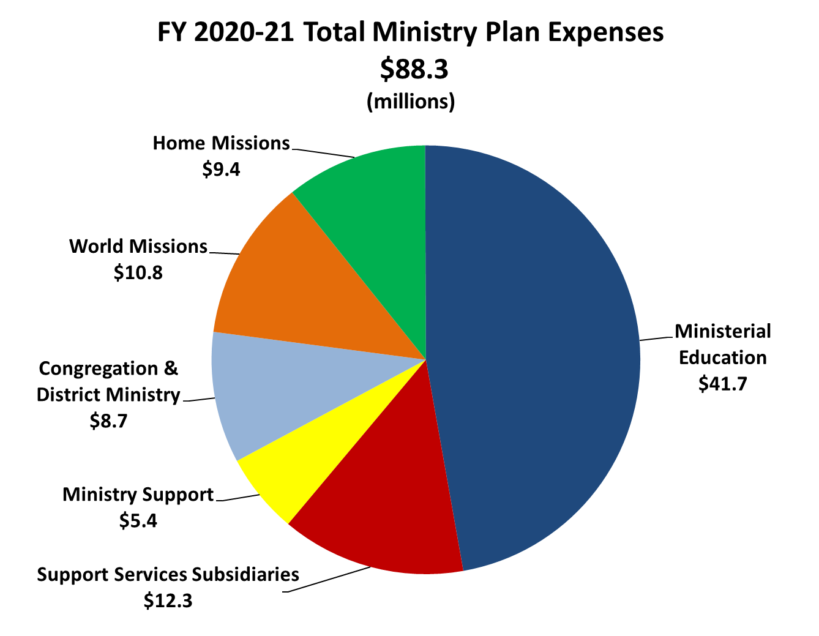
Notes:
The proposed plan, totals $88.3 million for fiscal year 2020-21.

Slide 17
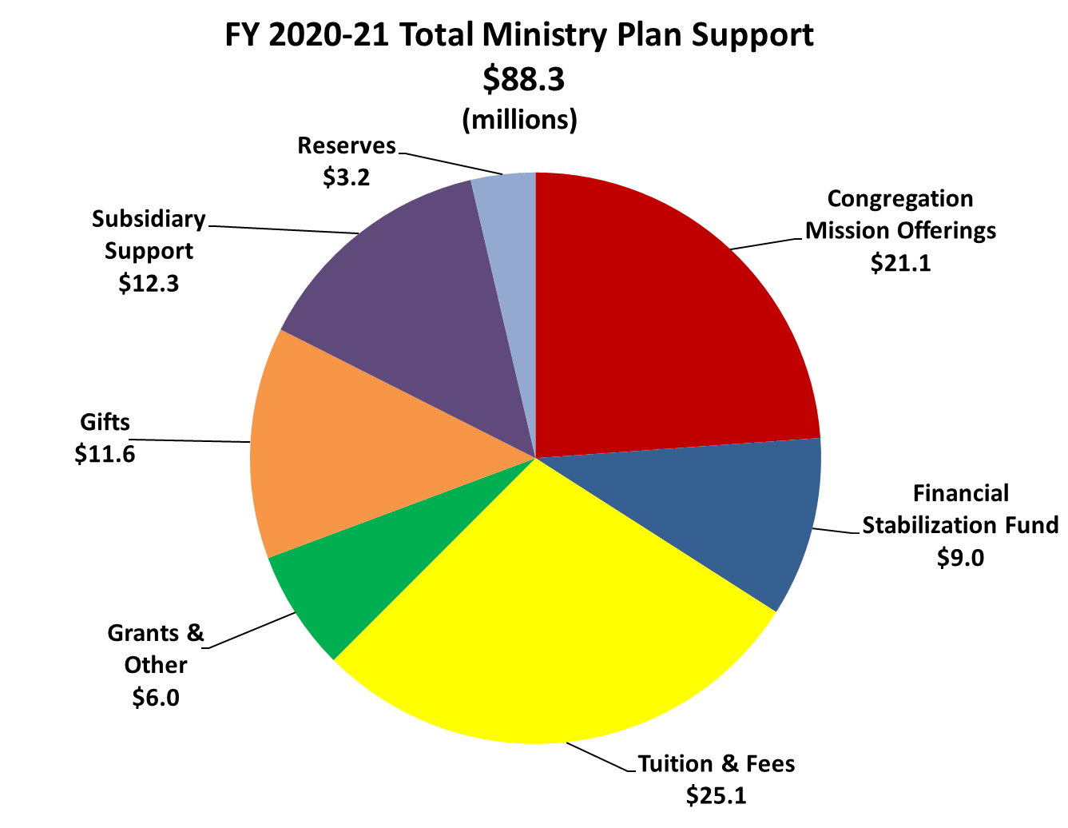
Notes:
The ministry plan for fiscal year 2020-21 will be funded by the following sources

Slide 18
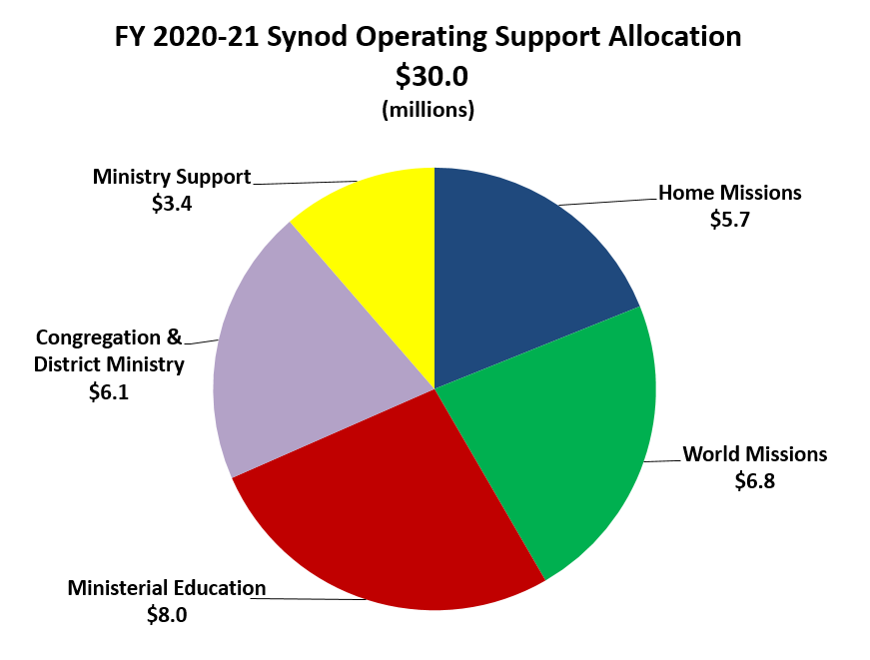
Notes:
Synod Operating support is allocated as follows in the plan

Slide 19
Thank you!
Notes:
I would like to give special thanks to Jamie Ristow, WELS Director of Finance and Accounting and the rest of the WELS financial services team for the materials and support she and they provided areas of ministry for the plan development. I would also like to thank the areas of ministry, schools and support services subsidiaries for the countless hours they put into development and modification of the ministry financial plan.
Later this week Floor Committee #6 will present its report and resolutions for approval of the ministry financial plan for your consideration and action.
Thank you. Mr. Chairman, this concludes my report.

