Slide 1
65th Biennial Convention of the

Slide 2
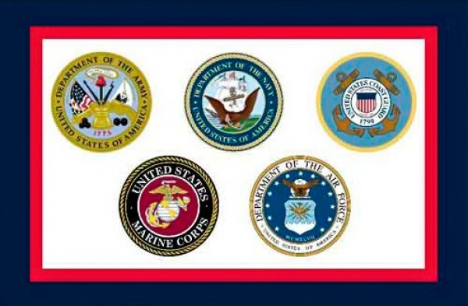
Our Gratitude
wels.net/2019synodconvention

Slide 3
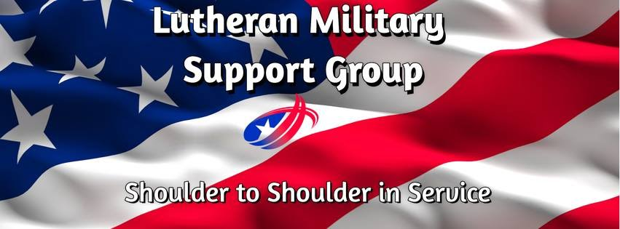
wels.net/2019synodconvention

Slide 4
A Holy Vocation
“Such tremendous strife, common throughout the entire world, which no one can endure, must be counteracted by the little strife called war or the sword. This is why God honors the sword so highly that he calls it his own order. God does not want us to say or think that humans invented or established it.”
“Because of this, the hand that uses this sword and kills is no longer man’s hand, but God’s hand. In such a case, it is not man, but God, who hangs, tortures, beheads, slays, and wars. All these are his works and judgments.”
Luther, Can Christians Be Soldiers?
wels.net/2019synodconvention

Slide 5
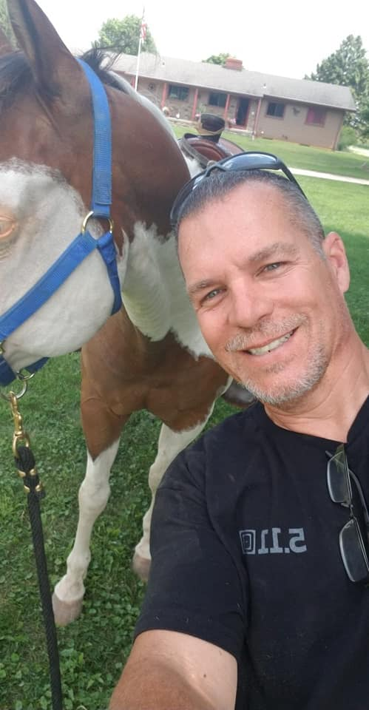
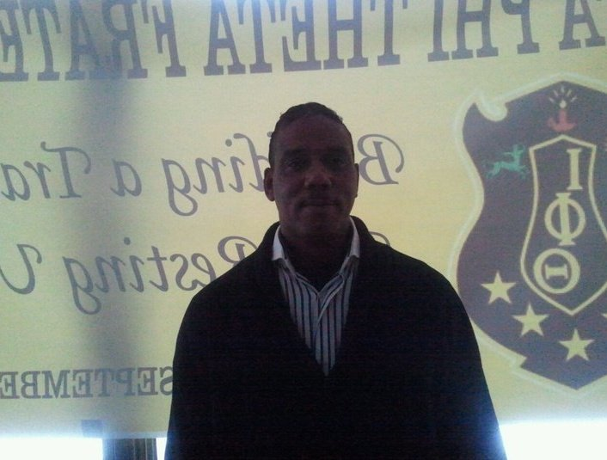
Meet Gerald, Kevin, and another guy

Slide 6
A Holy Vocation
The Spirit of the Sovereign Lord is on me,
because the Lord has anointed me
to proclaim good news to the poor.
He has sent me to bind up the brokenhearted,
to proclaim freedom for the captives
and release from darkness for the prisoners,
to proclaim the year of the Lord’s favor
and the day of vengeance of our God,
to comfort all who mourn,
and provide for those who grieve in Zion—
to bestow on them a crown of beauty
instead of ashes,
the oil of joy
instead of mourning,
and a garment of praise
instead of a spirit of despair.
wels.net/2019synodconvention

Slide 7
An Important Ministry
Who we are
The group is a national level organization designed to have national reach but local impact.
LMSG is designed to be both an auxiliary to the WELS Military Services and the ELS Christian Service Board in their support of active duty service members and an independent organization supporting the needs of our military veterans and our military families of both active duty members and veterans.
wels.net/2019synodconvention

Slide 8
An Important Ministry
What we do
National and local projects, programs, recognition, and support for Lutheran military members, veterans, and their families.
wels.net/2019synodconvention

Slide 9
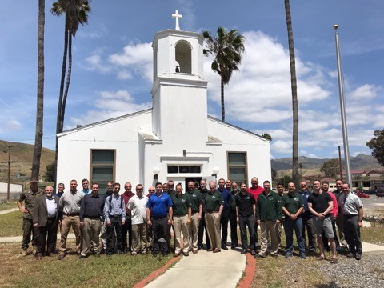
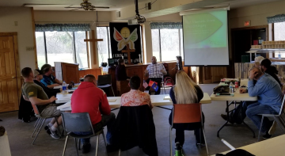
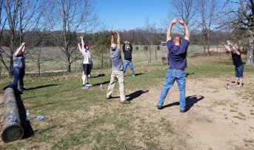
PTS Spiritual R&R
Civilian Chaplain Conference

Slide 10
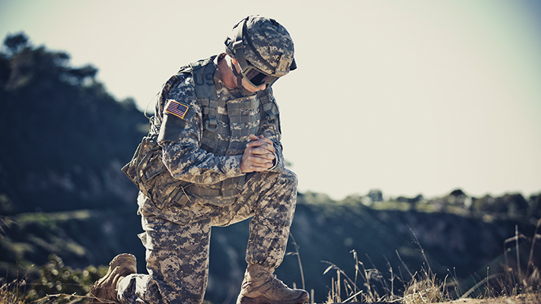
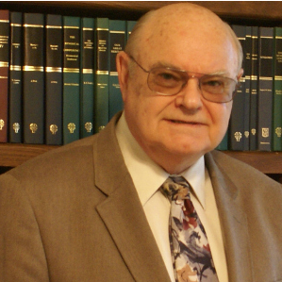
National Chaplain
Christian Service Members Handbook

Slide 11
An Important Ministry
How we do it
Each congregation is to have an LMSG liaison
​Sharing information received from LMSG with their congregation.
​Making the congregation aware of the difficulties military service members and their ​​​families face every day.
​Identifying projects and situations that may assist in providing God’s Word to deployed ​​​service members.
​
wels.net/2019synodconvention

Slide 12
An Important Ministry
How we do it
Each congregation is to have an LMSG liaison
Providing information and resources on Post Traumatic Syndrome (PTS) to share and ​​​study.
​Furnishing LMSG with a current census of all active duty personnel who are members of ​​​their congregation.
​
wels.net/2019synodconvention

Slide 13
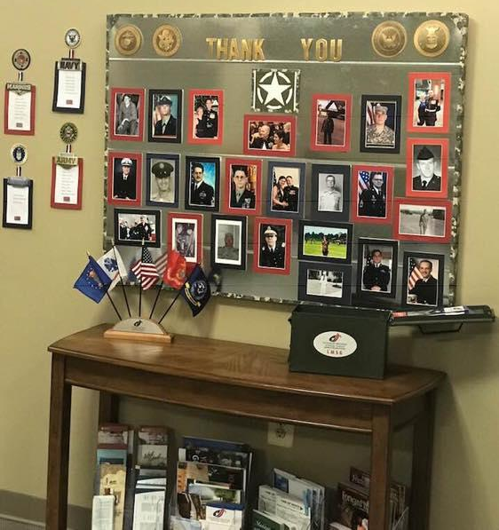
An Important Ministry
How we do it
The Ammo Can
Memorial Day and Veterans Day
​
wels.net/2019synodconvention

Slide 14
An Important Ministry
www.lutheranmilitary.org
​
wels.net/2019synodconvention

