Slide 1
65th Biennial Convention of the

Slide 2
Ministerial Education
“The harvest is plentiful, but the workers are few.”
wels.net/2019synodconvention

Slide 3
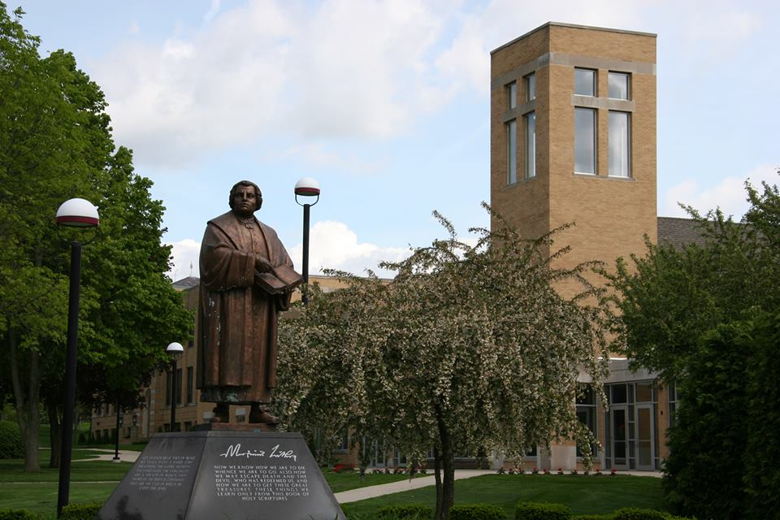
Prep Schools
Michigan Lutheran Seminary
Luther Preparatory School

Slide 4
Martin Luther College
Preseminary
Education and Staff Ministry

Slide 5
MLC
“Equipping Christian Witnesses”
1 – Student Recruitment
2 – Student Financial Aid
3 – Student Facilities
wels.net/2019synodconvention

Slide 6
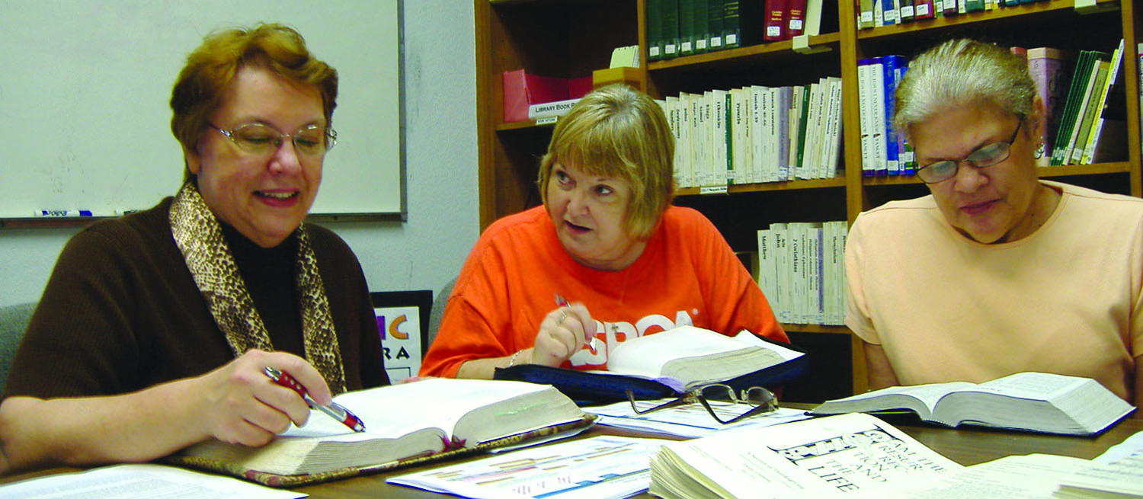
Martin Luther College
Graduate Studies
Ministry Certification

Slide 7
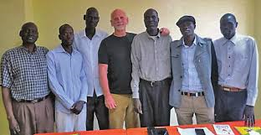
Pastoral Studies Institute
Second Career Students
Non-Traditional Students

Slide 8
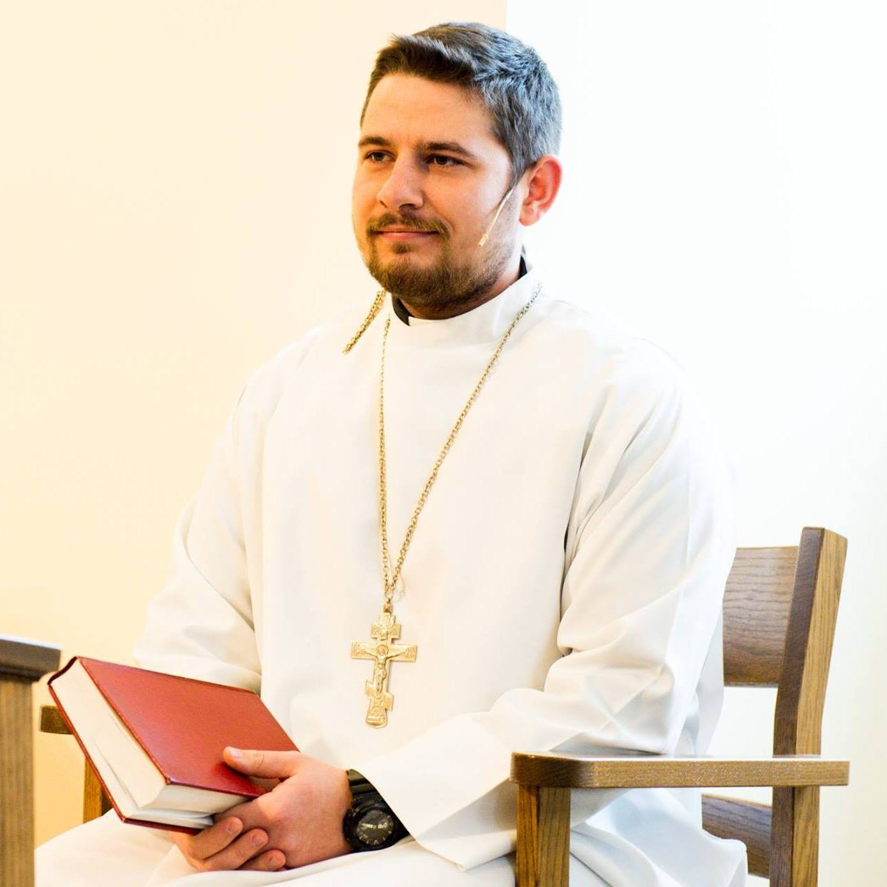
Wisconsin Lutheran Seminary
Domestic Students
International Students

Slide 9
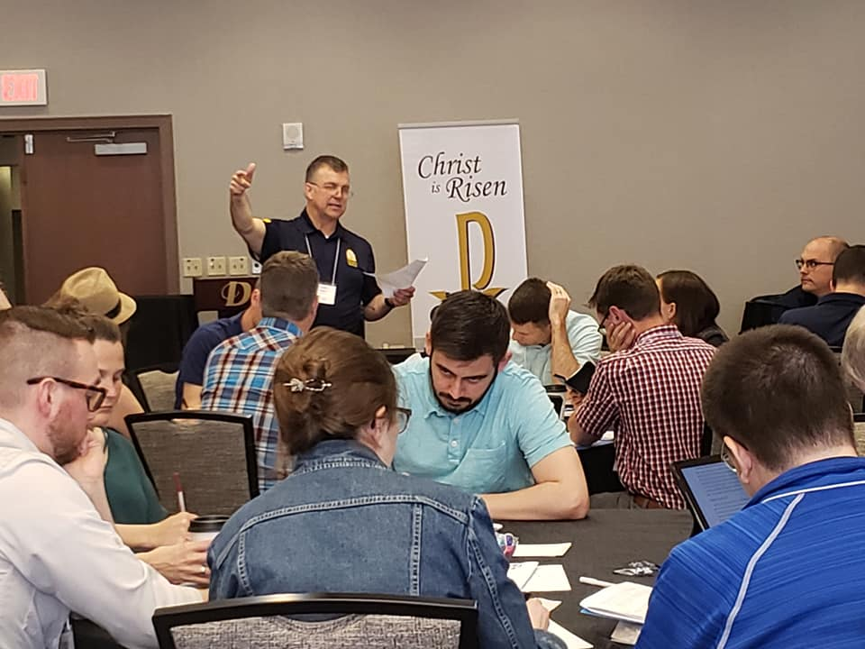
Grow in Grace
Continuing Education
Mentoring and Retreats

Slide 10
Joint Mission Council
Immigrant Groups Reaching Back to their Countries of Origin

Slide 11
Ministerial Education
“The harvest is plentiful, but the workers are few.”
wels.net/2019synodconvention

Slide 12
Ministerial Education
“Ask the Lord of the harvest to send out workers into his
harvest field.”
wels.net/2019synodconvention

