Slide 1
2024
Notes:
Someone at your church may present this PowerPoint using these slides and notes (it’s also helpful to have the full annual report for reference—go to wels.net/annualreport). If you prefer, you can invite one of your congregation’s WELS Christian giving counselors to give the presentation. Find your local Christian giving counselors at wels.net/givingcounselors or call WELS Ministry of Christian Giving at 414-256-3209 / 800-827-5482.
Pictured: (From left) Trung Lê and Grant Hagen greet worshipers after their ordination and installation service at King of Kings, Garden Grove, Calif., in August 2023.

Slide 2
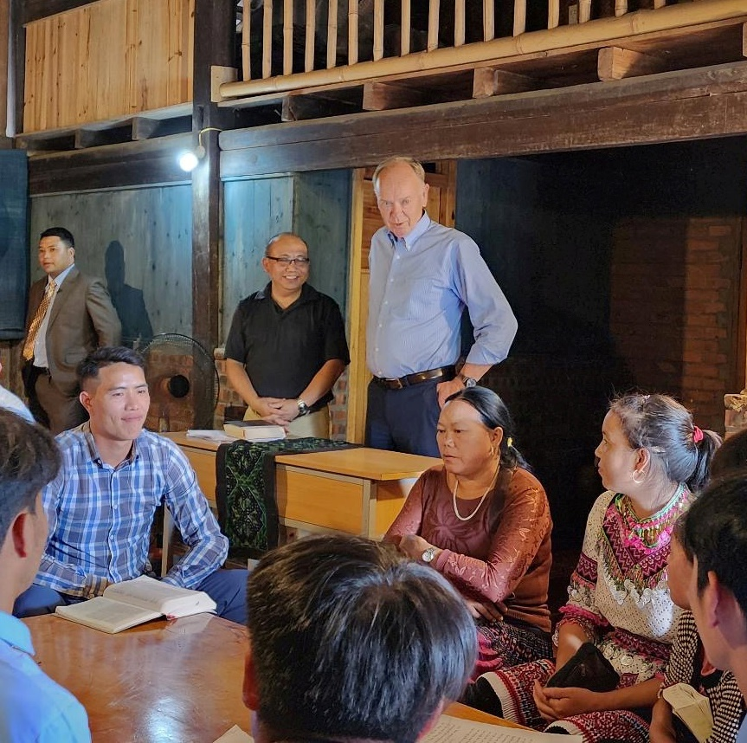
Message from the President
We thank God for his blessings close to home and beyond:
Called workers
Congregational efforts
Home Missions
World Missions
Notes:
Pictured: In early July, WELS President Mark Schroeder traveled to Vietnam to celebrate the formal building dedication of the new Theological Education Center in Hanoi and the graduation ceremony of the first class of 55 pastors from the Hmong Fellowship Church. Schroeder also traveled to rural villages throughout Vietnam to see the rural training program that is thriving there.

Slide 3
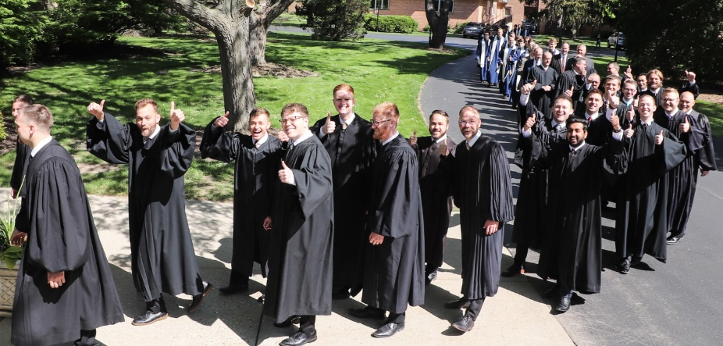
CALLED TO PREPARE
Wisconsin Lutheran Seminary, Mequon, Wis.
Prepares men for pastoral ministry.
Has 133 students enrolled.
Has significantly decreased resignations from ministry through the Grow in Grace mentoring program since 2010.
Notes:
Enrollment is as of 2023-2024 school year.

Slide 4
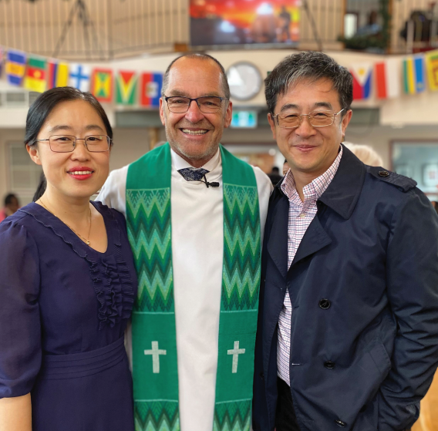
CALLED TO PREPARE
Pastoral Studies Institute (PSI)
Guides and assists spiritual leaders around the world through pre-seminary and seminary training.
David (pictured right), a PSI student, leads an online Bible study that has led to 40 East Asians from 20 cities around the world being baptized!

Slide 5
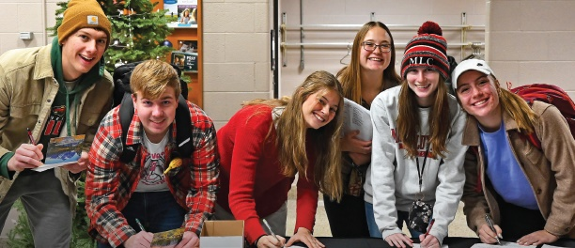
CALLED TO PREPARE
Martin Luther College, New Ulm, Minn.
Serves 620 undergraduates and 133 graduate students.
Prepares men for pastoral training at the seminary and men and women for teaching and staff ministry.
Prepares international students for ministry in partnership with WELS mission fields.
Will allow members to obtain education degrees while staying in their communities through the new Competency-Based Education program.
Notes:
Enrollment is as of 2023-2024 school year.
Pictured: The Lutheran Women’s Missionary Society sponsored a card-signing event for Martin Luther College students during fall 2023. The students wrote notes to missionaries and their families.

Slide 6
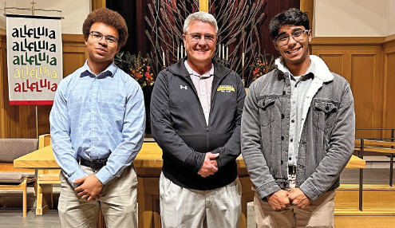
CALLED TO PREPARE
Luther Preparatory School, Watertown, Wis. and Michigan Lutheran Seminary, Saginaw, Mich.
Prepare high school students for future service as pastors, teachers, staff ministers, and congregational leaders.
Serve 411 students at LPS and 192 at MLS.
Notes:
Enrollments as of the 2023-24 school year.
Pictured: Arthur Robinson and Cristian Ferrer Bonilla, two Luther Preparatory School seniors, shadowed Thomas Kock, pastor at Atonement, Milwaukee, Wis., in October 2023.

Slide 7
CALLED TO PROCLAIM
HOME MISSIONS
Launched 100 Missions in 10 Years initiative to open 100 new missions and enhance 75 existing missions over the next 10 years.
Approved 10 new home missions and 10 enhancements in 2023.
Supported 145 home mission congregations.

Slide 8
CALLED TO PROCLAIM
CAMPUS MINISTRY
WELS Home Missions assists hundreds of congregations with campus ministry programs.
Notes:
Pictured: Colleen Thorson (back left) was invited by her roommate to church at Intown Lutheran, Atlanta, Ga. They joined a campus ministry Bible study. Colleen has since been baptized and other students are enrolled in the church’s Bible Basics course.

Slide 9
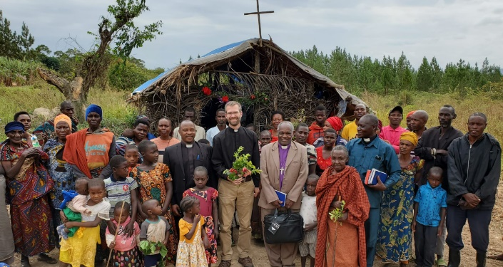
CALLED TO PROCLAIM
WORLD MISSIONS
Conducts gospel outreach in 45 countries and is exploring opportunities in 19 additional countries.
Forty-four missionaries partner with more than 400 national pastors to conduct outreach and train more than 380 students for service in Christ’s kingdom.
Notes:
Pictured: WELS missionary Benjamin Foxen and the members of Kyakojogoma church in northwest Tanzania outside the temporary shelter they built for worship.

Slide 10
CALLED TO PROCLAIM
WORLD MISSIONS
Native American reservations: The gospel is being shared on the Apache reservations and exploratory mission work is beginning on other reservations throughout North America.
Africa: Missionaries and national church partners from seven countries are exploring outreach in at least six more countries throughout the continent.
Asia: Sixteen missionaries have joined together to equip, encourage, and empower others to bring the gospel to 1.8 billion unreached souls.

Slide 11
CALLED TO PROCLAIM
WORLD MISSIONS
Latin America: Hundreds of thousands of people are being reached through Academia Cristo online courses and more than 25 individuals are actively leading a group in worship and study.
Europe: Missionaries partner with national churches to train the next generation of church leaders and bring the gospel to countries without a strong Lutheran presence.

Slide 12
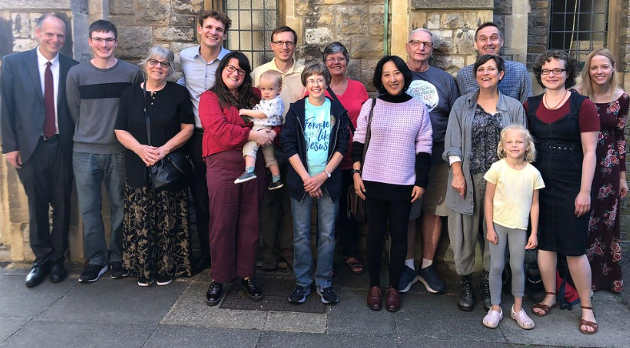
CALLED TO PROCLAIM
MISSION JOURNEYS
Mission Journeys is the official WELS program for short-term mission trips. Seven people from St. Martin’s Lutheran Church in Watertown, S.D., participated in a WELS Mission Journeys trip to London in October 2023.
Notes:
Pictured: St. Martin’s members as well as members of WELS’ mission in London and WELS’ two missionaries in London, Mike Hartman and Conifer Berg.
Interested in participating in a short-term mission trip with members of your congregation? Visit wels.net/missionjourneys for more information.

Slide 13
CALLED TO PROCLAIM
JOINT MISSIONS
Supports mission opportunities that are the responsibility of Home Missions, World Missions, and Ministerial Education. Much of this work centers around people-group ministries, where immigrants in the U.S. take the gospel back to their country of origin.
Notes:
Pictured: Steve Gabb, pastor at Hope, Los Angeles, Calif., baptized Amber in February 2023. Neil Birkholz connected Amber, originally from East Asia, with Gabb when he learned that she was looking for a WELS church in the Los Angeles area.

Slide 14
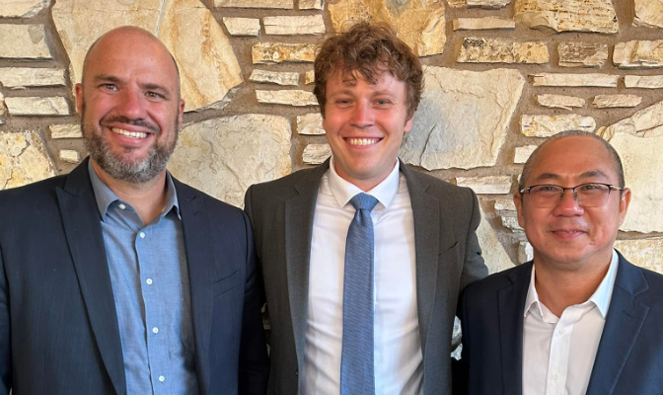
CALLED TO PROCLAIM
One Campus, Three Languages
In August 2023, King of Kings, Garden Grove, Calif., ordained and installed its second and third pastors in a trilingual worship service—English, Spanish, and Vietnamese.
Notes:
Pictured left to right: King of Kings pastors Brian Doebler, Grant Hagen, and Trung Le.

Slide 15
CALLED TO SERVE
CHRISTIAN AID AND RELIEF
Reflects Christ’s love to those suffering as a result of disasters or other hardships as well as through humanitarian aid distributed through WELS missions.
Traveled to Southeast Asia to review humanitarian aid efforts there.
Provides matching grants to churches carrying out compassion ministry in their communities.

Slide 16
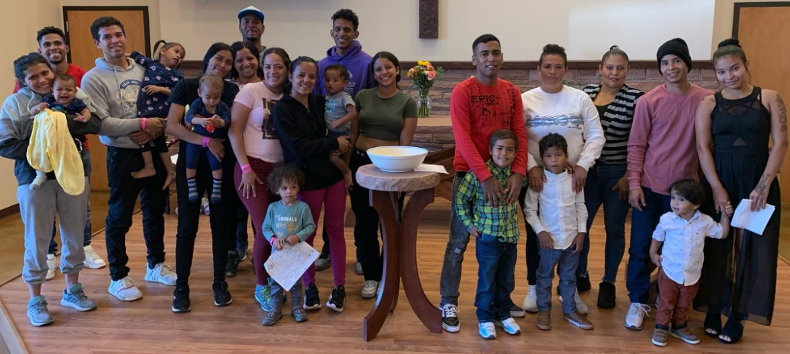
CALLED TO SERVE
CHRISTIAN AID AND RELIEF
Christ, Denver, Colo., received a matching grant to help Venezuelan migrants, which has led to the baptism of 15 children so far!

Slide 17
CALLED TO SERVE
CONGREGATIONAL SERVICES
Encourages and equips congregations for faithful and fruitful gospel ministry.
Is helping some congregations consider merging for more zealous ministry.
Produces biblical resources to help Christians live their faith.
Notes:
Biblical resources include youth, family, military, and outreach resources.

Slide 18
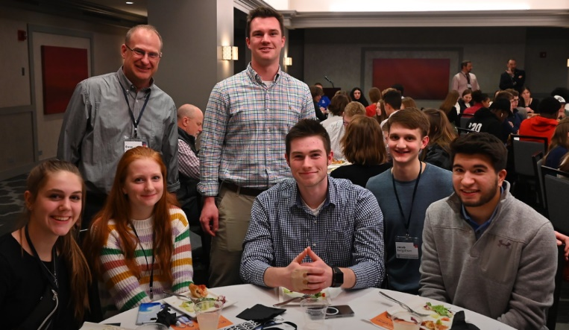
CALLED TO SERVE
CONGREGATIONAL SERVICES
Commissioned new military chaplains in the U.S. and Europe.
Enrolled more students at area Lutheran high schools.
Hosted the National Conference on Lutheran Leadership.
Helped 36 churches build an outreach culture through the Everyone Outreach workshop.
Notes:
Pictured: Students attending the National Conference on Lutheran Leadership, held in Chicago in January 2023.

Slide 19
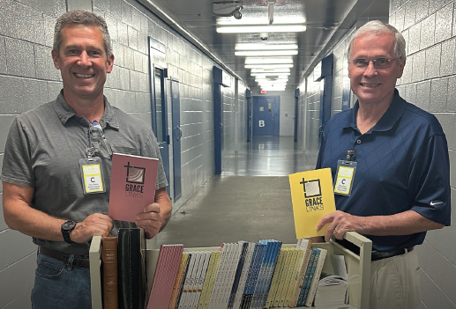
CALLED TO SERVE
CONGREGATIONAL SERVICES
Shared God’s saving love with thousands of prisoners—and workers—through WELS Prison Ministry’s partnership with other WELS ministries.
Has planned several events for 2024 including the International Youth Rally, Women’s Ministry Conference, and the National Worship Conference.
Notes:
Pictured: Pastors Matt Brown (left) and Don Tollefson at the Harris County jail in Texas with some of the devotion books provided by Institutional Ministries.

Slide 20
CALLED TO SERVE
MINISTRY OF CHRISTIAN GIVING: Thank God and his people for record-breaking Congregation Mission Offerings, $694,000 to competency-based education at Martin Luther College, $2.98 million for 100 Missions in 10 Years, and $40.5 million in expected gifts.
175TH ANNIVERSARY: A committee is preparing a pictorial history of WELS and accompanying video for the synod’s 175th anniversary in 2025.
Notes:
The competency-based education and 100 Missions in 10 Years dollar amounts have been updated in this slide as of January 12, 2024.
WELS Ministry of Christian Giving has 13 Christian giving counselors located across the 12 districts of WELS to provide free, confidential gift planning assistance to WELS members. Find your local giving counselor at wels.net/givingcounselors, by calling 800-827-5482, or by e-mailing mcg@wels.net.
Pictured: The dedication of the new seminary campus in Thiensville (now Mequon), Wis., on Aug. 18, 1929. The service was one of the largest gatherings of WELS members in history with more than 10,000 people estimated to have attended.

Slide 21
CALLED TO SUPPORT
FINANCIAL SERVICES
WELS is in a very strong financial position, which allows for the continued expansion of mission and ministry.
Congregation Mission Offerings, which fund 70 percent of WELS’ operating budget, were $23.4 million in fiscal year 2023.
The Financial Stabilization Fund supports about 30 percent of WELS’ Operating budget with undesignated, non-CMO funding.

Slide 22
CALLED TO SUPPORT
WELS BENEFIT PLANS
Serves WELS and ELS workers and organizations through administration of the VEBA Health Plan, the Pension Plan, and the Shepherd Plan (for retirement savings).
More than 80 percent of WELS workers and calling bodies participate in WELS VEBA.
Coverage and benefits are uniform throughout all 50 states, which supports WELS ministry and the call process by providing benefits regardless of geographic location.

Slide 23
CALLED TO SUPPORT
WELS FOUNDATION helps WELS members support WELS ministry through planned gifts.
WELS INVESTMENT FUNDS manages $300 million in assets for 255 WELS organizations. Investors benefit from lower investment costs, WELS board members, investment consultants, and helpful WELS staff.
NORTHWESTERN PUBLISHING HOUSE released more than 30 Christian resources in print and digital formats and launched an online book club.

Slide 24
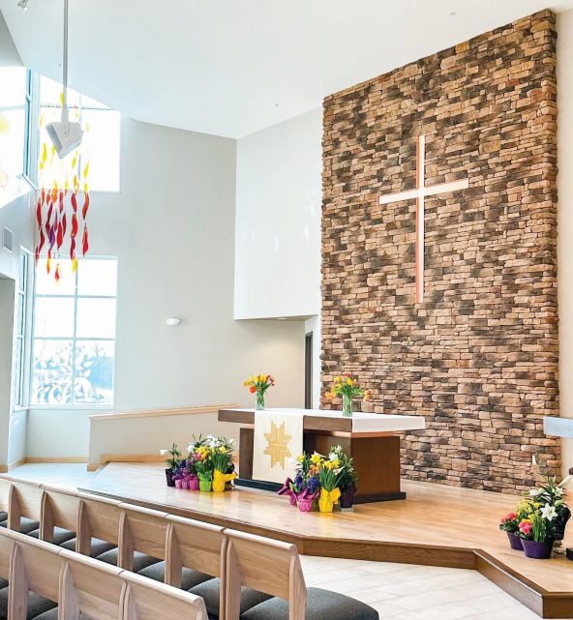
CALLED TO SUPPORT
WELS CHURCH EXTENSION FUND provides loans and grants for WELS home missions and mission-minded congregations through people’s gifts and investments.
In 2022-23, $55.8 million of new loans and $2.7 million of new grants were approved.
CEF disbursed $2.1 million in grants to Home Missions.
Notes:
Pictured: Good News, Mount Horeb, Wis., a WELS home mission, received support from WELS Church Extension Fund as it built its new church.

Slide 25
WELS in brief
WELS’ calling: Nurture the faith of members and spread the gospel of Jesus Christ throughout the world.
Third largest Lutheran church body in the United States
1,243 churches
335,648 baptized members
269,032 communicant members
One of the largest parochial school systems in the U.S.
280 elementary schools
356 early childhood ministries
30 area Lutheran high schools

Slide 26
WELS in brief
Twelve districts allow for more area-specific ministry.
WELS is a member of the Confessional Evangelical Lutheran Conference, an organization of 34 confessional church bodies throughout the world.
WELS’ headquarters is in Waukesha, Wis.

Slide 27
WELS in brief
From collections that document the administration of WELS to individual congregational records, the WELS Archives helps preserve and share the history of our synod.

Slide 28
Thank you for your support!
N16W23377 Stone Ridge Drive Waukesha, WI 53188-1108 wels.net

