Slide 1
2023
Notes:
Someone at your church may present this PowerPoint using the slides and these notes (it’s also helpful to have the full annual report for reference—go to wels.net/annualreport). If you prefer, you can invite one of your congregation’s WELS Christian giving counselors to give the presentation. Find your local Christian giving counselors at wels.net/givingcounselors or call WELS Ministry of Christian Giving at 414-256-3209 / 800-827-5482.
Pictured: Mark Panning, a missionary on WELS’ One Africa Team, traveled to Dukem, Ethiopia, to teach a course on the pastoral epistles.

Slide 2
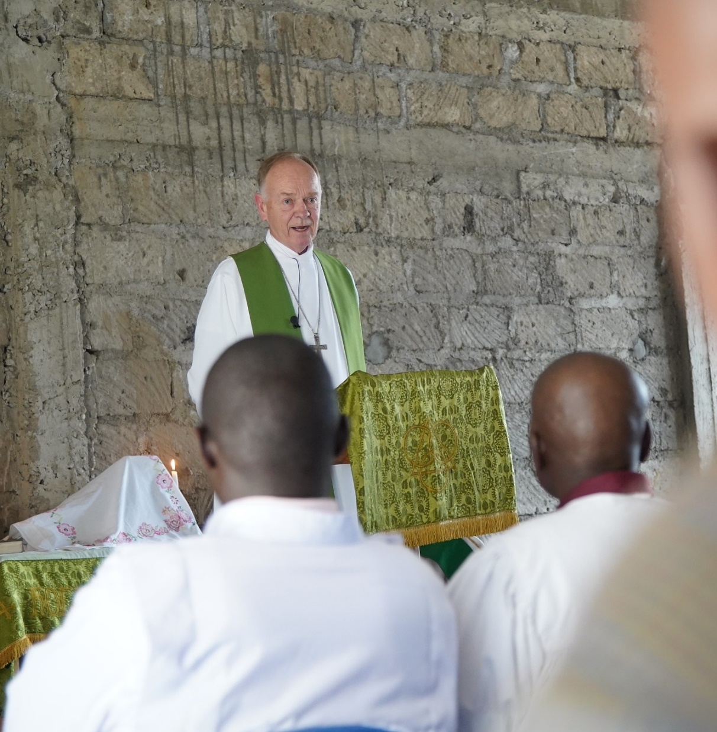
Message from the PRESIDENT
The synod is people who are united by faith in Jesus to treasure his Word and share his saving love with others.
This report is a summary of God’s blessings and the opportunities he has placed before us.
Notes:
Pictured: In fall 2022, WELS President Mark Schroeder traveled to Kenya and Ethiopia with WELS World Missions.

Slide 3
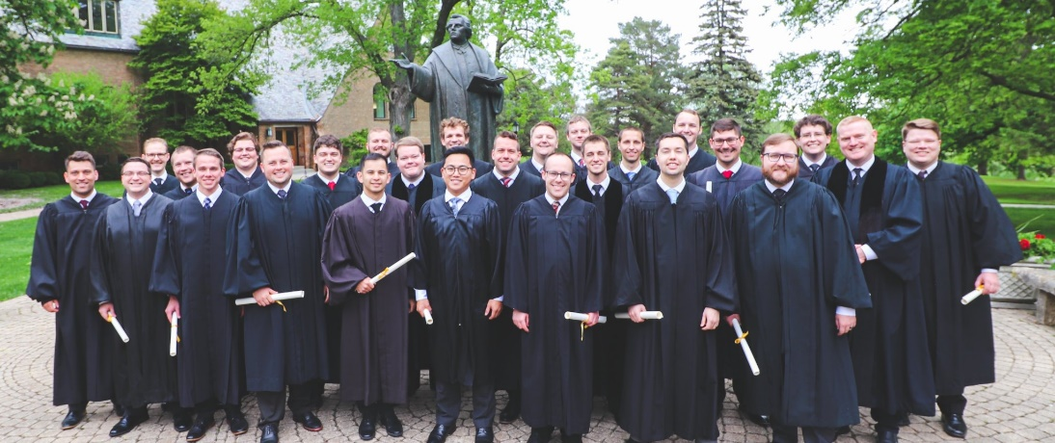
CALLED TO PREPARE
WELS MINISTERIAL EDUCATION
Prepares pastors, teachers, staff ministers, and missionaries to proclaim Christ’s love in congregations, schools, and mission fields in our fellowship.
Educates on three levels at four schools.
Notes:
Pictured: In May, 26 men graduated from Wisconsin Lutheran Seminary and began their pastoral ministries.

Slide 4
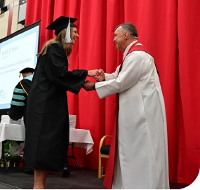
CALLED TO PREPARE
Martin Luther College, New Ulm, Minn.
Serves 629 undergraduates.
Prepares men for pastoral training at Wisconsin Lutheran Seminary and men and women for teaching and staff ministry.
Prepares international students for ministry in partnership with WELS mission fields.
Awarded almost $1.25 million to students through the Congregational Partner Grant Program.
Notes:
Enrollment is as of 2022-2023 school year.
Pictured is President Richard Gurgel presenting a diploma to a graduate who received an assignment to serve as an early childhood education teacher at Resurrection, Aurora, Ill.
MLC’s new strategic plan is entitled Pursuing Excellence Under the Cross.

Slide 5
CALLED TO PREPARE
Wisconsin Lutheran Seminary, Mequon, Wis.
Prepares men for pastoral ministry.
Has 148 students enrolled.
Runs Grow in Grace to provide continuing education for pastors.
Operates the Pastoral Studies Institute to guide and assist spiritual leaders around the world through pre-seminary and seminary training.
Notes:
Enrollment is as of 2022-2023 school year.
Pictured: Jeremiah Wallander spent his vicar year serving Hope, Toronto, Ontario, Canada. Here he’s with a student at Hope’s summer music camp.

Slide 6
CALLED TO PREPARE
Luther Preparatory School, Watertown, Wis. and Michigan Lutheran Seminary, Saginaw, Mich.
Prepare high school students for future service as pastors, teachers, and staff ministers.
Serve 408 students at LPS and 194 at MLS.
Notes:
Enrollments as of the 2022-23 school year.

Slide 7
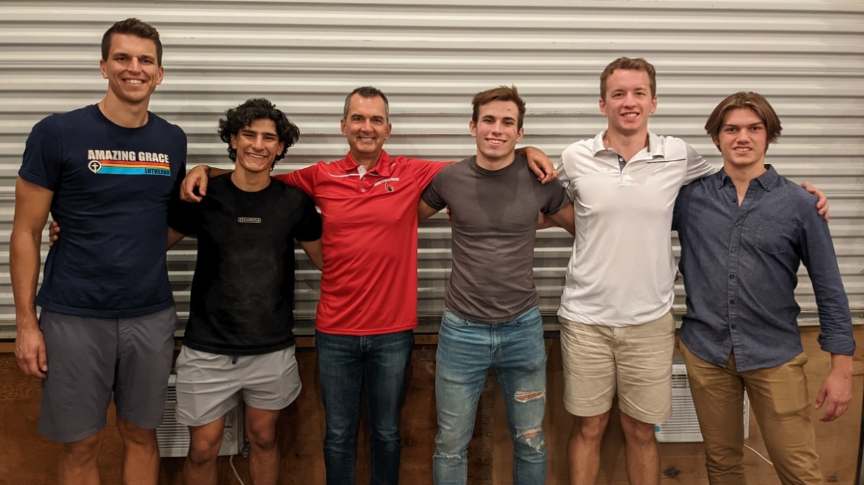
CALLED TO PREPARE
Luther Preparatory School, Watertown, Wis. and Michigan Lutheran Seminary, Saginaw, Mich.
Notes:
MLS seniors traveled to mission settings across the United States for a long weekend in October 2022. Pictured are three of those young men who shadowed home missionaries in Texas and then attended the South Central District’s annual missionaries conference. One of the seniors commented, “This was an awesome experience. I was already thinking of being a pastor, but this experience settled it for me.”

Slide 8
CALLED TO PROCLAIM
WORLD MISSIONS
Conducts gospel outreach in 44 countries and is exploring opportunities in 18 additional countries.
Forty-nine missionaries partner with almost 500 national pastors to conduct outreach and train more than 380 students for service in Christ’s kingdom.

Slide 9
CALLED TO PROCLAIM
WORLD MISSIONS
Native American reservations: The gospel has been shared for 125 years on Apache reservations. Exploratory mission work is beginning on other reservations throughout North America.
Africa: Missionaries and national church partners from six existing countries are exploring mission work in at least seven more countries throughout the continent.
Asia: Two missionary teams empower others to bring the gospel to 1.8 billion unreached souls.

Slide 10
CALLED TO PROCLAIM
WORLD MISSIONS
Latin America: Hundreds of thousands of people are being reached through Academia Cristo online courses and more than 40 individuals are being trained to plant a church.
Europe: Missionaries partner with national churches to train the next generation of church leaders and bring the gospel to countries without a strong Lutheran presence.

Slide 11
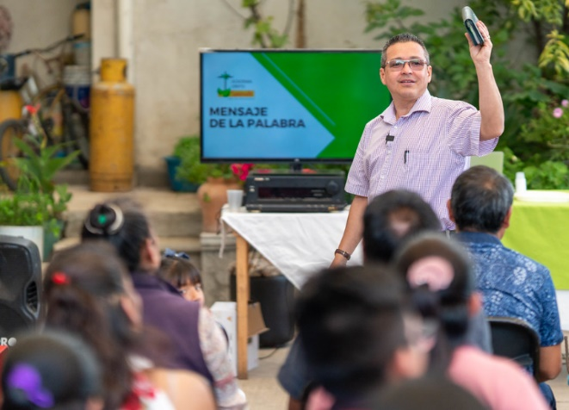
CALLED TO PROCLAIM
WORLD MISSIONS
Multi-Language Productions: This ministry has produced materials in more than 56 languages and reaches tens of thousands of English-speakers in more than 30 different countries through the TELL online training platform.
Notes:
Pictured: Henry Herrera, a pastor in Colombia and president of Iglesia Cristo WELS Internacional, teaching in Cuernavaca, Mexico.

Slide 12
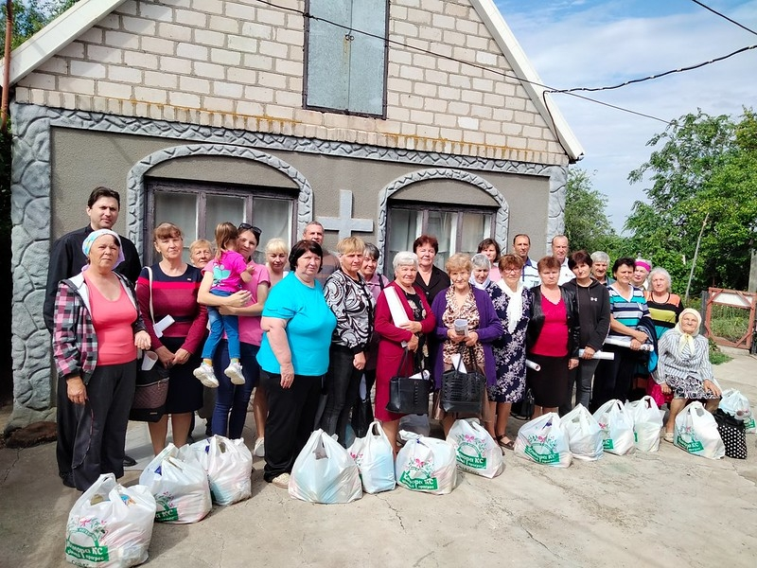
CALLED TO PROCLAIM
WORLD MISSIONS
WELS is supporting the Ukrainian Lutheran Church by providing aid for clothing, food, medicine, and other supplies.

Slide 13
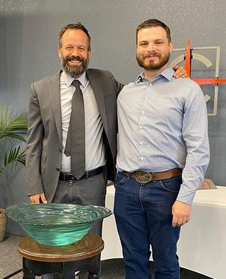
CALLED TO PROCLAIM
HOME MISSIONS
Approved five new home missions, five enhancements, and two churches receiving unsubsidized mission support.
WELS Home Missions supports 134 congregations and assists hundreds of congregations with campus ministry programs.
Notes:
Pictured: Jesse Jensen (right), the first adult baptism and new member at Carbon Valley Lutheran Church in Firestone, Colo. He is standing with Missionary Tim Spiegelberg.

Slide 14
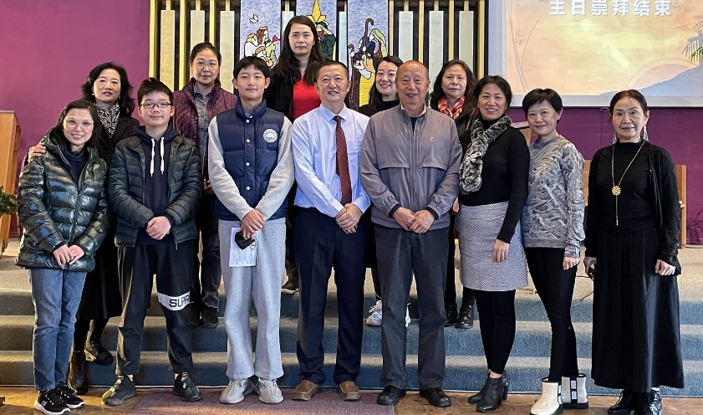
CALLED TO PROCLAIM
JOINT MISSIONS
Supports mission opportunities that are the responsibility of Home Missions, World Missions, and Ministerial Education. Much of this work centers around people-group ministries, where immigrants in the U.S. take the gospel back to their country of origin.
Notes:
Pictured: Abiding Love, Coquitlam, British Columbia, Canada, launched public worship in Chinese on Nov. 27, 2022. The congregation will also continue to offer Chinese worship twice a month in Vancouver, which is central to many members of Abiding Love.

Slide 15
CALLED TO SERVE
CONGREGATIONAL SERVICES
Congregational Services provides resources, training, and personal assistance to congregations so that they may carry out gospel ministry in the most faithful way on the local level (welscongregationalservices.net).
Consists of six commissions: Congregational Counseling, Discipleship, Evangelism, Lutheran Schools, Worship, and Special Ministries.

Slide 16
CALLED TO SERVE
CONGREGATIONAL SERVICES
Women’s Ministry Conference, Won to be One, held at Luther Preparatory School and focused on believers’ identity in Christ. wels.net/women
Military Contact Pastor Workshop held at Risen Savior, Pooler, Ga. WELS has 125 congregations near military installations providing care to military service members and their families. wels.net/military

Slide 17
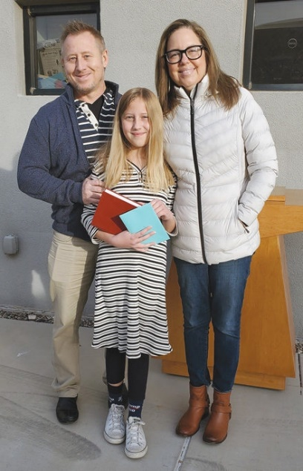
CALLED TO SERVE
CONGREGATIONAL SERVICES
Lutheran Schools:
Enrollment is up 9.8 percent in 2021-22—the highest ever for early childhood ministries and the highest since 2004-05 for elementary schools.
Thirty-three percent of early childhood families and sixteen percent of elementary families identify as non- Christian or having no church home.
welscongregationalservices/net/telling-the-next- generation
Notes:
Pictured: Blythe, a student at Cross of Glory, Peoria, Ariz., was baptized at one of the school’s outdoor chapel services.

Slide 18
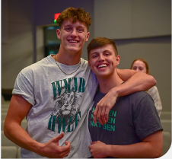
CALLED TO SERVE
CONGREGATIONAL SERVICES
Youth Ministry:
More than 2,200 teens and youth leaders attended the WELS 2022 International Youth Rally.
“Youth Night” events were introduced for teens and youth leaders to grow in God’s Word and build relationships between rallies.
welscongregationalservices.net/wels- youth-night

Slide 19
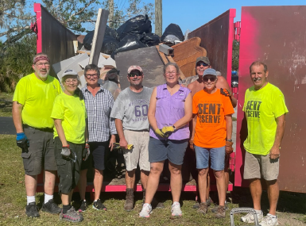
CALLED TO SERVE
CHRISTIAN AID AND RELIEF: Coordinated disaster relief for 13 Florida congregations affected by Hurricane Ian. They offer matching grants of up to $2,500 to congregations doing compassion ministry in their communities.
COMMUNICATION SERVICES: Produces WELS Connection video, “Together” e-newsletter, and Forward in Christ magazine.

Slide 20
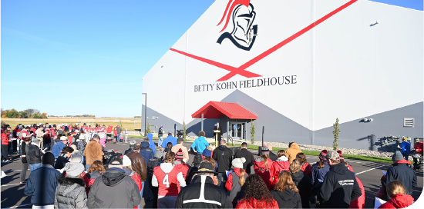
CALLED TO SERVE
MINISTRY OF CHRISTIAN GIVING: Thank God and his people for record-breaking Congregation Mission Offerings, $9.6 million to Equip Christian Witnesses at Martin Luther College, and initial gifts for 100 Missions in 10 Years.
TECHNOLOGY: The “Contact us” web form receives more than 1,000 questions or comments per year: wels.net/contact-us.
Notes:
Pictured: The dedication of the Betty Kohn Fieldhouse at Martin Luther College. This 36,000 square foot indoor turfed facility includes batting cages, golf simulators, indoor practice fields, and more.
WELS Ministry of Christian Giving has 11 Christian giving counselors located across the 12 districts of WELS to provide free, confidential gift planning assistance to WELS members. Find your local giving counselor at wels.net/givingcounselors, by calling 800-827-5482, or by e-mailing mcg@wels.net.

Slide 21
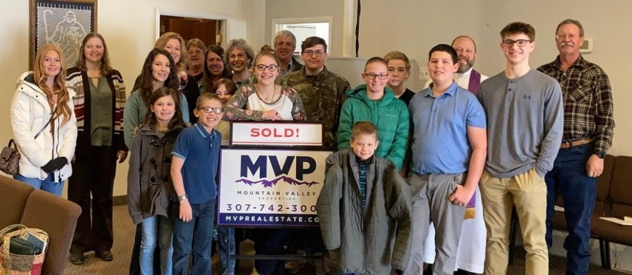
CALLED TO SUPPORT
WELS CHURCH EXTENSION FUND provides loans and grants for WELS home missions and mission-minded congregations through people’s gifts and investments.
In 2021-22, $24.1 million of new loans and $2.4 million of new grants requests were approved.
CEF gave $1.63 million in grants to the Board for Home Missions.
Notes:
Pictured: In 2022, Living Shepherd, Laramie, Wyo., bought the facility it had been worshiping in for a year with the help of WELS Church Extension Fund.

Slide 22
CALLED TO SUPPORT
NORTHWESTERN PUBLISHING HOUSE released more than 725 Christian resources in print and digital formats, including Christian Worship resources Musician’s Resource and Service Builder.
WELS FOUNDATION helps people support WELS ministry through planned gifts. Over the last three years, WELS Foundation has distributed $37.5 million in donor-directed gifts to various WELS ministries.
WELS INVESTMENT FUNDS manages $250 million in assets for more than 245 WELS ministries.

Slide 23
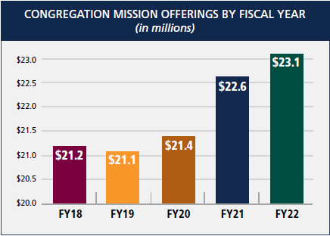
CALLED TO SUPPORT
FINANCIAL SERVICES
WELS continues to be financially strong, which allows for expanding ministry.
Congregation Mission Offerings, which fund 70 percent of WELS’ operating budget, exceeded $23 million for the first time.

Slide 24
CALLED TO SUPPORT
WELS BENEFIT PLANS
Serves WELS and ELS workers and organizations through administration of the VEBA Health Plan, the Pension Plan, and the Shepherd Plan (for retirement savings).
More than 80 percent of WELS workers and calling bodies participate in WELS VEBA.
The WELS Pension Plan was frozen. WELS workers now earn retirement benefits through defined contributions to their WELS Shepherd Plan accounts.

Slide 25
WELS in brief
WELS’ calling: Nurture the faith of members and spread the gospel of Jesus Christ throughout the world.
Third largest Lutheran church body in the United States
1,250 churches
340,511 baptized members
272,555 communicant members
One of the largest parochial school systems in the U.S.
284 elementary schools
362 early childhood ministries
29 area Lutheran high schools

Slide 26
WELS in brief
Twelve districts allow for more area-specific ministry.
WELS is a member of the Confessional Evangelical Lutheran Conference, an organization of 34 confessional church bodies throughout the world.
WELS’ headquarters is in Waukesha, Wis.

Slide 27
WELS in brief
From collections that document the administration of WELS to individual congregational records, the WELS Archives helps preserve and share the history of our synod.

Slide 28
Thank you for your support!
N16W23377 Stone Ridge Drive Waukesha, WI 53188-1108 wels.net

