Slide 1
Notes:
Someone at your church may present this PowerPoint using the slides and these notes (it’s also helpful to have the full annual report for reference—go to wels.net/annualreport). If you prefer, you can invite one of your congregation’s WELS Christian giving counselors to give the presentation. Find your local Christian giving counselors at wels.net/givingcounselors or call WELS Ministry of Christian Giving at 414-256-3209 (toll-free 800-827-5482).
Pictured: St. John, Burlington, Wis., held a hymnal introduction seminar in November.

Slide 2
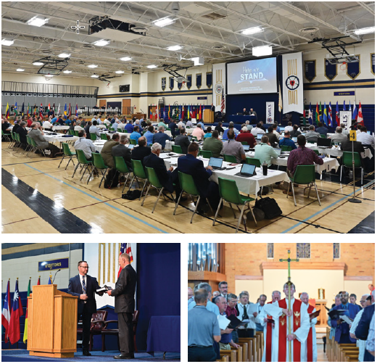
MESSAGE from the PRESIDENT
In 2021 we were able to return to in-person worship and ministry planning.
God blessed our ministry.
God’s people provided more financial support than ever before.
“Not to us, O Lord, not to us, but to your name be the glory!”
Notes:
Pictured: The 2021 synod convention was held this past July at Luther Preparatory School, Watertown, Wis., under the theme “Here we stand.” This synod convention included in-person and virtual delegates.

Slide 3
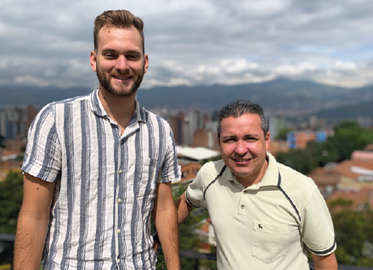
CALLED TO PREPARE
WISCONSIN LUTHERAN SEMINARY, Mequon, Wis.
Prepares men for pastoral ministry.
Has 92 students enrolled.
Grow in Grace provides continuing education for pastors.
Pastoral Studies Institute guides and assists non-traditional students through pre-seminary and seminary training.
Notes:
Enrollment is as of 2021-2022 school year.
Pictured: Zach Satorius (left) was called to serve as vicar in Medellín, Colombia, under Rev. Henry Herrera (right) of the Colombian Lutheran Church. It has been 12 years since a Wisconsin Lutheran Seminary vicar was placed in Latin America. Satorius arrived in Medellín in August 2021 and will return to Wisconsin Lutheran Seminary for his final year of study in August 2022.

Slide 4
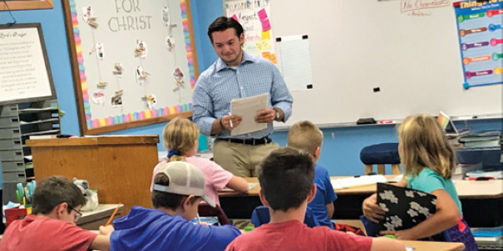
CALLED TO PREPARE
MARTIN LUTHER COLLEGE, New Ulm, Minn.
Serves 714 undergraduates.
Prepares men for pastoral training at Wisconsin Lutheran Seminary.
Prepares men and women for teaching and staff ministry.
Prepares international students for ministry in partnership with WELS mission fields.
Notes:
Enrollment is as of 2021-2022 school year.
Pictured: Luke Schultz listens to memory treasures at Immanuel, Hutchinson, Minn.

Slide 5
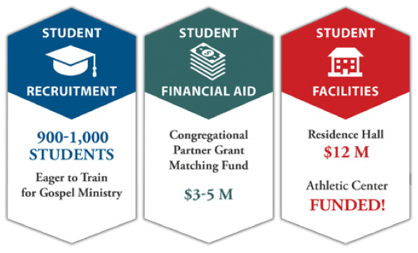
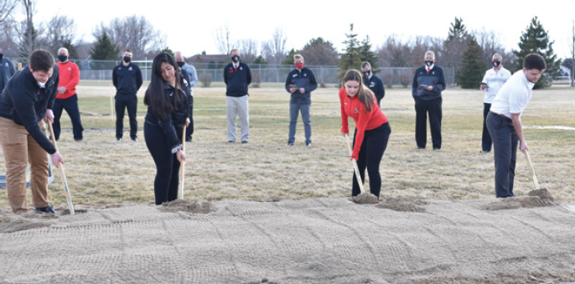
CALLED TO PREPARE
MARTIN LUTHER COLLEGE, New Ulm, Minn.
Progressed in “Equipping Christian Witnesses” campaign including building of the Betty Kohn Fieldhouse.
Notes:
Pictured: The groundbreaking of the Betty Kohn Fieldhouse.

Slide 6
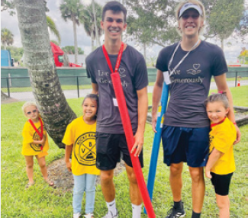
CALLED TO PREPARE
LUTHER PREPARATORY SCHOOL, Watertown, Wis. and MICHIGAN LUTHERAN SEMINARY, Saginaw, Mich.
Prepare high school students for future service as pastors, teachers, and staff ministers.
Serve 425 students at LPS and 182 at MLS.
Notes:
Enrollments as of the 2021-22 school year.
Pictured: Luther Prep students on a Project Timothy trip to Divine Savior, West Palm Beach, Fla.

Slide 7
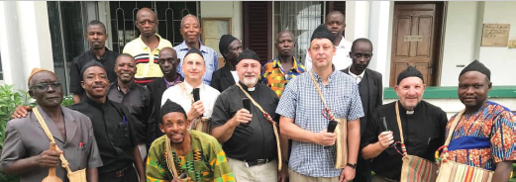
CALLED TO PROCLAIM
WORLD MISSIONS
Conducts gospel outreach in 44 countries and is exploring opportunities in 20 additional countries.
Forty-one missionaries partner with more than 400 national pastors to conduct outreach and train more than 380 students for service in Christ’s kingdom.
Notes:
Pictured: Members of WELS’ One Africa Team with a delegation from the Lutheran Church of Cameroon. The Lutheran Church of Cameroon includes 31 congregations that are served by 8 national pastors, 3 evangelists, and 4 certified assistants.

Slide 8
CALLED TO PROCLAIM
WORLD MISSIONS
Apache reservations: Ministry is carried out at eight churches, one preaching station, and two Lutheran elementary schools.
Africa: Missionaries and national church partners from six existing countries are exploring mission work in ten additional African countries.
Europe: National churches are partnering with WELS missionaries and the Pastoral Studies Institute to train the next generation of church leaders.

Slide 9
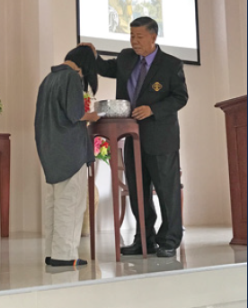
CALLED TO PROCLAIM
WORLD MISSIONS
Asia: The Asia One Team is coordinating resources and partnering with sister synods to reach out with the gospel to Buddhist, Catholic, Hindu, and Muslim individuals in nine different countries.
East Asia: Missionaries are coaching and mentoring 45 mission group leaders in spite of tightening security, and Asia Lutheran Seminary is reaching hundreds of new students through new online classes.
Notes:
Pictured: Missionary Tom Chaleunsouk baptized six people in March 2021 in Nong Khai, Thailand. Since 2020, Chiang Mai, Thailand, has served as a home base for the Asia One Team, which coordinates WELS
mission efforts in South Asia and the Asia-Pacific Rim.

Slide 10
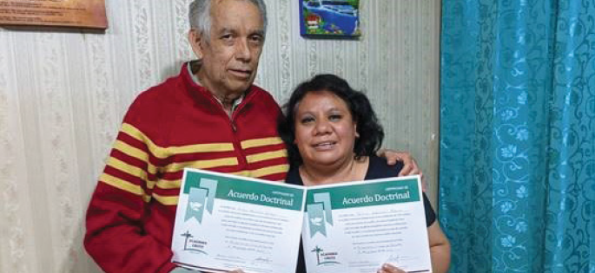
CALLED TO PROCLAIM
WORLD MISSIONS
Latin America: The Academia Cristo online training tool is walking more than 360 people through self-led classes, and missionaries have identified more than 25 men in 11 different countries as potential church planters.
Multi-Language Productions: This ministry has produced confessional Christian content in more than 56 languages and on a variety of platforms.
Notes:
Pictured: Arturo and Maricruz Navarrete learned about God’s grace through Academia Cristo and were confirmed as Lutherans. The couple sold their living room furniture and purchased chairs, tables, and a coffee maker so they can host a new church group in their home in Mexico City, Mexico.

Slide 11
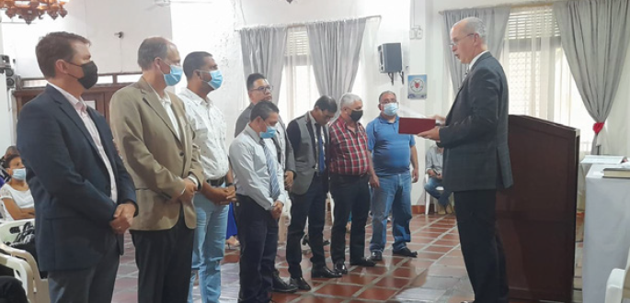
CALLED TO PROCLAIM
WORLD MISSIONS Highlights
Central Africa Medical Mission (CAMM) celebrated its 60th anniversary.
A new synod was formed in Latin America.
Notes:
CAMM: CAMM provides health care through clinics in Malawi and Zambia, serving more than 70,000 patients per year.
Latin American synod: In October 2021, representatives from WELS and WELS’ sister churches throughout Latin America met in Medellín, Colombia, to form a new synod—Iglesia Cristo WELS Internacional. Founding members come from churches in Bolivia, Colombia, Dominican Republic, Haiti, and Venezuela. As part of a synod, these churches now carry out mission work together, train pastors together, and support each other with prayers and fellowship. Synod membership is expected to swell in the future through God’s blessings on Academia Cristo.
Pictured is Rev. Larry Schlomer, administrator of WELS World Missions, installing the officers of the new synod.

Slide 12
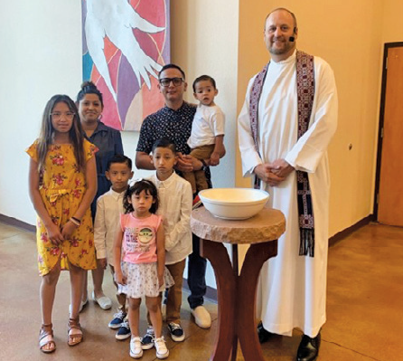
CALLED TO PROCLAIM
HOME MISSIONS
Approved five new home missions and financial support for four existing ministries.
The synod convention approved opening 100 new home missions and enhancing 75 existing ministries from 2023-2033.
Notes:
Pictured: Salvador, a Spanish-speaker who lives in Denver, Colo., began studying virtually with Academia Cristo and then sought a local congregation that would teach the same things as Academia Cristo. He found Christ Lutheran Church/Iglesia Luterano Cristo, WELS’ home mission in Denver, which offers Spanish worship services. Salvador’s children were recently baptized (pictured with Rev. Paul Biedenbender), the family attends church regularly, and Salvador is training to become a leader in the congregation.

Slide 13
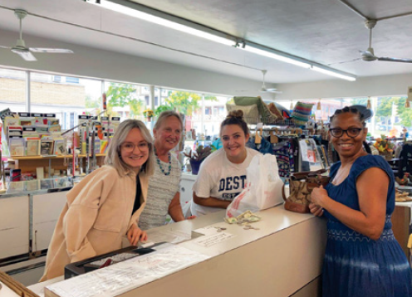
CALLED TO PROCLAIM
Campus Ministry
Provides 25 campus ministries with financial support.
A full-time campus ministry mission counselor, Rev. Dan Lindner, is now serving all WELS campus ministries.
Notes:
Pictured: Campus ministry students in Milwaukee, Wis., volunteered at the WELS Bargain Center, which supports its ministry.

Slide 14
CALLED TO SERVE
CONGREGATIONAL SERVICES
Congregational Services provides resources, training, and personal assistance to congregations so that they may carry out gospel ministry in the most faithful way on the local level.
Resources at welscongregationalservices.net include training videos, leaders’ guides, Bible studies, graphics, and more.
Notes:
Examples of resources produced by Congregational Services:
The Foundation – Worship, evangelism, discipleship, and school resources built around each week’s worship theme
Everyone Outreach – Helps congregations that want to build a culture of outreach so that every ministry and every member is thinking about and participating in outreach. The workshop and extended program include group activities, thought-provoking discussions, and a process to keep outreach in focus and track engagement.
A God-Lived Life – A stewardship program that challenges Christians in specific ways and urges them to put into practice a closer walk with God and a life of love toward others. Its four parts focus on the aspects of a God-lived life—a life of being a disciple, a life lived for others, a life of hospitality, and a life lived shrewdly.
Equip Women to Teach the Word – This program provides online training to Christian women, enabling them to teach the Word of God in home and congregational settings.

Slide 15
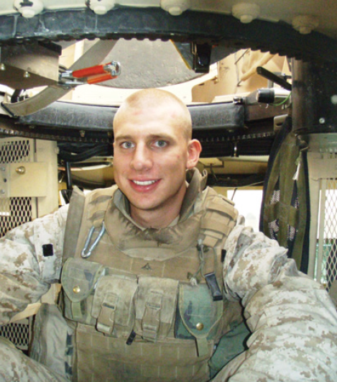
CALLED TO SERVE
CONGREGATIONAL SERVICES Highlights
PRISON MINISTRY: The ministry-by-mail program reaches more than 70,000 inmates, and 83 percent of Bible studies distributed get responses from inmates.
MILITARY SERVICES: WELS serves military men and women through spiritual resources and 120 contact pastors located near military installations.
Notes:
Pictured: Paul Wolfgramm, a 35-year-old Marine Corps Reserve veteran and a laymember of the WELS Military Services Committee.
Also, congregations received and started using the new hymnal.

Slide 16
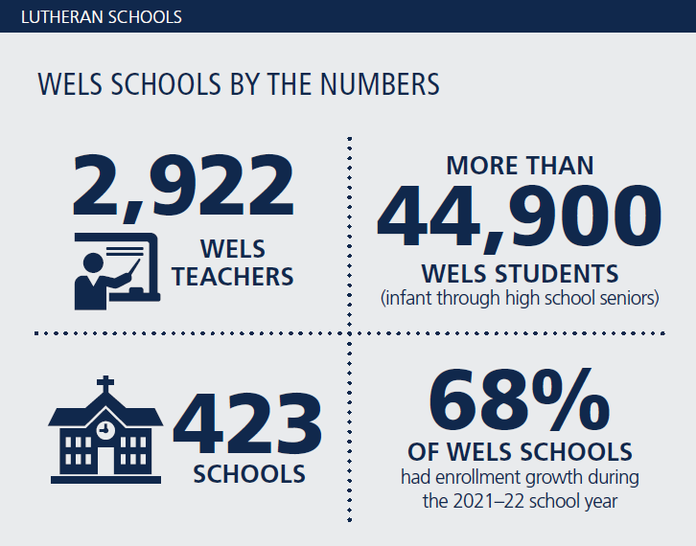
CALLED TO SERVE
CONGREGATIONAL SERVICES Highlights
Notes:
Note that the “WELS in brief” slide at the end of this presentation lists 282 elementary schools, 368 early childhood ministries, and 27 area Lutheran high schools (677 schools total). The “423 schools” number here reflects the fact that many early childhood ministries are part of an elementary school.

Slide 17
CALLED TO SERVE
CHRISTIAN AID AND RELIEF: Approved $470,882 for humanitarian aid projects in world mission fields in 2021-22, granted money to congregations to help during the pandemic, and offers disaster relief.
COMMUNICATION SERVICES: Coordinates design, content, and strategy for new ministry tools as they are communicated across platforms like wels.net, “Together” e-newsletter and video update, Forward in Christ magazine, WELS Connection, and social media sites.

Slide 18
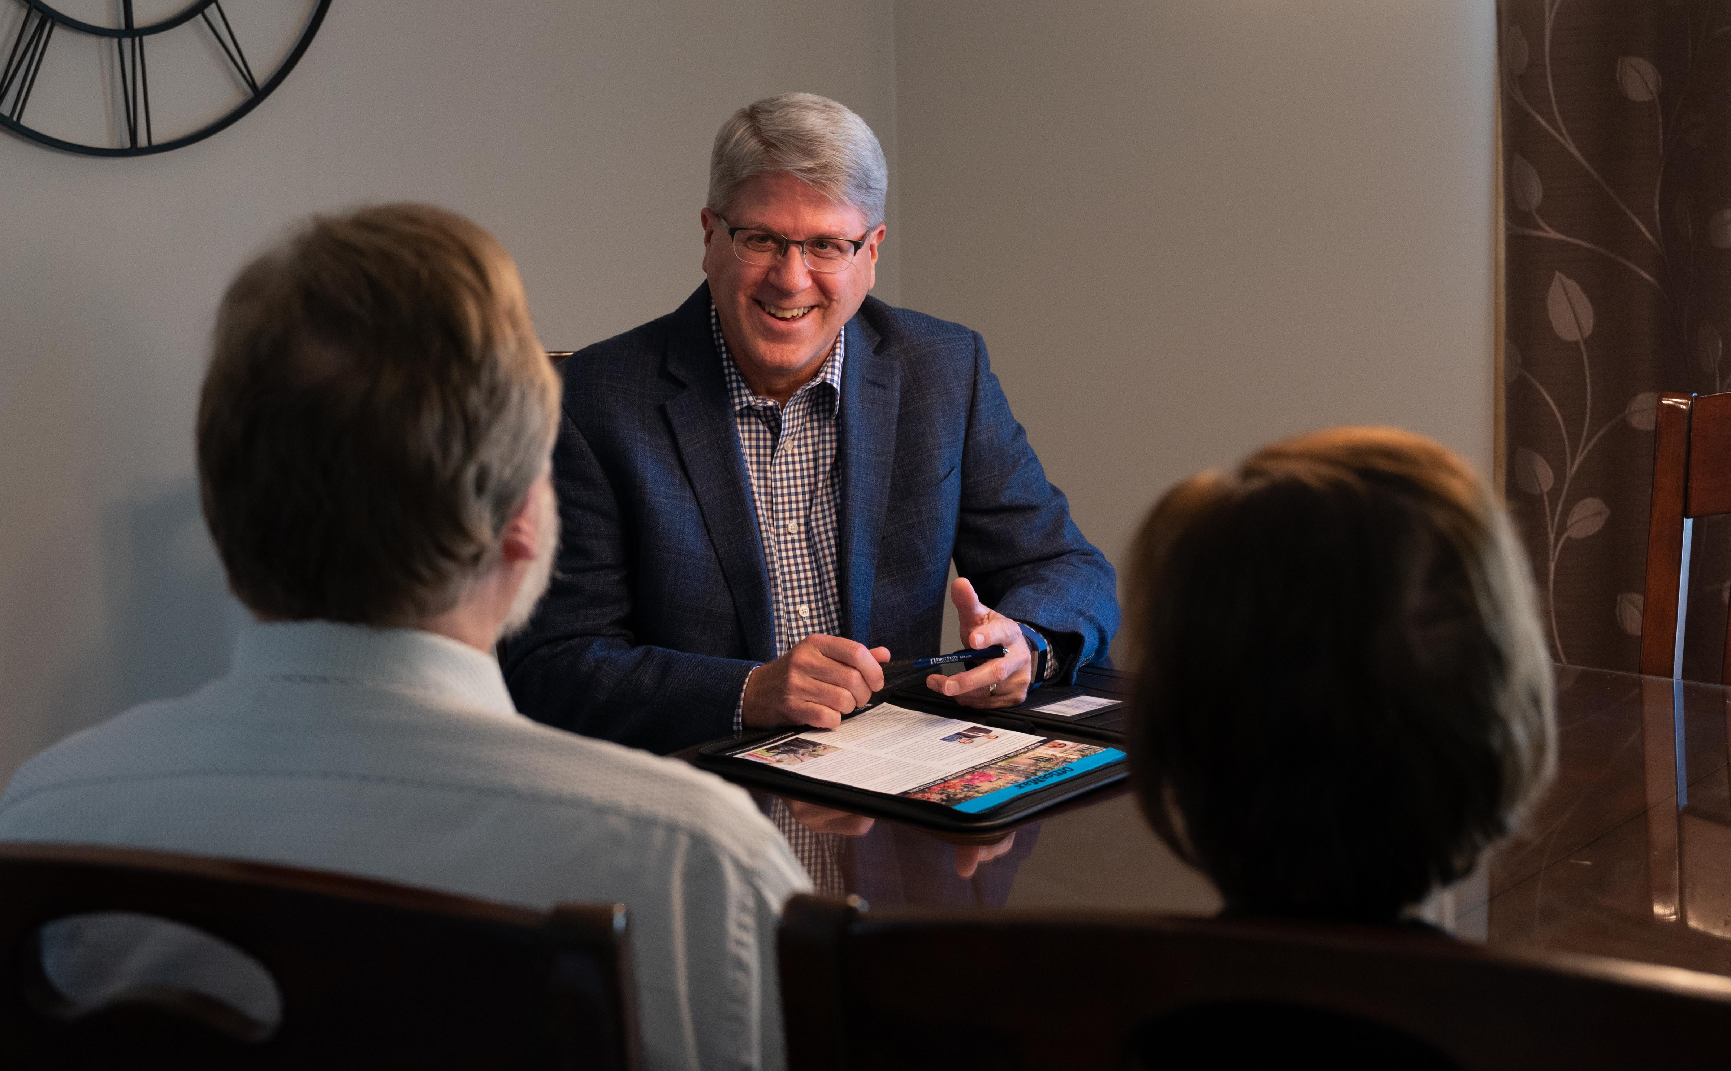
CALLED TO SERVE
TECHNOLOGY: Seeks to help spread the gospel with the latest technology the Lord makes available.
MINISTRY OF CHRISTIAN GIVING: Over the past 14 years WELS Christian giving counselors have helped members offer $93 million in immediate gifts and $419 million in deferred expectancies.
Notes:
Pictured: Rev. Michael Hatzung, a WELS Christian giving counselor since 2005.
WELS Ministry of Christian Giving has 13 Christian giving counselors located across the 12 districts of WELS to provide free, confidential gift planning assistance to WELS members. Find your local giving counselor at wels.net/givingcounselors, by calling 800-827-5482, or by e-mailing mcg@wels.net.

Slide 19
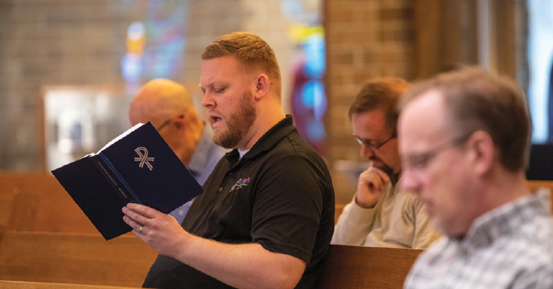
CALLED TO SUPPORT
NORTHWESTERN PUBLISHING HOUSE released more than 39 Christian resources in print and digital formats, including the majority of the Christian worship hymnal suite volumes.

Slide 20
CALLED TO SUPPORT
WELS BENEFIT PLANS
Serves WELS and ELS workers and organizations through administration of the VEBA Health Plan, the Pension Plan, and the Shepherd Plan (investing for retirement).
The synod convention voted to change WELS’ Pension Plan to a defined contribution plan for future worker retirement benefits.
Notes:
Beginning January 1, 2022, eligible workers are being provided with contributions to be used for retirement benefits through a defined contribution plan that is administered through the WELS Shepherd Plan, which is the name of WELS’ retirement savings plan for synod workers. “There are three main advantages to the change,” notes Mr. Joshua Peterman, director of WELS Benefit Plans. “First, workers will receive meaningful contributions for retirement benefits. Then, workers will have more flexibility to provide for their retirement income needs and to share savings with their survivors. Finally, sponsoring organization costs will remain more stable over time.”

Slide 21
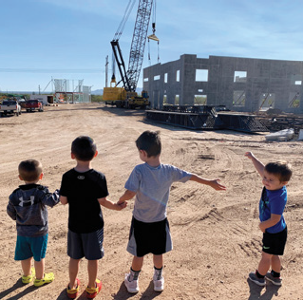
CALLED TO SUPPORT
WELS CHURCH EXTENSION FUND provides loans and grants for WELS congregations through funding received by gifts and investments.
In 2020-21, $15.4 million of new loans and $1.98 million of new grants requests were approved.
Made $1.66 million in grants to the Board for Home Missions.
Provided loans for 205 congregations and affiliates.

Slide 22
CALLED TO SUPPORT
WELS FOUNDATION helps people support WELS ministry through planned gifts. The foundation administers 1,200 donor directed gifts. In 2020-21 they distributed $13.7 million from donors to various WELS ministries.
WELS INVESTMENT FUNDS had investment returns of 25.19 percent for the Balanced Fund and 32.27 percent for the WELS Endowment Fund. For the second year the WELS Endowment Fund’s net investment return ranked in the 90th percentile among foundations.

Slide 23
CALLED TO SUPPORT
FINANCIAL SERVICES
WELS continues to be financially strong, allowing the synod to maintain existing ministries and to develop a well-balanced ministry plan.
Congregation Mission Offerings are coming in at record levels.
WELS has strong reserves. These will help fund initiatives like “100 home missions in 10 years.”
Notes:
CMO funds nearly three-quarters of the operating budget.

Slide 24
WELS in brief
WELS’ calling: Nurture the faith of members and spread the gospel of Jesus Christ throughout the world.
Third largest Lutheran church body in the United States
1,264 churches
344,244 baptized members
275,259 communicant members
One of the largest parochial school systems in the U.S.
282 elementary schools
368 early childhood ministries
27 area Lutheran high schools

Slide 25
WELS in brief
Twelve districts allow for more area-specific ministry.
WELS is a member of the Confessional Evangelical Lutheran Conference, an organization of 34 confessional church bodies throughout the world.
WELS’ headquarters is in Waukesha, Wis.

Slide 26
WELS in brief
From collections that document the administration of WELS to individual congregational records, the WELS Archives helps preserve and share the history of our synod.

Slide 27
Thank you for your support!
N16W23377 Stone Ridge Drive Waukesha, WI 53188-1108 wels.net

