Slide 1
64th Biennial Convention of the
Wisconsin Evangelical Lutheran Synod

Slide 2
64th Biennial Convention of the
Wisconsin Evangelical Lutheran Synod
21st-Century Lutheran Principal Initiative
James Rademan
Director, WELS Commission on Lutheran Schools
Dr. John Meyer
Director of Continuing Education, Martin Luther College

Slide 3
Changes since 2013
328
WELS Schools
143 changes

Slide 4
Changes since 2013
48 – Accept principal call
95 - Attrition
143 changes
29 – Non-principals
37 – Resignations
22 – Retirements
7 – Terminations

Slide 5
Principals assigned 2012–16
8 resigned
2 accepted non-principal calls
1 school closed
1 accepted new principal call
31 schools

Slide 6
New principal attrition
49.5% avg retention rate
2016
2015
2014
2013
2012

Slide 7
If the trend continues . . .
Each year
9 principals will resign
7-8 will accept a non-principal call
5-6 will retire (expected to increase)
1-2 will have position terminated

Slide 8
If the trend continues……
25
principals
each year

Slide 9
Principal influence
Math and Language scores drop
Progress stalled up to three years
(Beteille, T., Kalogrides, D., & Loeb, s. (2011)

Slide 10
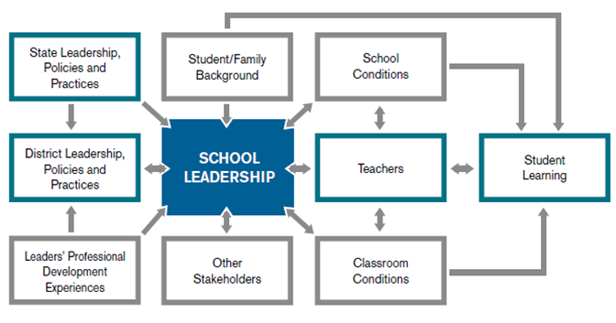
Principal influence
Figure 1: Influence of the Principal (Wahlstrom, Seashore Louis, Leithwood, & Anderson, 2010)

Slide 11
The path forward
Stop the attrition.
Recruit teacher leaders.
Give principals the tools they need.

Slide 12
2015 WELS survey
Principals’
beliefs about their position.
100%
80%
60%
40%
82%
73%
57%
20%
0%
Insufficient
Time
Insufficient
Training
Insufficient
Salary

Slide 13
Interest in being principal
Present conditions
Low / No Interest
100%
Low / No Interest
80%
60%
Interest /
High Interest
Interest
79%
40%
20%
0%
Current Principals
Non-Principal Young Men

Slide 14
Interest in being principal
Present conditions
100%
Low / No Interest
80%
60%
Interest
79%
40%
40%
20%
0%
Current principals
Non-principal young men

Slide 15
Interest in being principal
Adequate time, training, & compensation
100%
Low / No Interest
80%
60%
Interest
91%
74%
79%
40%
40%
20%
0%
Current principals
Non-principal young men

Slide 16
Identify a man with “gifts for leadership.”
Make him a principal.
Let him figure out the job.

Slide 18
First among teachers
Represents the school
Manages resources and tasks
Coordinates the school program
Enforces school discipline
Provides spiritual leadership
WELS paradigm

Slide 19
First among teachers
Represents the school
Manages resources and tasks
Coordinates the school program
Enforces school discipline
Provides spiritual leadership
Lead Board of Education
Coordinate with other principals
School legalities and compliance
Counsel students, families, and faculty
Policy creation, implementation, revision
Curriculum development Instructional supervision
Staff development Building safety
School promotion Develop programs
Manage daily communication Collaborate with community and faculty
Faculty development and coaching Enrollment management / recruitment
Navigate political and social issues Student achievement accountability
Set vision Create culture & climate Long-term master planning
Ongoing professional growth Evaluate school programs Data-driven decision-making
Marketing Ensure financial sustainability Monitor trends and research
Accommodate student diversity Manage volunteers Crisis management planning
Ensure campus safety
WELS paradigm
1960s
21st-century expectations
1970s
1980s
1990s
2000s
2010s
(Clifford, Behrstock-Sherratt, & Fetters, 2012; Granberg, et al., 2013)

Slide 20
Figure 1: Influence of the Principal (Wahlstrom, Seashore Louis, Leithwood, & Anderson, 2010)

Slide 21
Goal
Every WELS principal is fully prepared prior to receiving a school leadership call and receives the administrative release time and compensation needed to ensure success.

Slide 23
Identify a man with “gifts for leadership.”
Make him a principal.
Let him figure out the job.
Identify a man with “gifts for leadership.”
Fully prepare him to be a Lutheran principal.
Call him as principal to a school that provides adequate levels of time and compensation.

Slide 24
How does WELS compare?
Qualification for principal | WI | MN | WELS
Synod certification
Teaching license
3 years experience
MS ed administration

Slide 25
Recruit
Minimum 3 years of teaching experience
Gifts for Leadership
Train
Year 1 – Leadership Candidate Training (CLS)
Years 2 & 3 – MS Educational Administration (MLC)

Slide 26
Leadership Candidate Training – CLS
Leadership Training Event 1
Leadership Training Event 2
Leadership Training Event 3
The Principalship
3 cr online course
Year 1

Slide 27
MS in Educational Administration – MLC
Summer
6 credits
Fall
6 credits
Spring
6 credits
Summer
6 credits
Fall
3 credits
Spring
Intern
6 credits
Years 2 & 3

Slide 28
Initiative underway
COP – Assigned only 2 principals
CLS – First cohort of 6
MLC – Enrolling MS Ed Admin

Slide 29
The research says . . .
High quality preparation
Mentoring
Professional development
Training to lead instruction, not just manage buildings. Gill, J. (2012)

Slide 30
The research says…..
High quality preparation
Leadership Candidate Training
MLC Master’s Program
Coursework and experience with principal standards

Slide 31
The research says . . .
Mentoring
New Teacher Induction and Apprentice Mentoring
Principal Training Program
Leadership Candidate Training

Slide 32
The research says . . .
Professional development
Master’s Program – WELS Principal Standards
Ministry Development Plan
Webinars and seminars
Materials and resources

Slide 33
What’s your role?
Prayer
Ministry recruitment
Support

Slide 34
Thank you!

