Slide 1
64th Biennial Convention of the
Wisconsin Evangelical Lutheran Synod

Slide 2
64th Biennial Convention of the
Wisconsin Evangelical Lutheran Synod
Congregation and Ministry Support Group

Slide 3
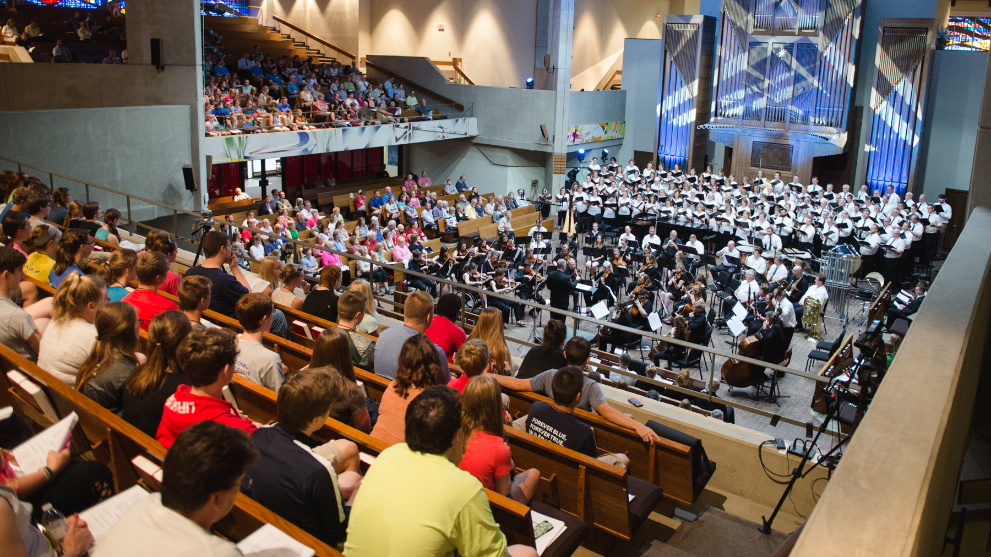
2017 Worship Conference
Teens in foreground
Chapel seats
1,700

Slide 4
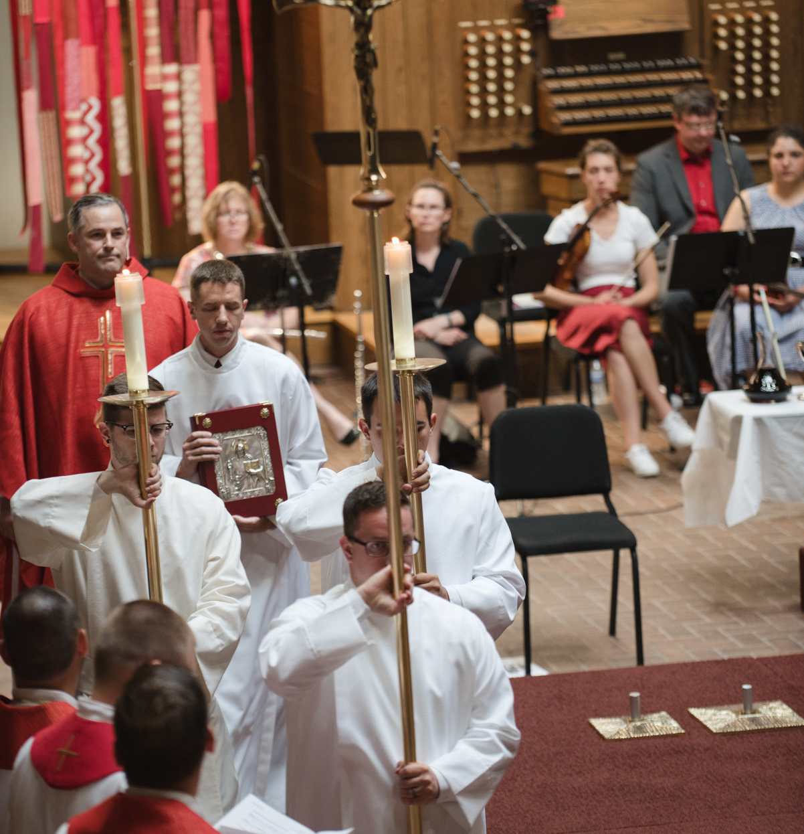
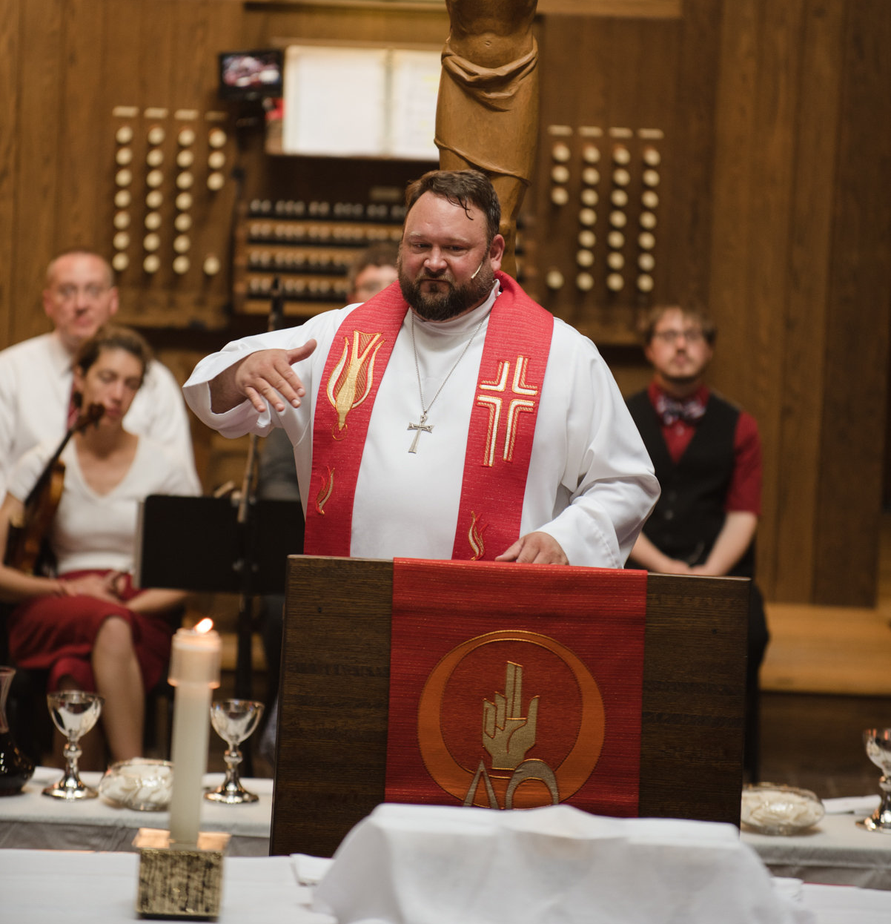
Opening Reformation Service
much like convention’s . . . only 3x larger
Opening Reformation Service,
much like Convention’s… only 3x larger

Slide 5
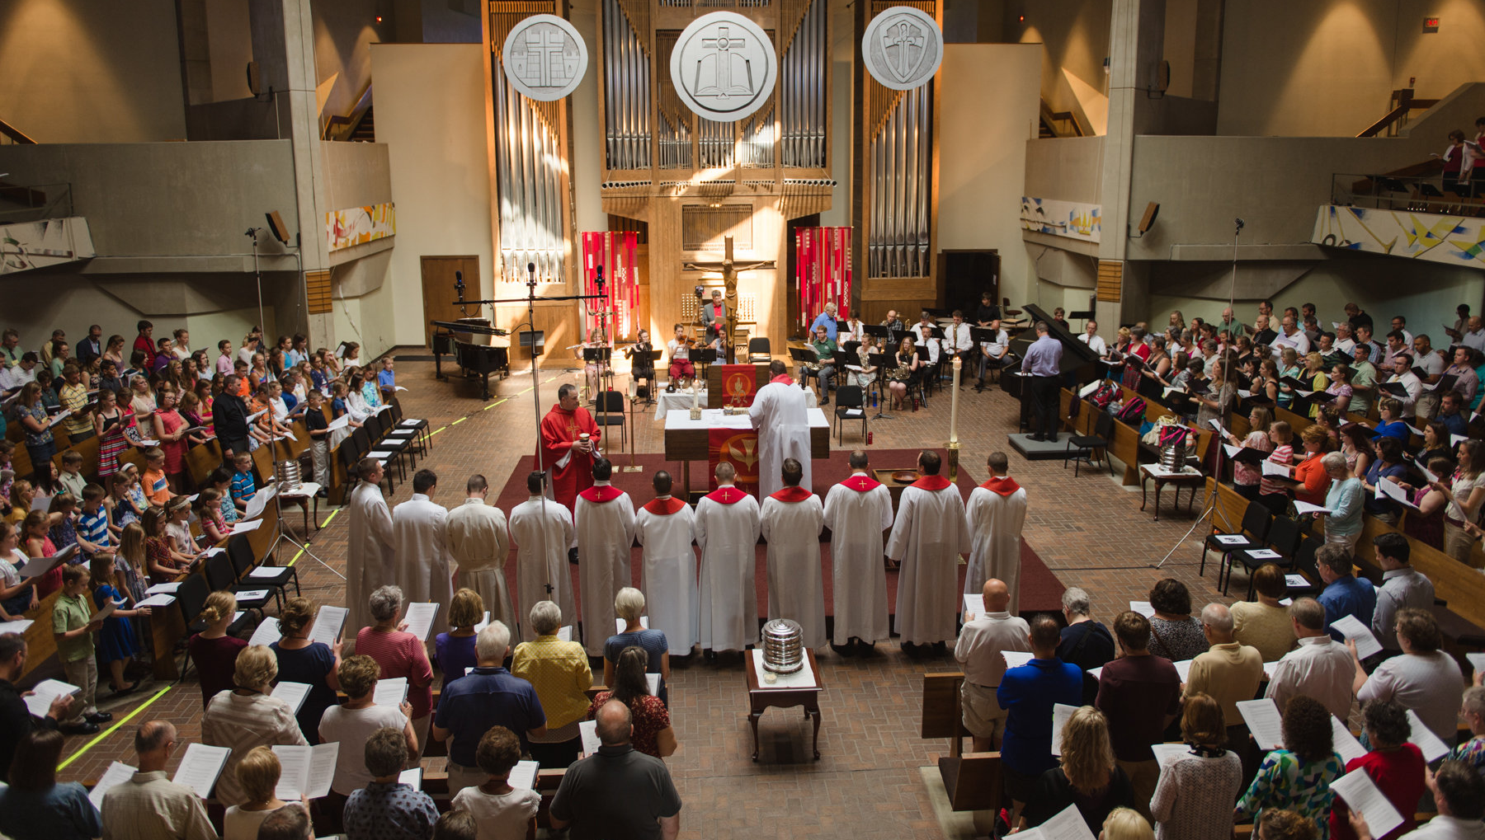
Communing 900

Slide 6
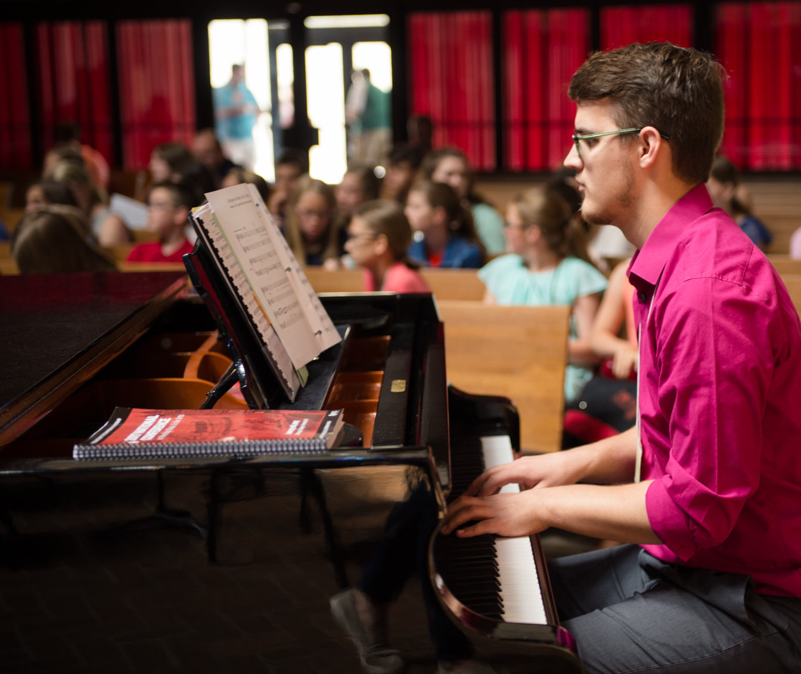
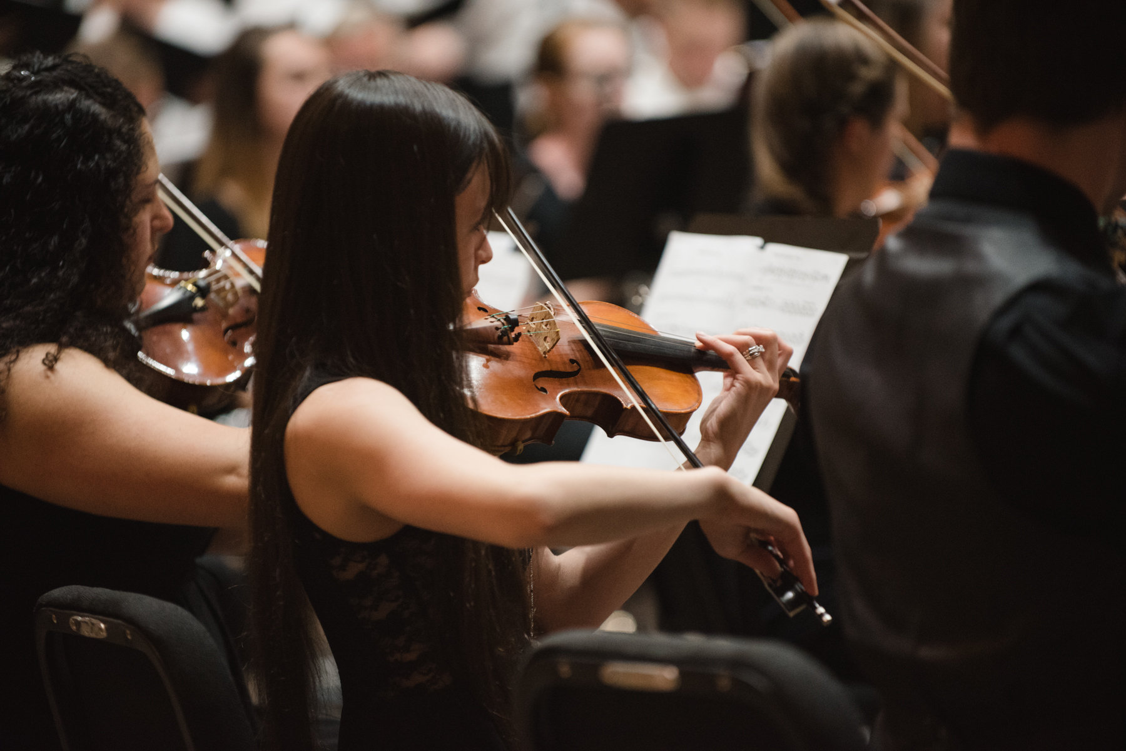
Young musical talent

Slide 7
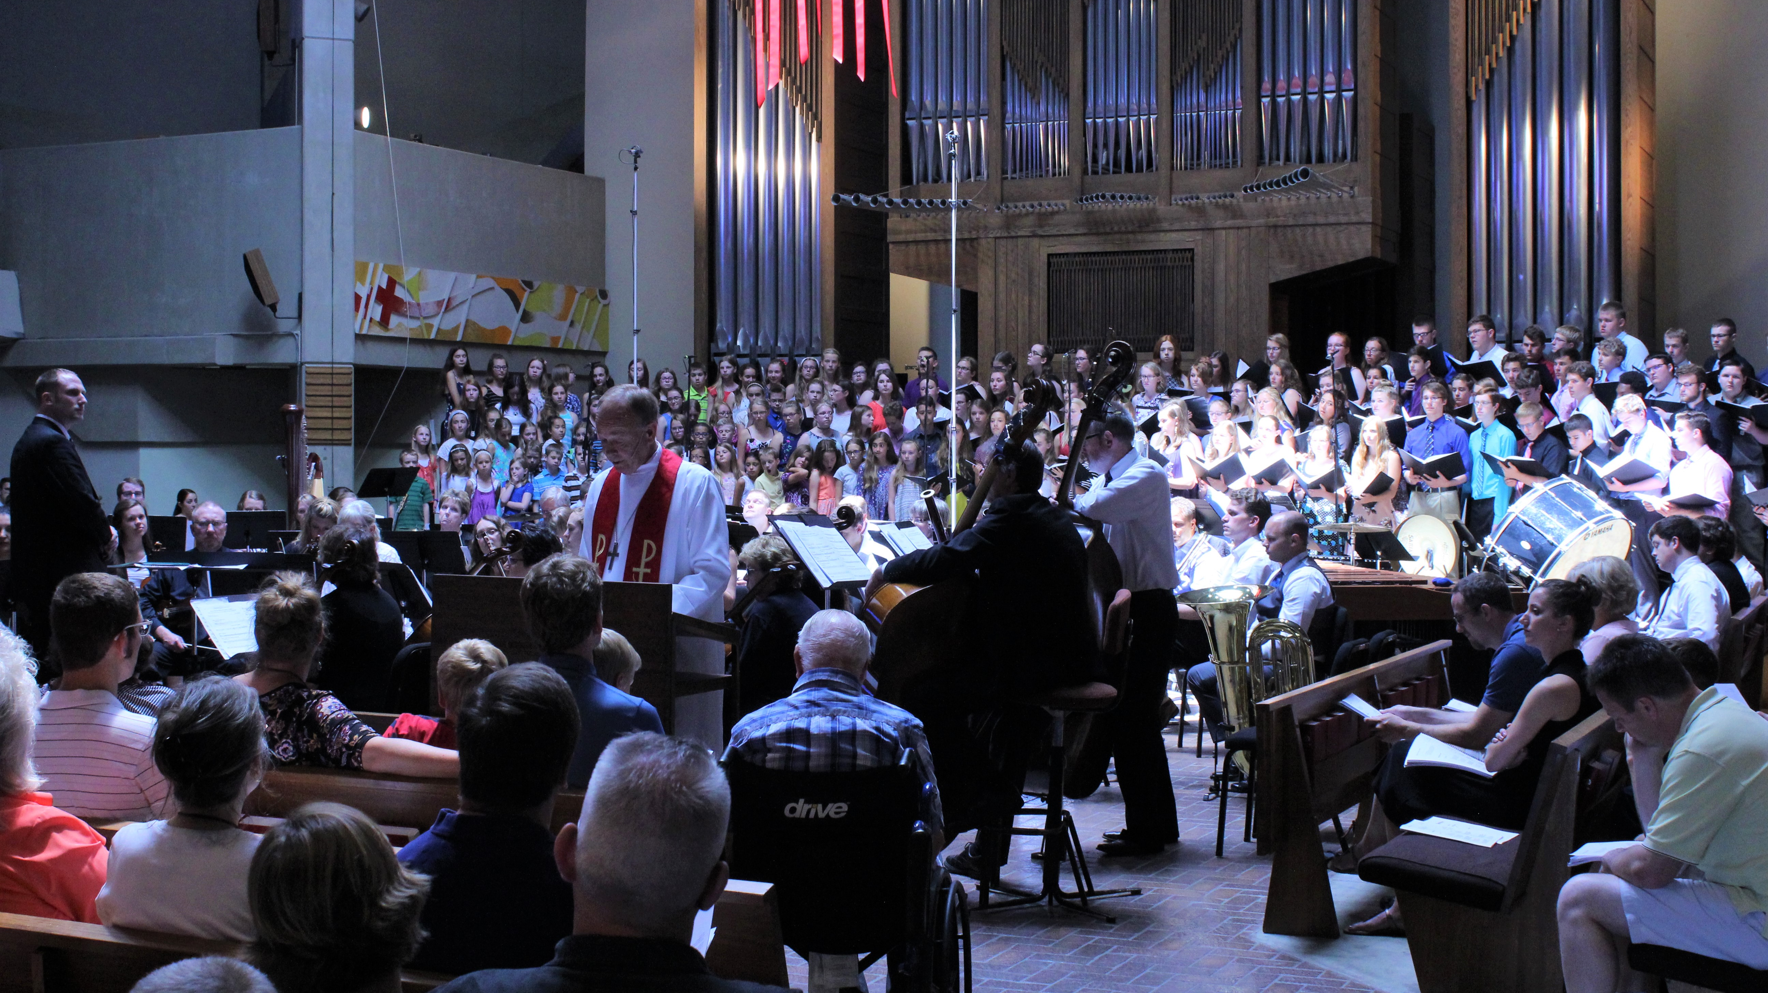
150 youth and a full orchestra,
with Pres. Schroeder

Slide 8
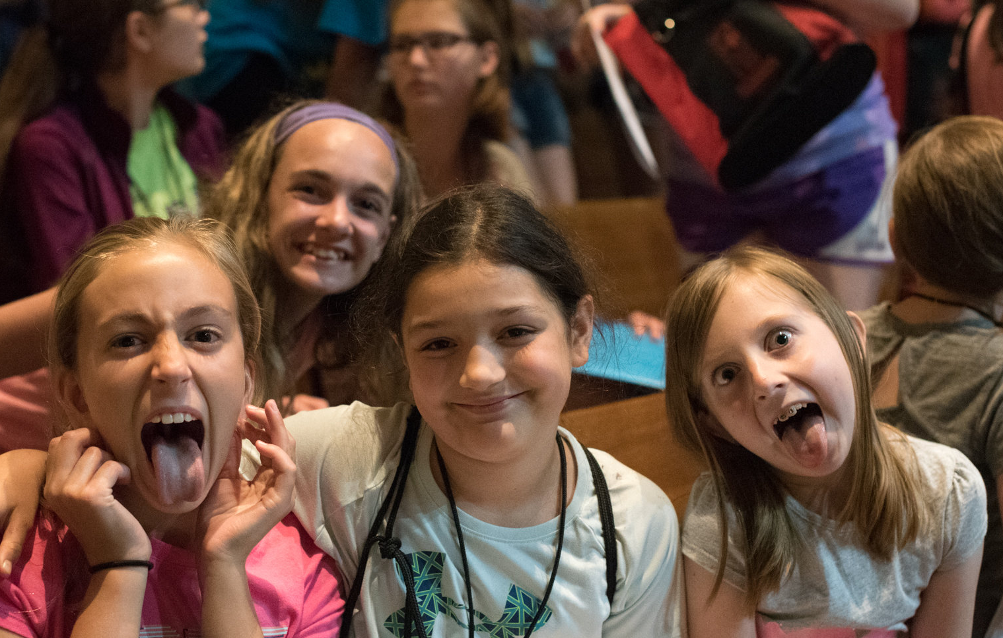
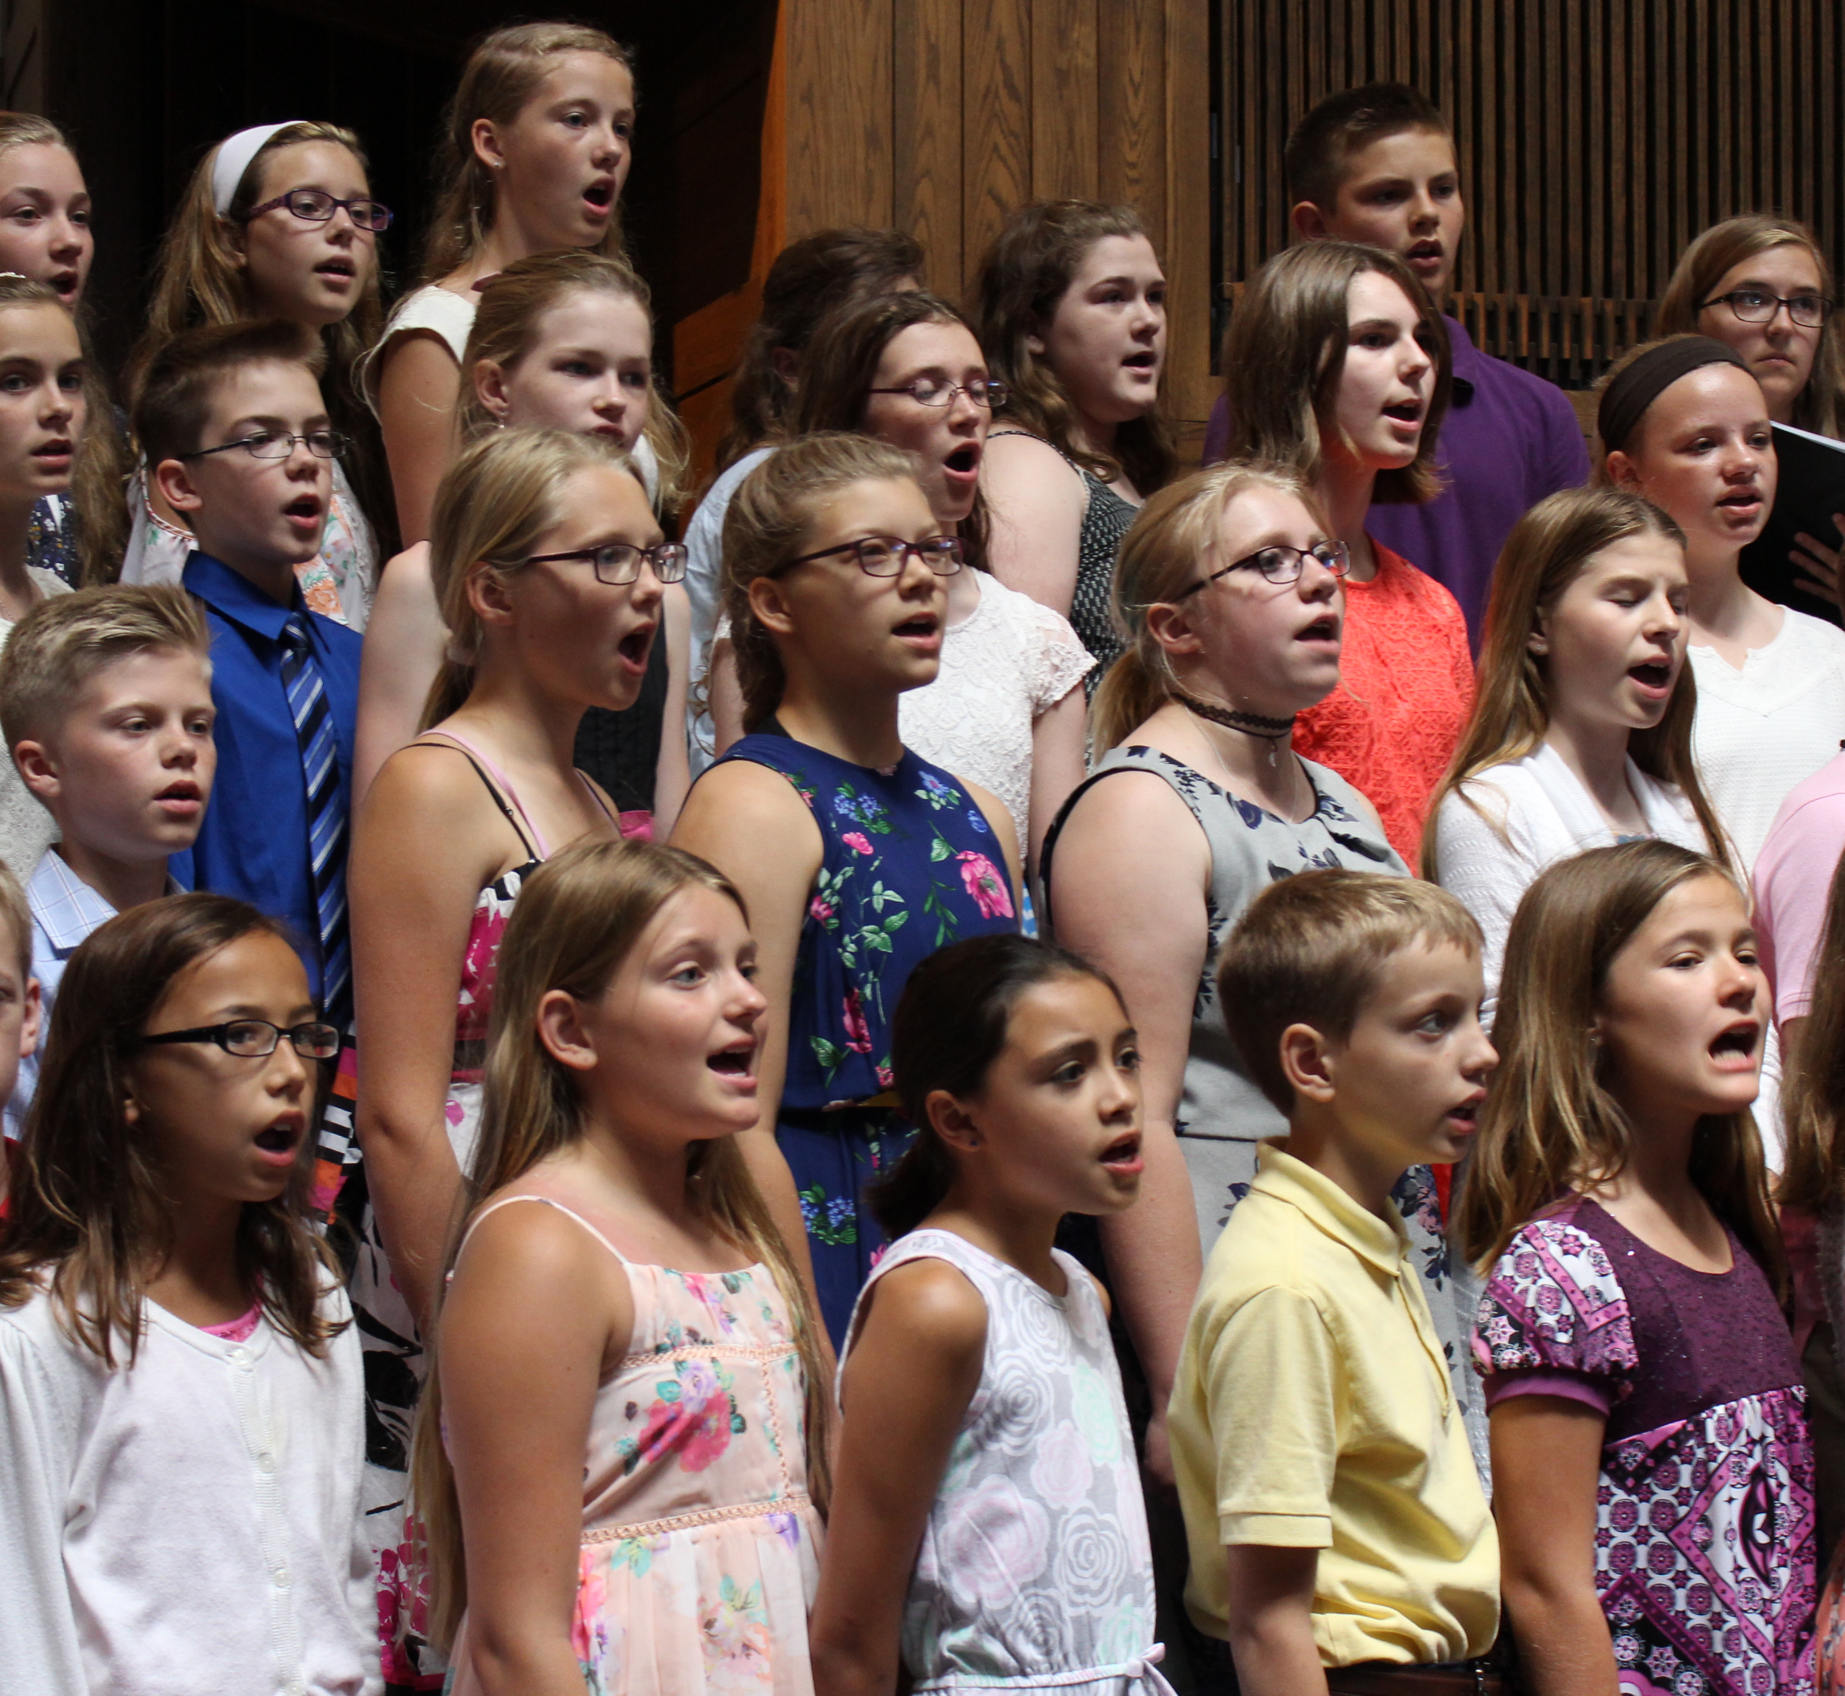
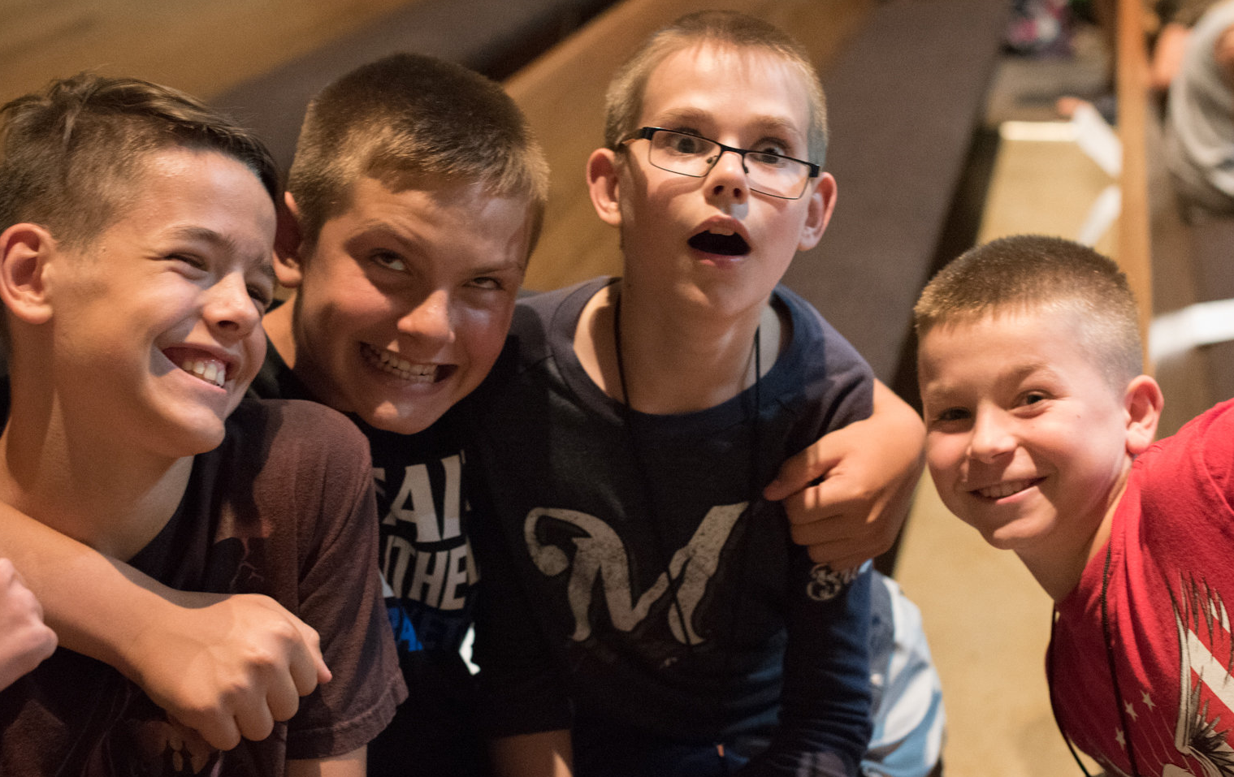
Children’s Choir

Slide 9
Hymnal Project
Rev. Michael Schulz
Project Director
Three digital products: repeat demo Wed. 12:45-1:15 in convention hall (gym)

Slide 10
Evangelism
School of Outreach
Assisting congregations with evangelism programming and implementation of outreach strategies
Telling the Next Generation
Planning assistance and resources for utilizing the Lutheran elementary school and early childhood ministry for outreach
New movie: To the Ends of the Earth
Showing fulfillment of Jesus’ command to proclaim the gospel . . . “to the ends of the earth”

Slide 11
Adult Discipleship and Youth/Family
Director of Discipleship
two calls declined; current call . . .
2018 WELS International Youth Rally
June 26-29
Bowling Green State University
Ohio

Slide 12
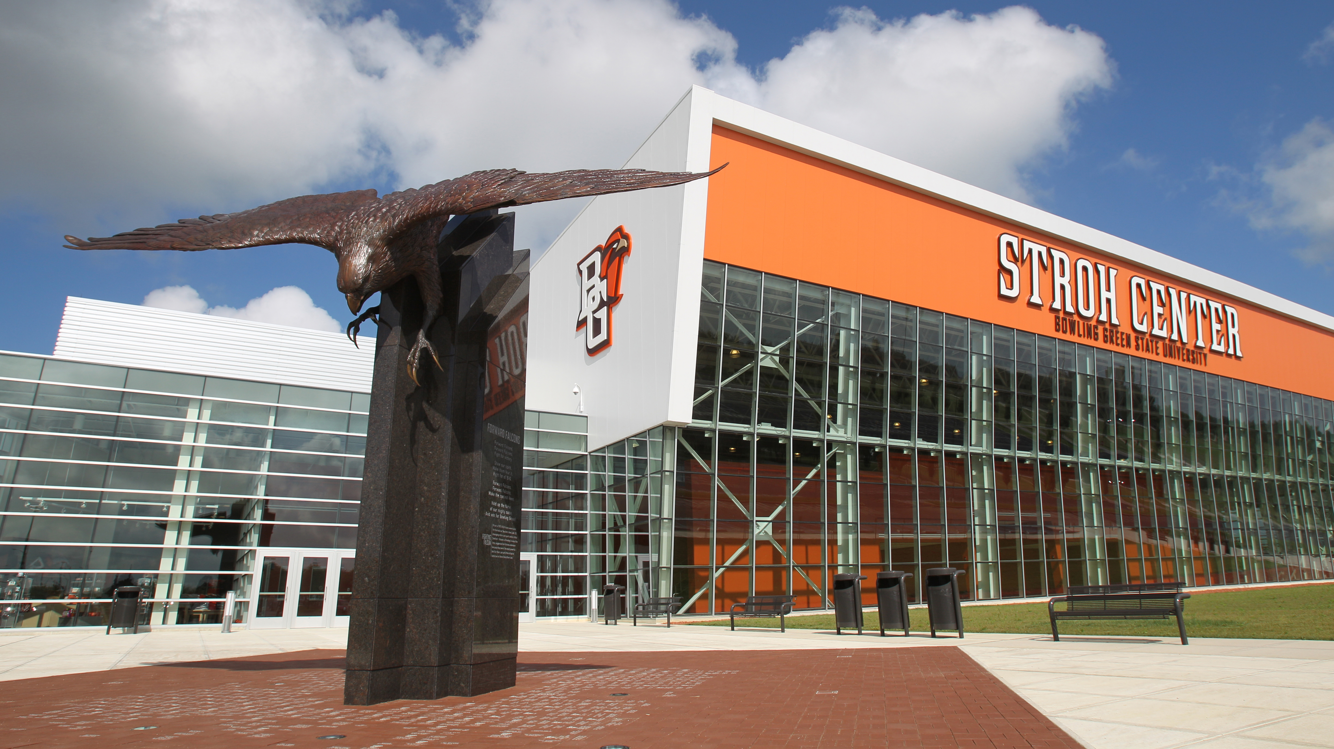
2018 Youth Rally

Slide 13
Lutheran Military Support Group
Ministry to the deployed Ministry to veterans

Slide 14
Veterans coming home know
Our nation does not understand vets’ suffering.
Our nation does not understand vets’ sacrifices.
Our nation does not understand why the military fights for it.
Our nation does not understand the “special love,” a “selfless love,” that most vets share.
Our nation looks at veterans like something is wrong with them; like they are misguided.
Our nation records 20 veteran suicides each day; average age = 50.

Slide 15
Recent/Planned donations
WELS National Chaplain - $10,000+
WELS European Chaplain support - $18,000
Active, NG, and Reserve kids’ summer camps - $10,000 [test]
Emergency support to families - $2,250
“Time of Grace” Armed Forces Network video – ca. $15,000
Spiritual Retreat for Traumatized Vets - $10,000 [test]
“AMMO BOX”
Memorial Day
Veterans Day

Slide 16
Something “special” for LMSG members
Challenge coin: “Put on the full armor of God”
P-38 Witnessing Tool
& Lutheran vets’ website/Facebook page & comradeship and understanding & opportunities to help yourself and others

Slide 17
Lutheran Military Support Group
www.lutheranmilitary.org

Slide 18
Special Ministries
Please refer your members in the military, reserve, or national guard. All we need is a name and a way to contact them and WELS Military Services can provide Christ-centered, biblical materials to serve your military members in their special spiritual needs. wels.net/refer
In your conference materials, you will see resources for your church's Care Committee for Called Workers. They are intended to help your members talk to called workers about preparing for retirement.

Slide 19
Lutheran Schools
Cindi Holman
National Coordinator Early Childhood Ministries
ECM devotions
Telling the Next Generation

Slide 20
Lutheran Schools
Tom Plitzuweit
Associate Director

Slide 21
Lutheran Schools
Jim Rademan
Director
Called worker shortage
Thanks a million
WELS Education, Technology, & Leadership Summit June 24-27, 2019 Wisconsin Dells

