Slide 1
64th Biennial Convention of the
Wisconsin Evangelical Lutheran Synod

Slide 2
64th Biennial Convention of the
Wisconsin Evangelical Lutheran Synod
WELS Ministry of Christian Giving
Rev. Kurt Lueneburg
Notes:
See our report in BORAM, pp. 32-38.

Slide 3
Scriptural encouragement
Your statutes are my heritage forever; they are the joy of my heart (Psalm 119:111).
Notes:
As we reflect on our great heritage in Jesus Christ and our privilege to spread his light from age to age by managing all of God’s blessings to his glory and the benefit of others, we say with the psalmist, “Your statutes are my heritage forever; they are the joy of my heart.”
Which statutes of the LORD give us joy? All of them, to be sure; especially…
The holy law of God which shows our sin and our need for rescue, and which is a light for our path.
The precious good news of Jesus who, for the joy set before him, endured the cross and sat at God’s right hand.
The blessed truth that the Holy Spirit has converted us to saving faith and guides/preserves us in Christ.
The encouragement to rejoice in the Lord always – in every situation and in every action, attitude and word.

Slide 4
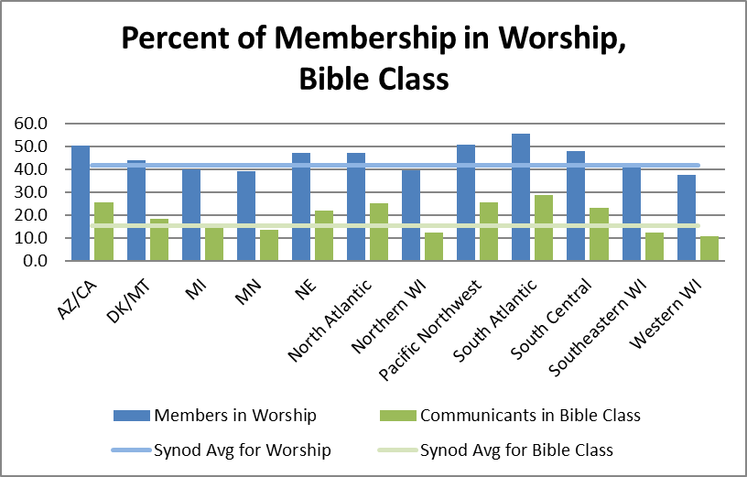
Worship and Bible study
41.7% in worship
15.2% in Bible class
2.5% of income to offerings
6.6% of church offerings given as CMO
Notes:
Note the fruit of those who rejoice in the Lord’s statutes during 2016:
Average worship attendance in 2016 is down from 42.1% in 2015
Average Bible class attendance is down from 15.5% in 2015
Personal income to offerings stayed the same. 2.5% income figure—based on WELS 2016 Statistical Report and the U.S. Dept. of Commerce Bureau of Economic Analysis (divided per communicant giving figure for synod by U.S. per capita income).
Church offerings given as CMO (based on figures from WELS 2016 Statistical Report) is slightly down from 6.7% in 2015. (CMO + other gifts to WELS = 7.4%.)
There’s room to grow in all these areas; let’s ask our gracious Savior to increase our love for his statutes!

Slide 5
Congregation Mission Offerings
2016 offerings totaled $21.1 million
This was 0.3 percent below commitments and 2.1 percent below prior year receipts
2017 subscriptions show an increase of 0.8 percent from 2016 actual offerings
2017 offerings through June are $136,000 (1.4 percent) above 2016 CMO for the same period
We thank the Lord and his people for their gifts!
Notes:
We’re truly grateful to our heavenly Father for the wonderful thank offerings his congregations gave him in 2016 for his worldwide work through our church body! We commend you for your part in encouraging and presenting such gifts! Christ’s gifts through his people continue to be strong in 2017. To him be the glory!

Slide 6
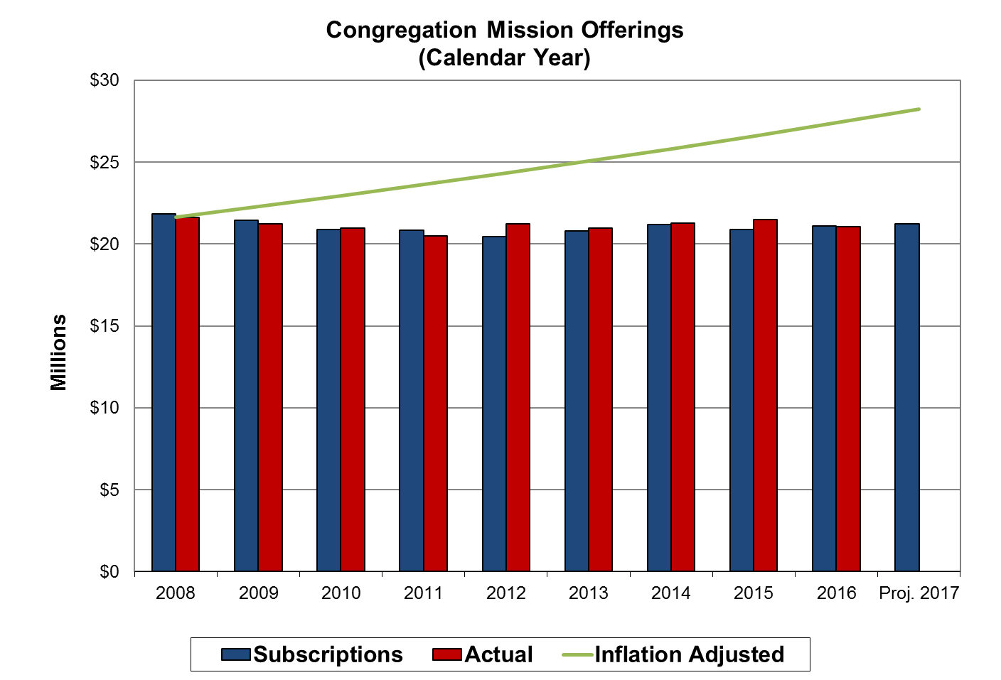
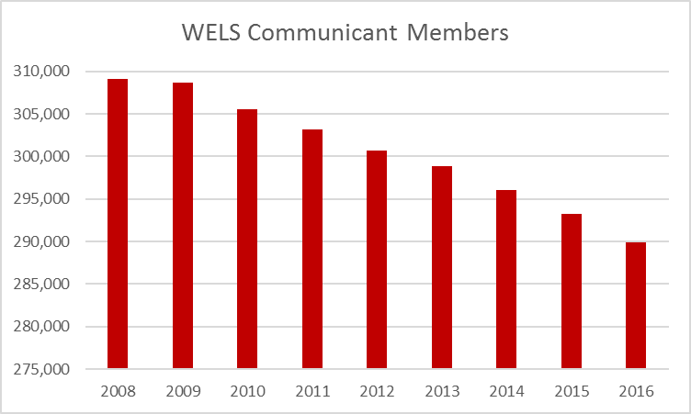
Congregation Mission Offerings
Year to year CMO have remained level.
Notes:
It is evident that God’s people glorify our Savior through their Congregation Mission Offerings. The level CMO is truly remarkable when we consider the decline in our communicant population (a loss of 20,000 communicants the past nine years).
Let us ask God for his blessings of contentment, trust, and generosity as we encourage growth in CMO and additional gifts from individuals.

Slide 7
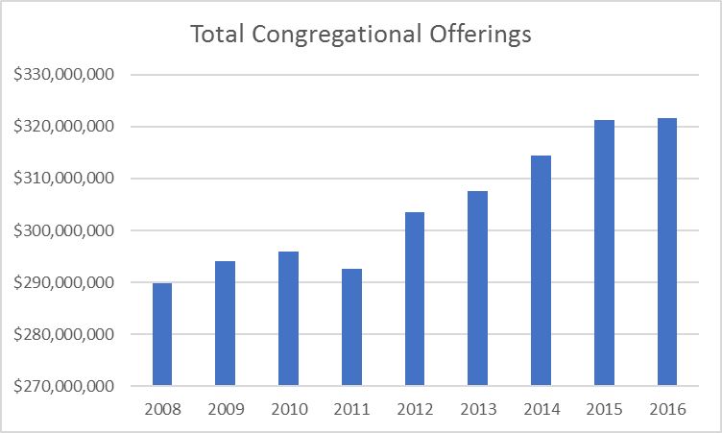
Congregation Mission Offerings
CMO remains level while total church offerings increased.
Notes:
It’s not that sufficient resources aren’t available to us.
While CMO has remained level the past nine years, total church offerings have increased 10 percent.
We do well to carefully review the portion of offerings that we designate to share our great heritage with precious souls in North America and around the world. To that end, God help us!

Slide 8
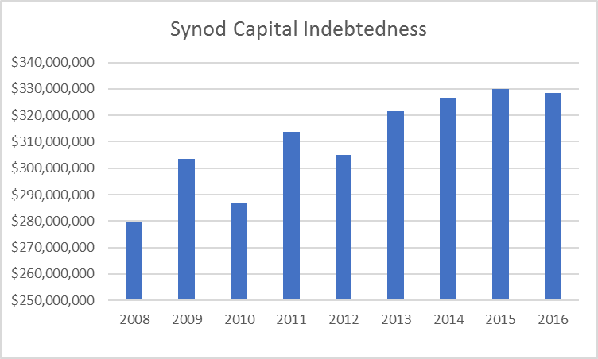
Congregation Mission Offerings
CMO remains level while capital indebtedness increased.
Notes:
One challenge a number of our congregations face is capital indebtedness, which has increased 14 percent the past nine years while CMO have remained level.
We pray that the Lord blesses our overall capital debt service so that we retire debts without pulling back support for Christ’s other gospel ministries.

Slide 9
Congregation Mission Offerings
When setting CMO, aim for 10 percent of offerings. If at or above this goal, encourage your congregation to keep increasing.
“Excel in this grace of giving….For you know the grace of our Lord Jesus Christ” (2 Corinthians 8:7,9).
Notes:
When setting CMO, we encourage all our congregations to consider designating 10+percent of general offerings for CMO.
The reason? Because you know the grace of our Lord Jesus Christ, and you want to share him with others!

Slide 10
Congregation Mission Offerings
WELS Connection
Together e-newsletter
Forward in Christ
Annual Report
Annual CMO setting materials
District President videos
Notes:
Please note these resources that are designed to keep you and others informed about how CMO and unrestricted IMO is being used to further Christ’s kingdom.
Remember to show your district president’s video to as many people as possible as you set your CMO commitment.

Slide 11
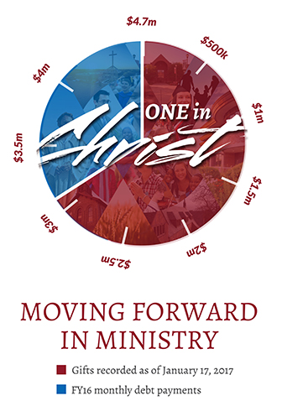
“One in Christ” Debt Elimination
Praise God - the effort to pay off our $4.7 million debt was successful!
From 7/1/15-6/30/17, 577 congregations and 2,274 individuals and other organizations gave $3.1 million.
$1.8 million in payments came from the synod budget.
Notes:
The “One in Christ” debt elimination offering has been wonderfully blessed by our Savior! We thank God for helping us eliminate $22.4 million in debt through payments and gifts in nine years! Join me in praising Jesus for the thousands of families whom he moved to participate in our debt elimination endeavor. What a wonderful response to Christ’s love!

Slide 12
Individual offerings
Notes:
(Note to user: At this point we suggest you minimize the PowerPoint, play the first 4.5 minutes of the video found at https://wels.net/giving/wels-foundation, then return to the PowerPoint.)
As we transition from our report on Congregation Mission Offerings and debt elimination, let me illustrate our Christian giving counselors’ free, confidential services by showing a new video produced by Communication Services for WELS Foundation.

Slide 13
Individual offerings
“In fiscal year 2016-17, WELS Christian giving counselors (11.8 full-time equivalents) conducted 3,370 free, confidential visits with God’s people that helped facilitate $5.4 million in gifts received and $45.8 million in gifts expected for WELS ministries.”
Notes:
Jesus is blessing our service to his people and him! Last fiscal year, our CGCs conducted over 3,370 visits that helped facilitate about $5.4 million in immediate gifts to WELS areas of ministry and $45.8 million in expected gifts for Christ’s work through WELS areas of ministry, your congregations, and regional ministries! (Not included are over $8 million in received expectancies.)

Slide 14
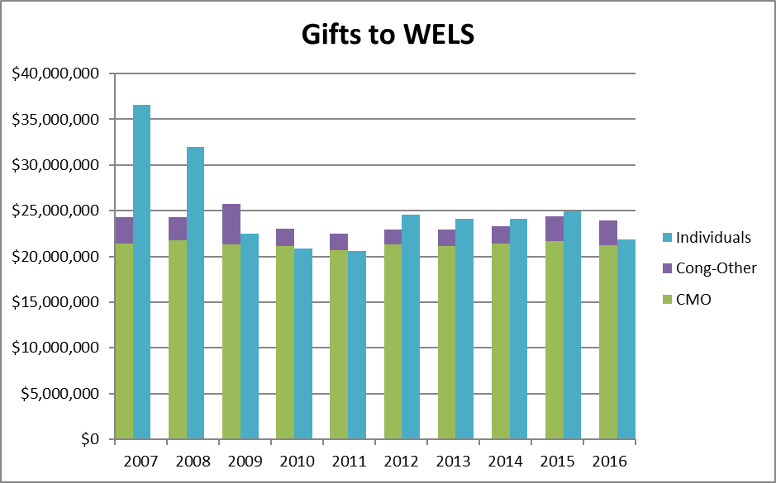
Individual offerings
Notes:
Individual Mission Offerings have been consistently strong over the last ten years and with two exceptions average between $20-25 million per year.
Individual offerings are gifts to WELS beyond those remitted by active congregations or their sub-organizations. These include gifts from individuals, foundations, closed congregations, etc.

Slide 15
Individual offerings
New opportunity: the qualified charitable distribution
Those 70.5 or older can make tax-free gifts to ministry from their IRAs.
Consider directing required minimum distributions to ministry to save on taxes, then use the cash you would have given to charity for other needs.
Notes:
God’s people age 70.5+ who don’t need the required minimum distributions that they receive from their IRA, may consider directing those to WELS to save on taxes, then use the cash you would have given to charity for other needs. (There’s a $100,000 limit per IRA holder each year.)

Slide 16
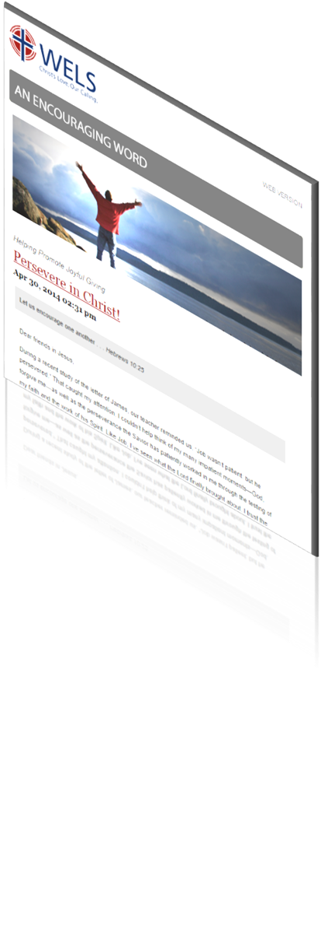
Resources
An Encouraging Word
Tips from those experienced in the area of stewardship
News and updates on resources
Prayers for synod ministry
“Stewardship by the lectionary” devotionals based on weekly readings; share God’s stewardship truths according to the pericope
Cut and paste planned giving articles
Notes:
We feel privileged to provide biblical resources for stewardship encouragement. For all of these resources go to Ministry of Christian Giving’s resource center on wels.net. To subscribe to Encouraging Word go to wels.net/subscribe.

Slide 17
Resources
Stewardship program: Joyful Generosity
Worship helps
Bible study
Personal devotions
Shares the Bible’s clear teachings on the management of our possessions
Notes:
This program was written by two MN District pastors, and is based on the WELS School of Stewardship materials (2008).

Slide 18
Resources
Congregational planned giving program
A guide for encouraging planned giving in your church using synod resources and the assistance of your local giving counselor
Includes “quick starts” to promoting planned giving and setting up an endowment as well as more complex options
Notes:
The congregational planned giving manual gives practical advice for regularly encouraging planned giving in your congregations and lists the free resources that are available to you. (It also explains how to set up a congregational endowment fund, whether doing this quickly and easily through WELS Foundation or administering your own.)

Slide 19
Mission and Ministry Sunday
WELS will provide worship, Bible study, and other resources to aid in traditional-style mission festivals.
This is a chance to recommit ourselves toward the Great Commission locally and through the opportunities God gives us as a synod.
Special offerings can go to a designation chosen by the congregation or to “WELS Mission and Ministry” to support our daily gospel work.
Notes:
These resources are available at www.welsrc.net/mission-festival.

Slide 20
Scriptural encouragement
For you, God, have heard my vows; you have given me the heritage of those who fear your name (Psalm 61:5).
Notes:
As we express our praise and thanks in tangible resolutions – both here and when we return to our vocations and congregations – we may be confident in Christ that God hears us and will bless us to his glory, our good, and the benefit of souls around the world!

Slide 21
Thank you!
WELS Ministry of Christian Giving
mcg@wels.net
800-827-5482
Notes:
Thank you for your time today and your partnership in Christ’s kingdom. The grace of the Lord Jesus be with you!

