Slide 1
64th Biennial Convention of the
Wisconsin Evangelical Lutheran Synod

Slide 2
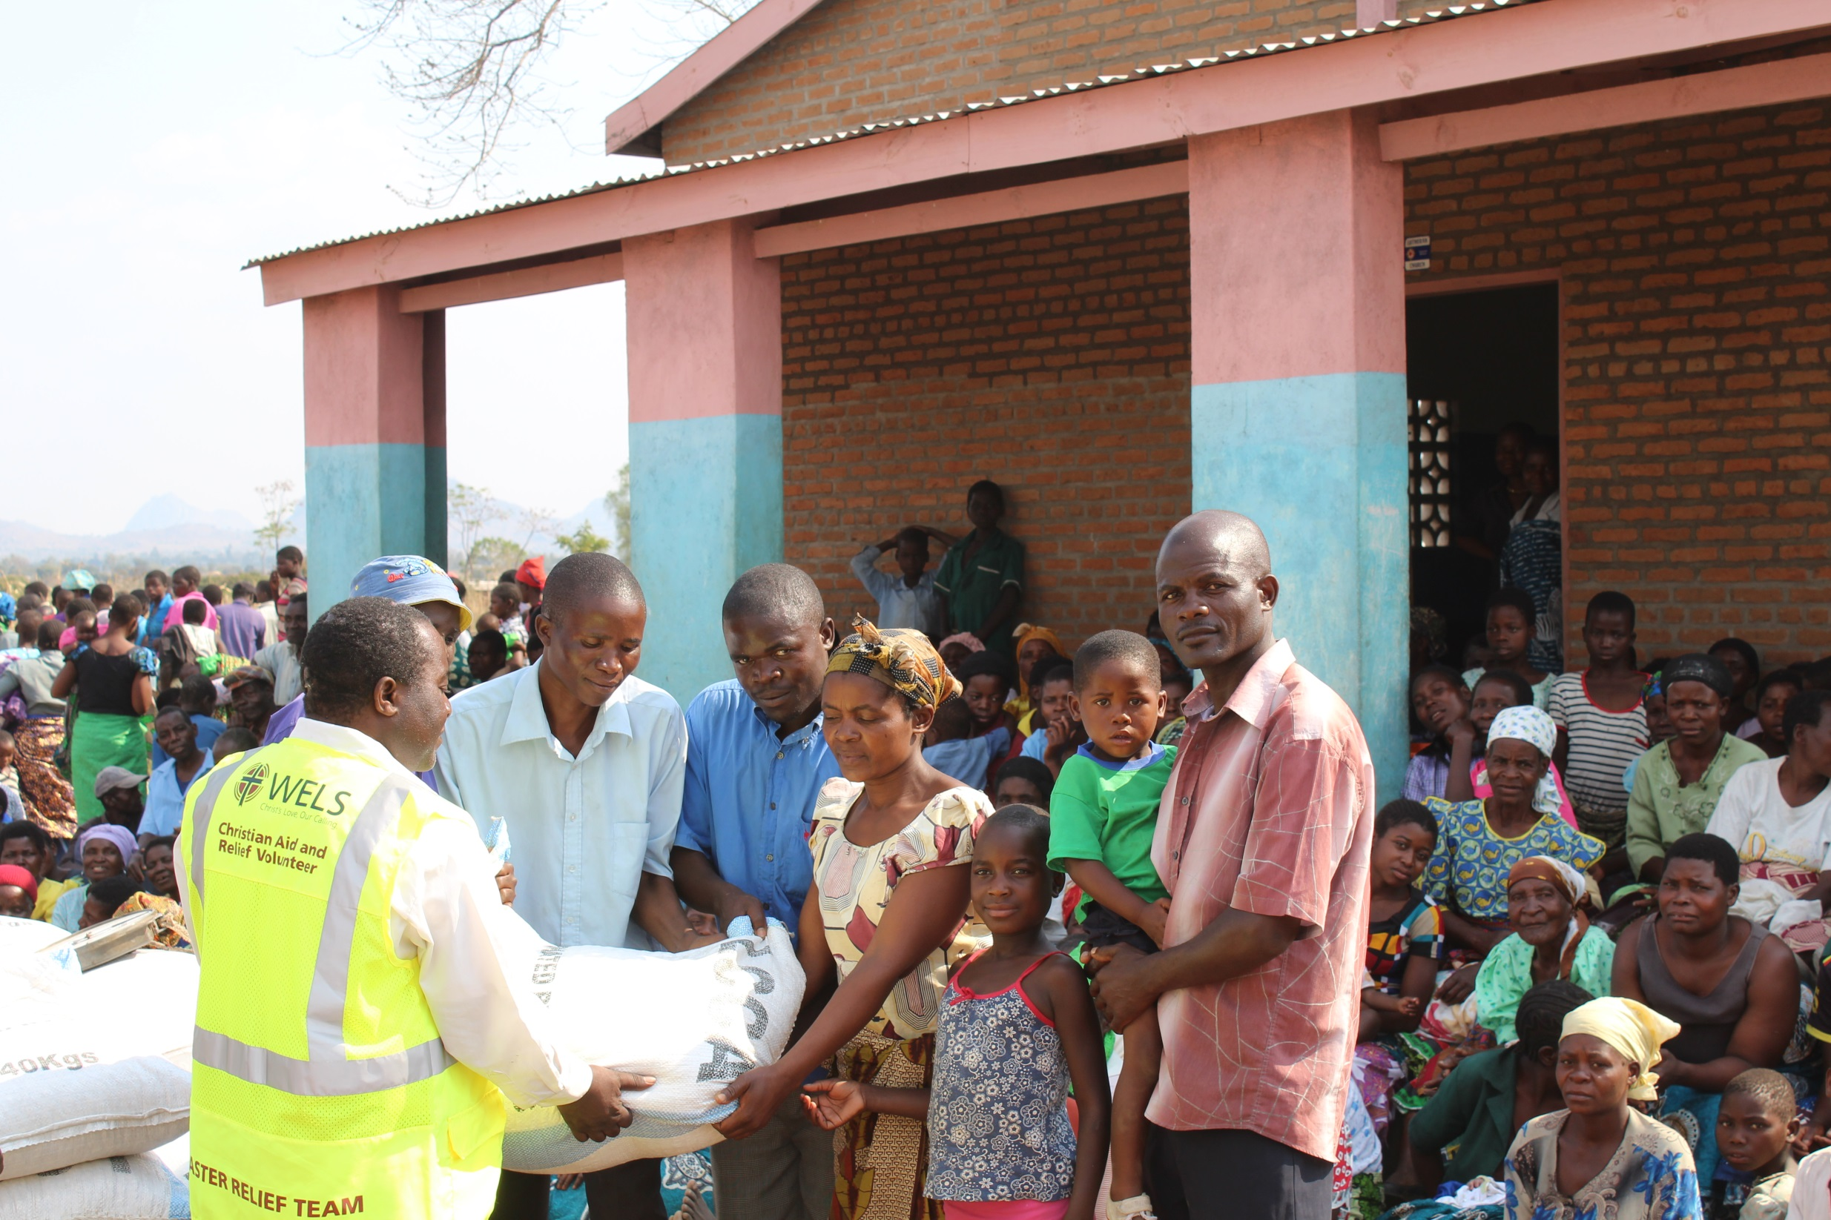
64th Biennial Convention of the
Wisconsin Evangelical Lutheran Synod
WELS Christian Aid & Relief

Slide 3
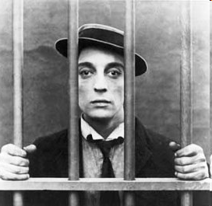
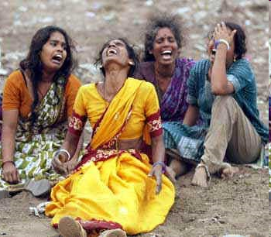
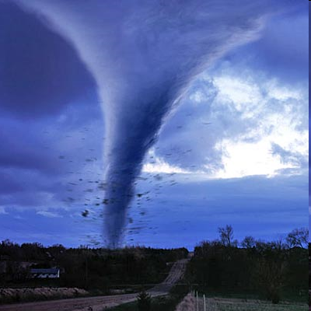
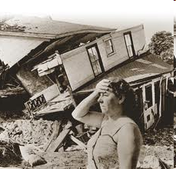
Why is there evil and disaster in the world?

Slide 4
Be imitators of God, therefore, as dearly loved children and live a life of love, just as Christ loved us and gave himself up for us.
Ephesians 5:1,2
Notes:
Read this verse together.
It starts with the word “THEREFORE”.
In school I was always taught when I see the word therefore, to always ask,
“what is it there for?”
Invariably, you will find that word preceded by a presentation of the wonderful things God has done for us, the love he lavishes upon us, the forgiveness he won for us, the blessings he offers us in Christ.
These blessings fill our hearts with joy and gratitude and motivate us to want to reflect Christ’s love and compassion to others.
Therefore, as we have opportunity, we want to do good to all people, especially to those who belong to the family of believers.

Slide 5
Relief work
Responding to natural disasters
Assisting with medical and financial hardships
Humanitarian aid
Ongoing assistance that serve as bridges for our missions to proclaim the gospel
Notes:
In one sense, our committee has been around for a long,
The Committee on Relief has been providing care and relief to people suffering from disasters and hardships for many years.
The humanitarian aid committee of the Board for World Missions has been funding grants for our world missions which help them build bridges to proclaim the Gospel.
We have been functioning as a new combined committee since October 2010 and have been officially approved as WELS Christian Aid and Relief at the July 2011 Synod Convention.
We are committed to balancing the needs of relief situations and humanitarian aid projects.
We believe as one combined committee we can better meet the needs and tell the stories of both areas of relief work.

Slide 6
Thanks
WELS Christian Aid and Relief is funded entirely by special gifts from WELS members
Notes:
We receive no funds from the synod budget.
We rely upon special gifts from WELS members to carry out our work.
We can give to others as you give to Christian Aid and Relief.
People respond when they hear of disasters, but keep in mind that the Humanitarian Aid projects we support our ongoing.
We want to be able to continue to fund the Gospel bridge building projects which the Board for World Missions forwards to us each year.
Thank you for your gifs of love and acts of compassion!!!

Slide 7
Goals
Reflect Christ’s compassion to needy people in U.S. and around the world
Assess needs and opportunities
Personalize our relief efforts working through our churches and missions
Build bridges to proclaim the gospel
Use volunteers when appropriate
Notes:
ASSESS – we want to make sure the offerings God’s people provide is used properly, so that the funds actually go to help the people in need.
PERSONALIZE – when there is a relief situation, we contact the pastors in the area. We first want to know if any members have been hurt or our churches damaged. Then we want to find out if the church or mission can use this as an opportunity to reach out to their community to show Christian love and concern, and to build bridges to proclaim the Gospel.
It’s been said, “People don’t care what you know till they know that you care.”
This allows our people to show they care.
Christian Aid and Relief is not just about sending relief donations.
More and more, volunteers are offering their time and talents to those in need.

Slide 8
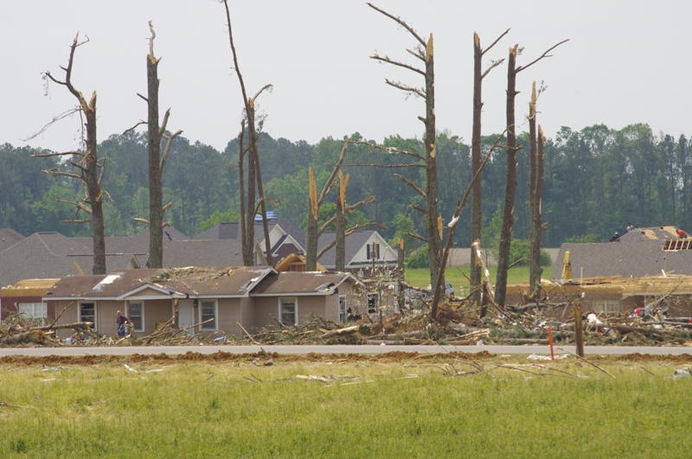
Disaster relief
Tornadoes, floods, hurricanes, earthquakes, fires

Slide 9
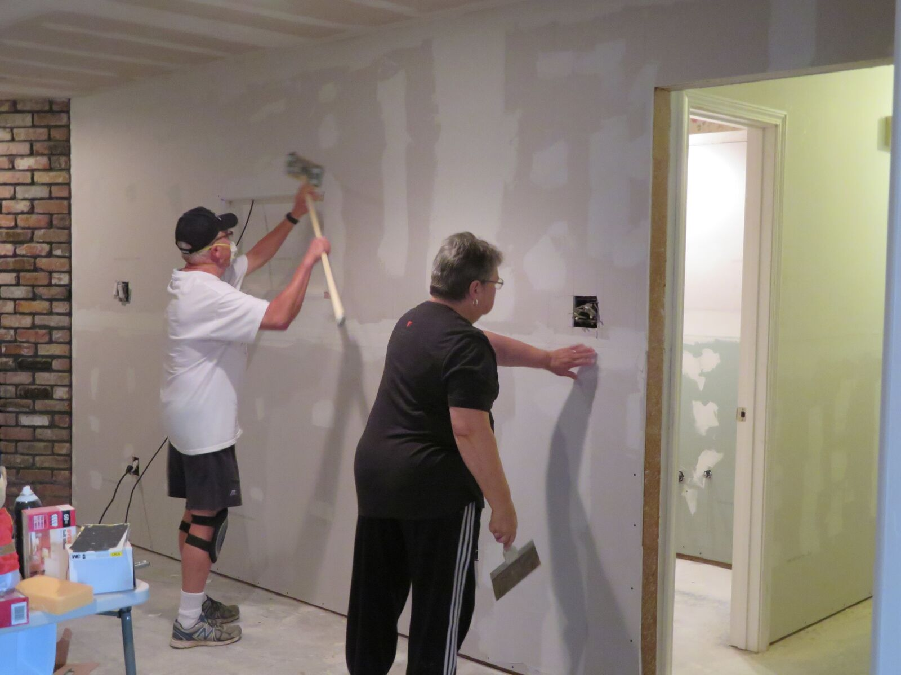
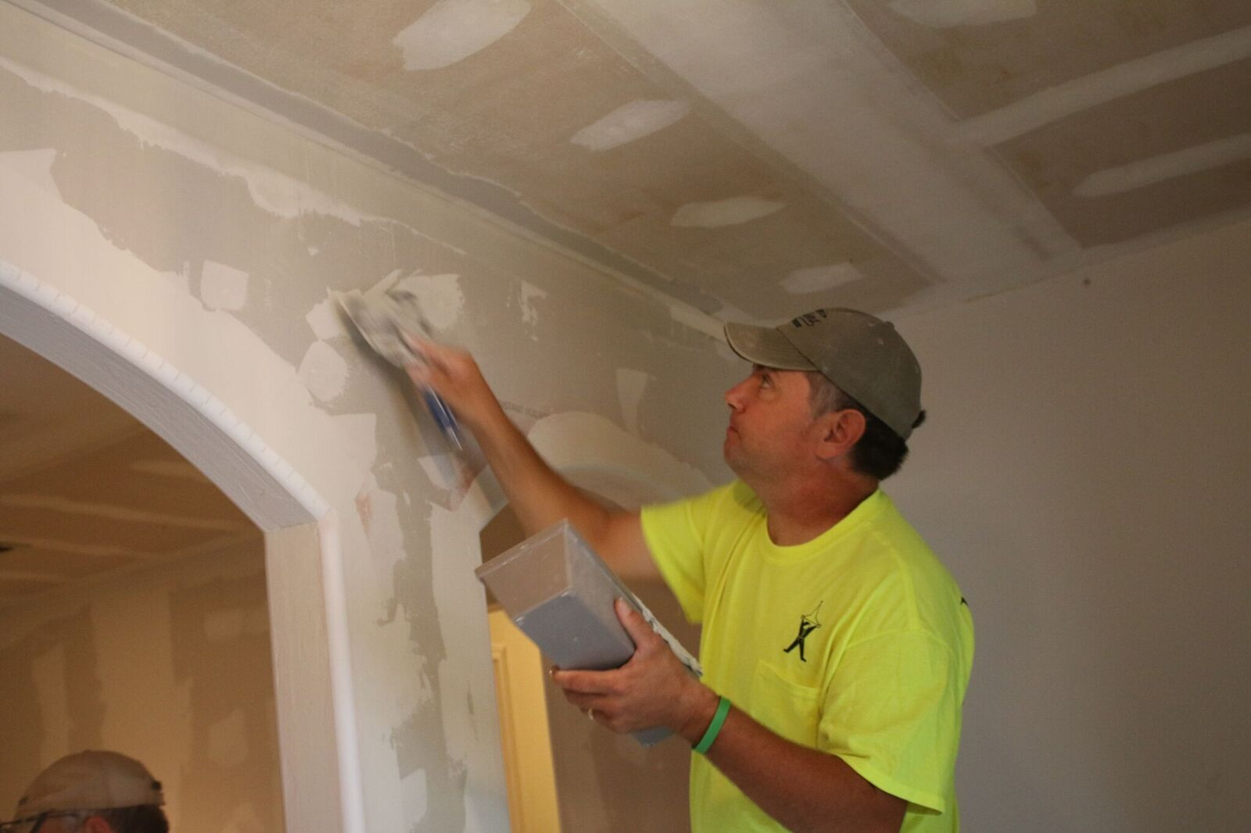
Flood relief in Baton Rouge, La.
Volunteers brought in to help rebuild 8 homes

Slide 10
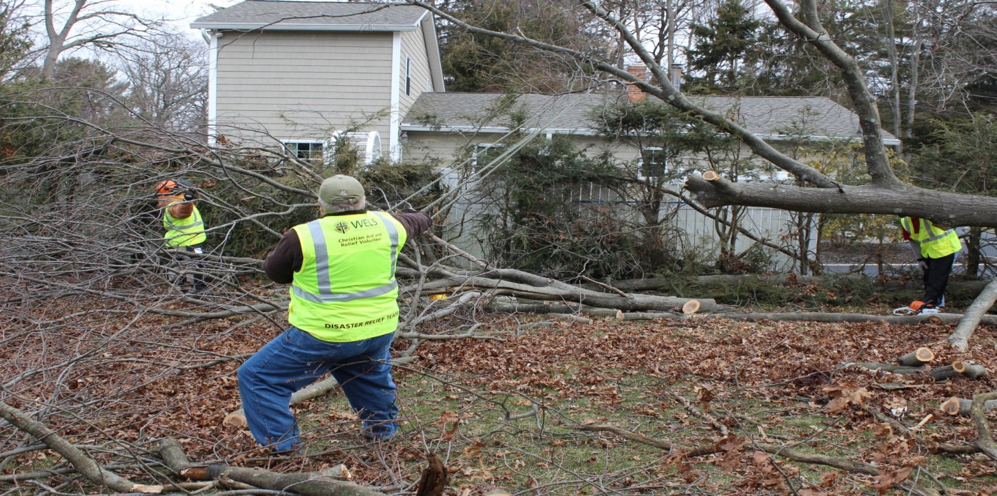
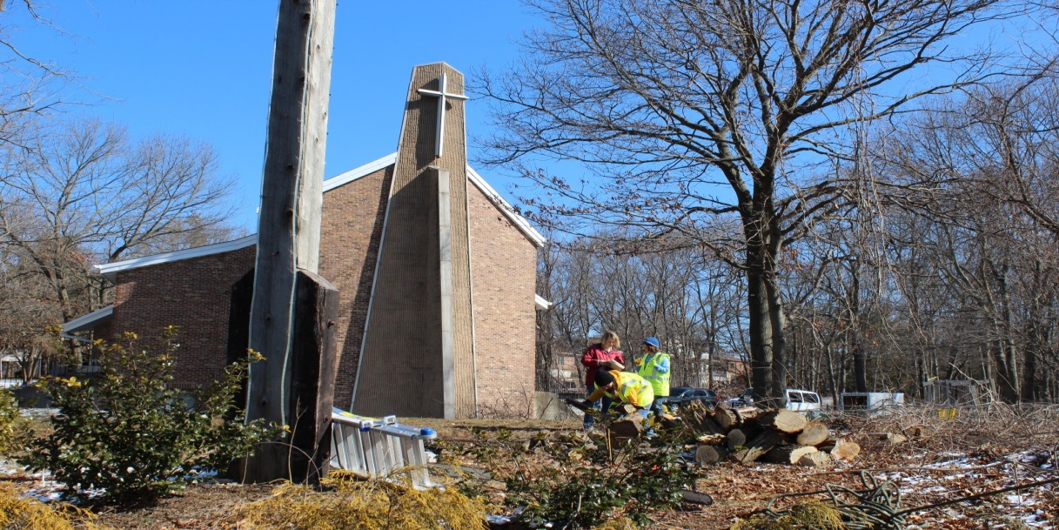
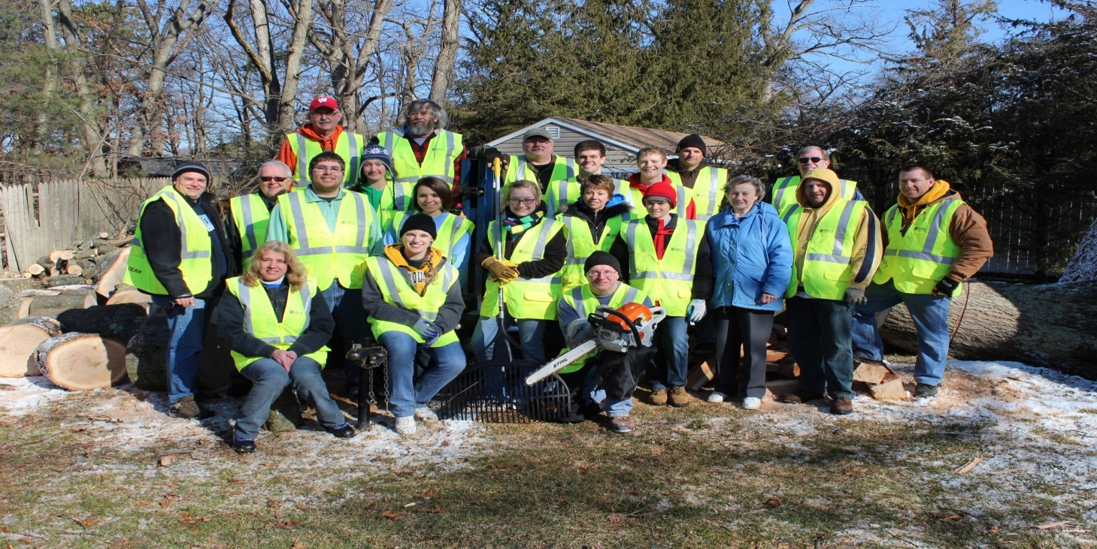
Relief volunteers

Slide 11
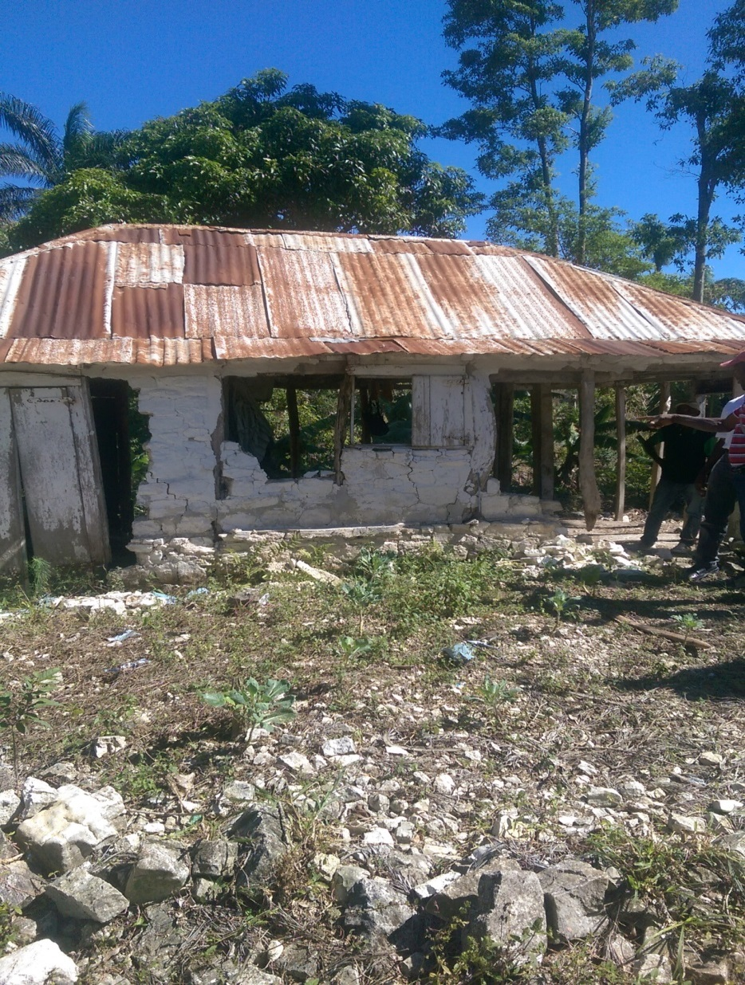
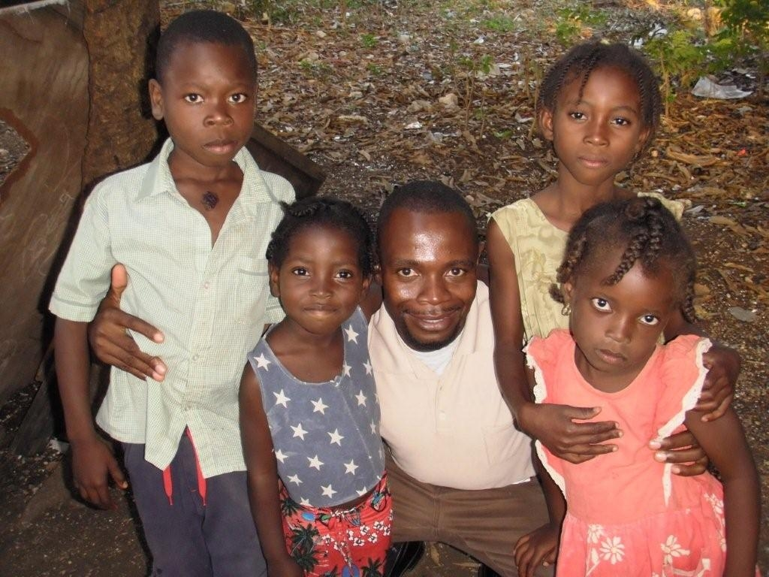
Hurricane relief in Haiti

Slide 12
451 tons of maize to feed 4,000 families in Malawi

Slide 13
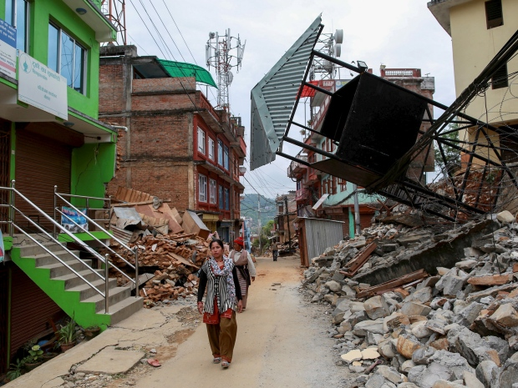
Nepal earthquake relief

Slide 14
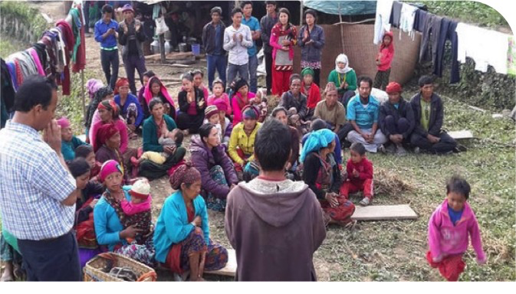
Earthquake relief in nepal
Grief counseling workshop

Slide 15
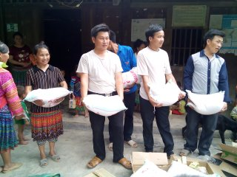
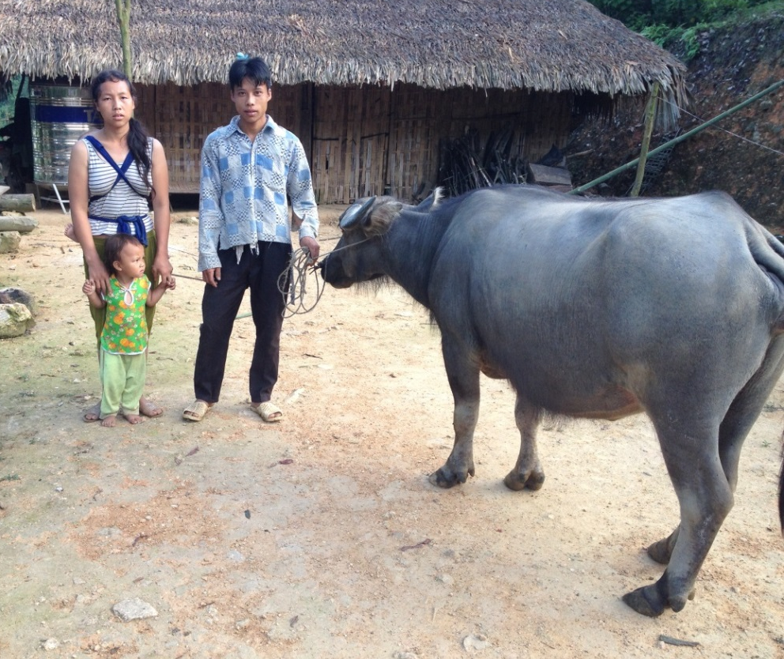
Disaster relief in Vietnam
After a destructive storm

Slide 16
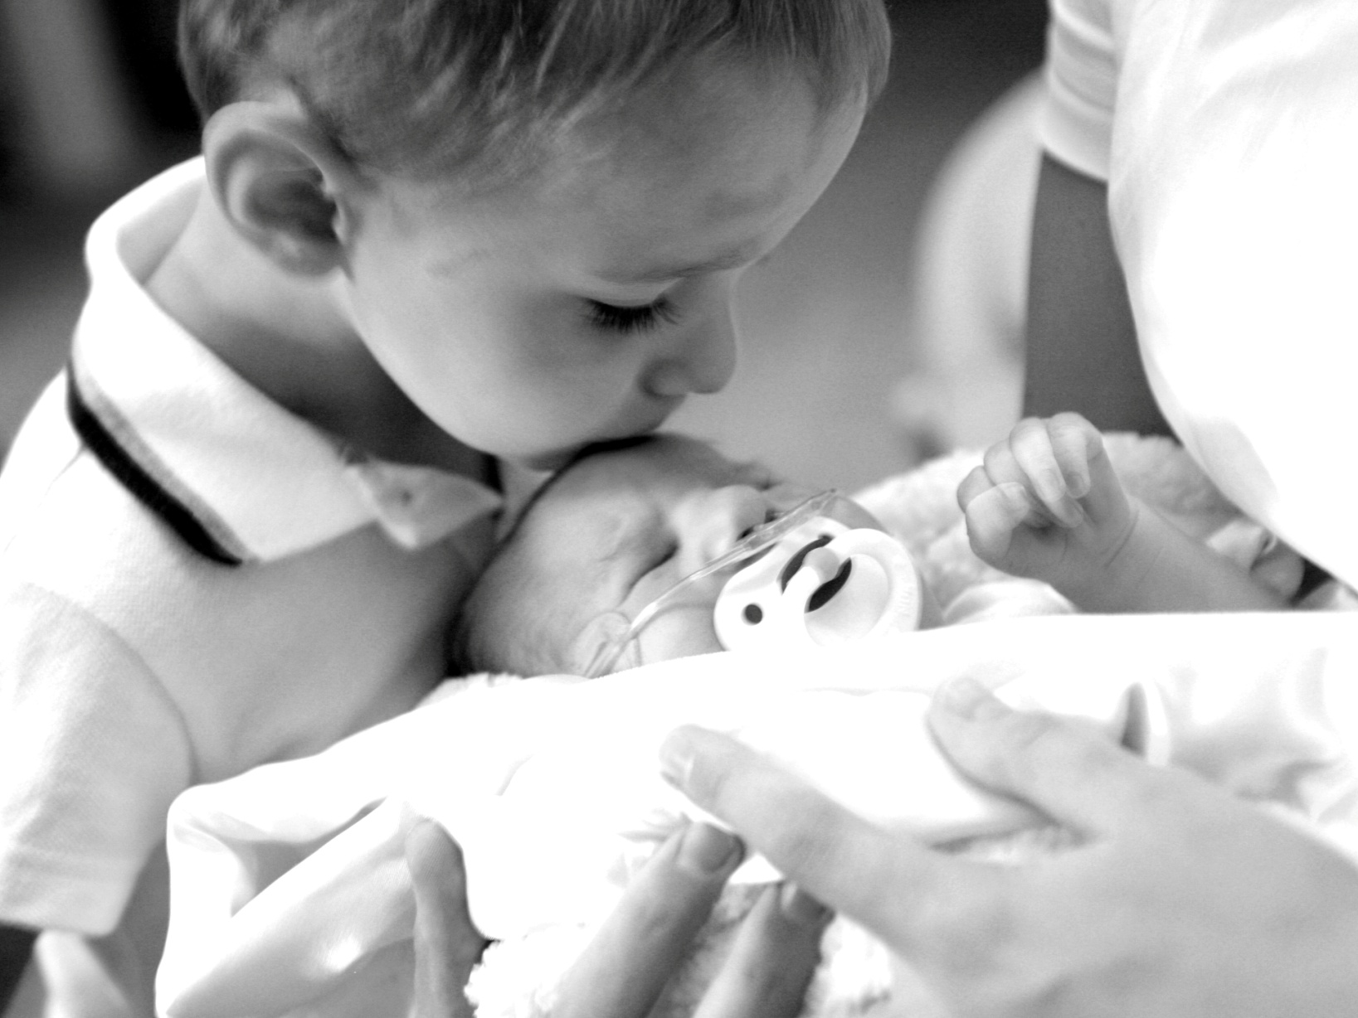
Personal medical/financial relief grants
Aid to families with medical and personal needs
Assisting relief efforts of local congregations
Notes:
Here are the five major categories for relief efforts.
Fires, tornadoes, hurricanes, floods, and earthquakes.
We also provide financial assistance to WELS families with medical needs and other difficult situations.
We like to work with local congregations, pastors, circuit pastors, and district presidents to carefully assess the situation.
Often we will assist or match the relief efforts of local congregations

Slide 17
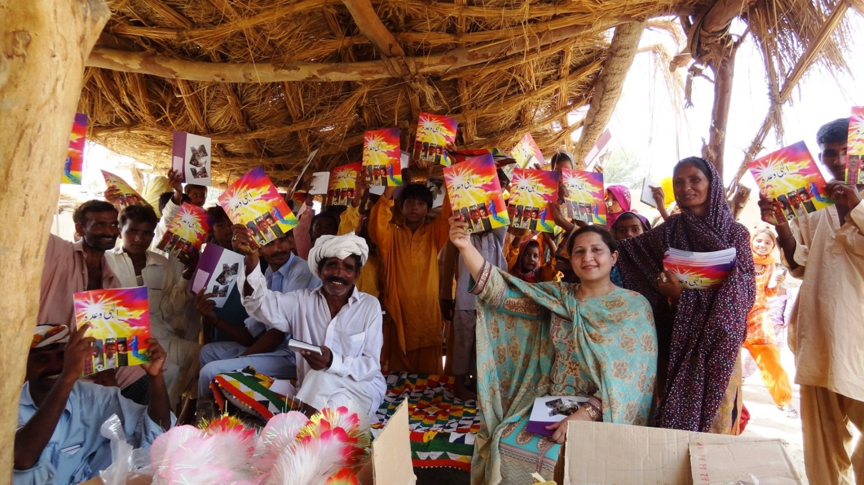
Be wise in the way you act toward outsiders
Make the most of every opportunity!

Slide 18
Building bridges for
the gospel
Nigeria, Zambia, Malawi, Russia, Thailand, Haiti, Mexico, India, Nepal, Indonesia, Bulgaria, Albania, Pakistan, Canada, Nevada, Texas, Idaho
Provide fresh water
Home-based care for sick and dying
Literacy programs
Health clinics – midwife training
Food assistance, welcome immigrants
Notes:
This slide highlights the various areas of the world where we are funding humanitarian aid projects.
It also spells out the type of projects we are supporting.
Each project involves our people reaching out to precious souls with the Gospel.
Home based care for the sick and dying enables volunteers to share the Gospel with people in dire physical need or near the end of their life.
We have the opportunity to share Christ with them before they die.

Slide 19
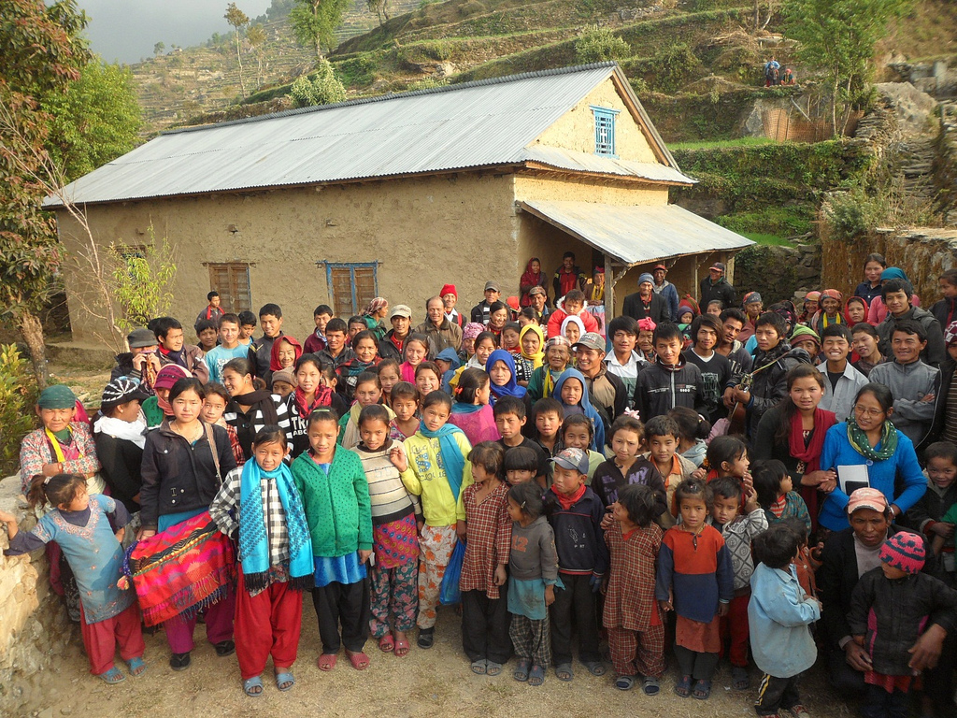
Humanitarian aid projects total
$327,000
granted this year
Notes:
Another major focus of our ministry is funding humanitarian aid projects.
These projects come to our committee annually from the Board for World Missions.
They start with missionaries in the field looking for ways to build bridges for proclaiming the Gospel. They forward these requests to their area adminstrators to be approved by the Board for World Miissions. Then our committee grants the funding.
We were happy to grant $260,000 for humanitarian aid projects this year.
We welcome special gifts so that we can continue funding these humanitarian aid projects in years to come!

Slide 20
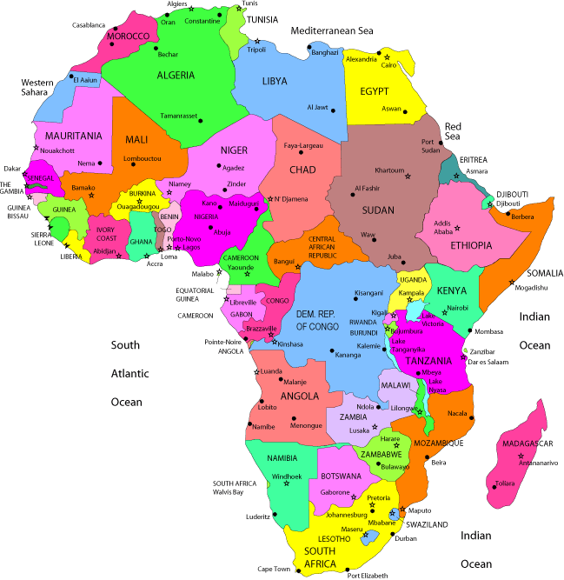
Humanitarian aid
Malawi
Zambia
Nigeria
Ethiopia

Slide 21
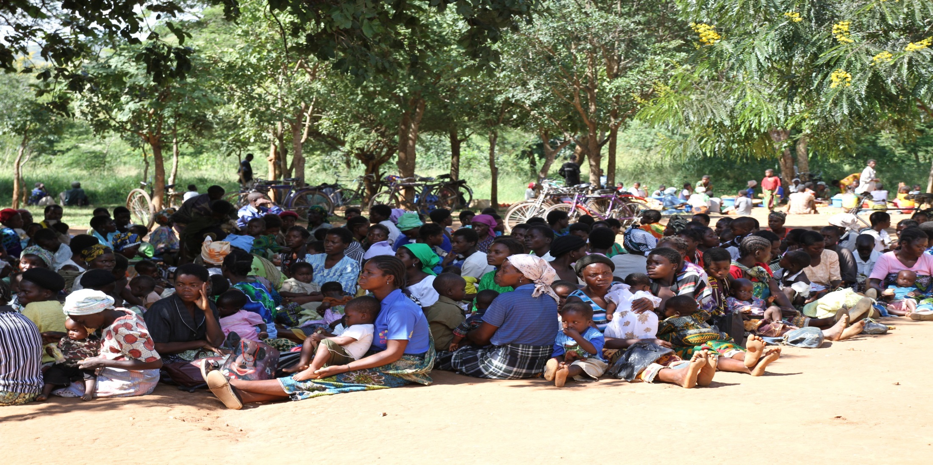
Mobile Medical Clinic at Suzi
Run by Central Africa Medical Missions

Slide 22
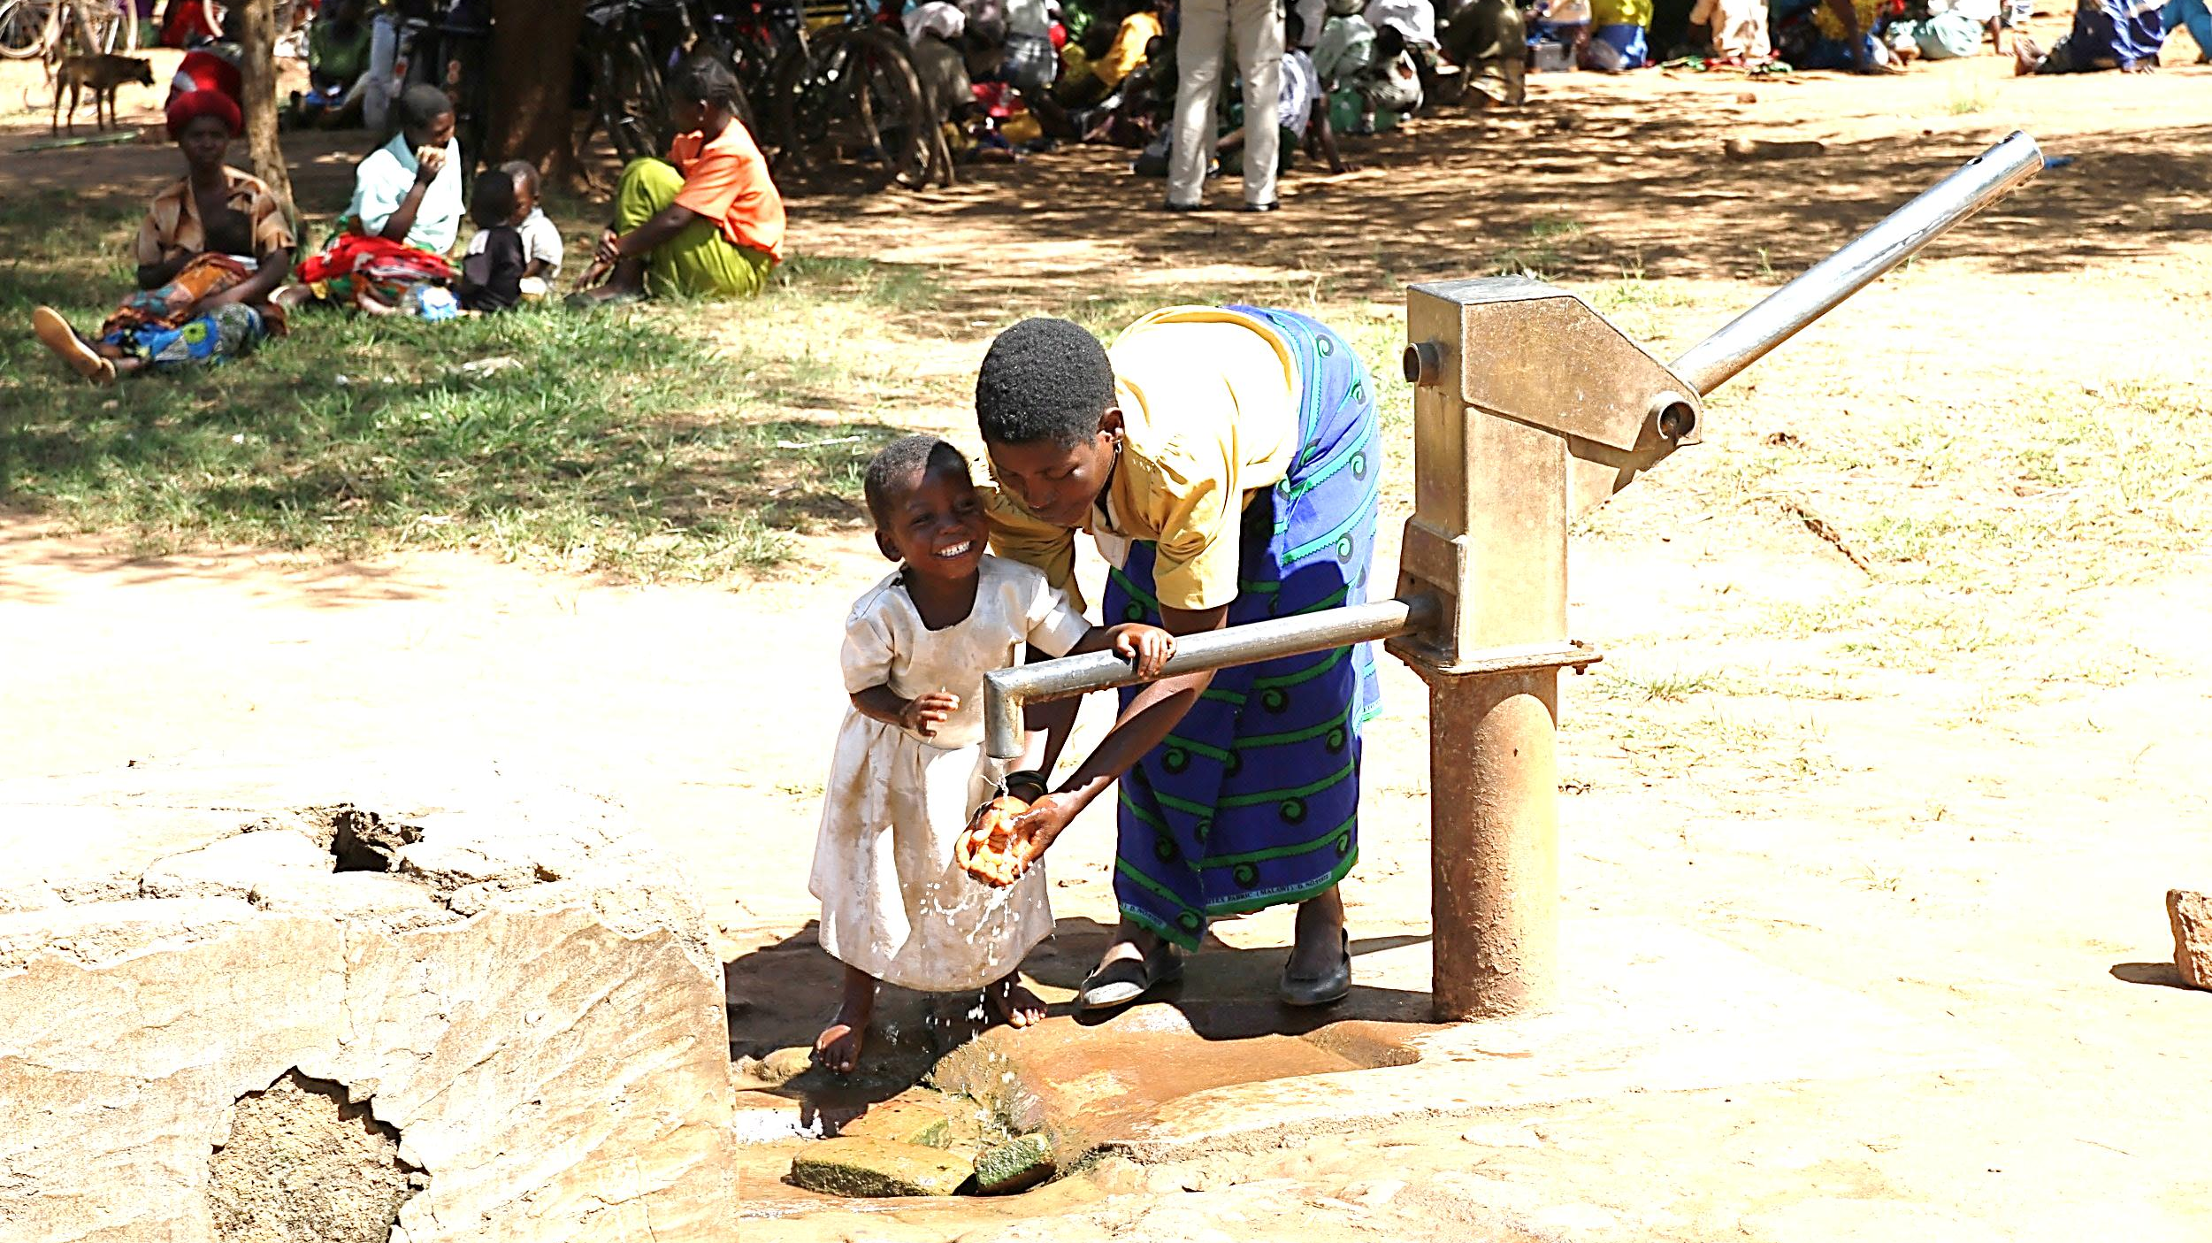

Slide 23
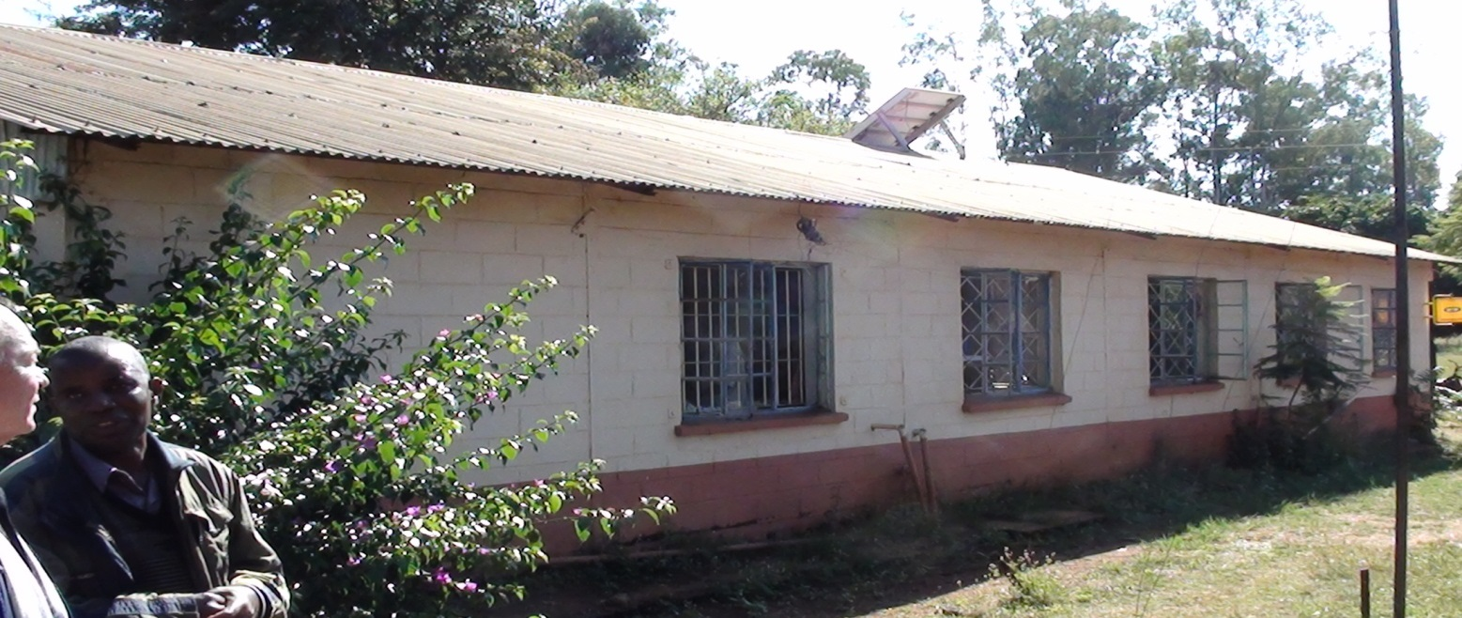
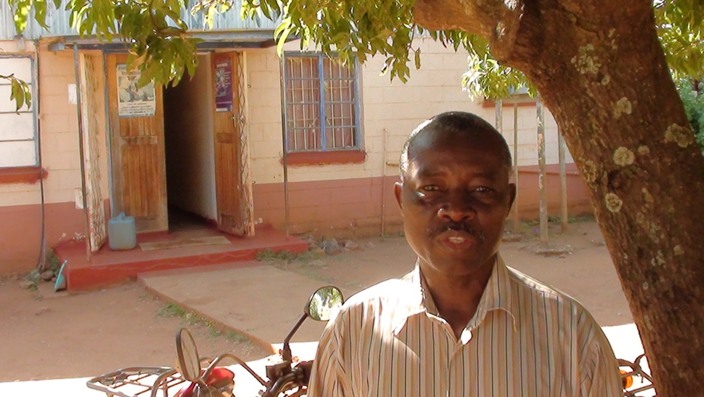
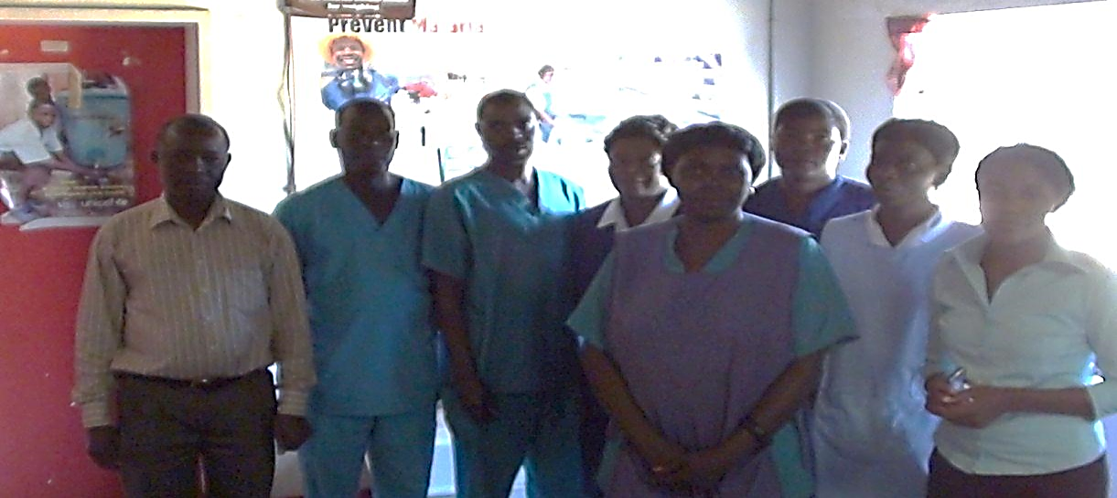
Medical clinic Mwembezhi
Jackson and health workers

Slide 24
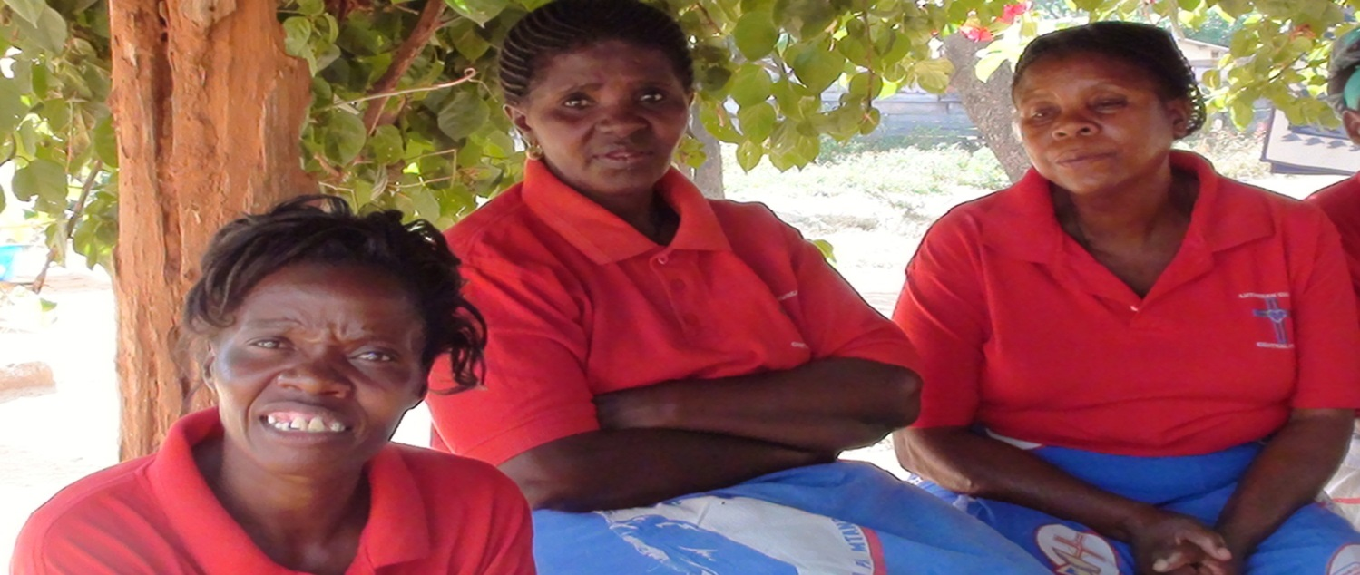
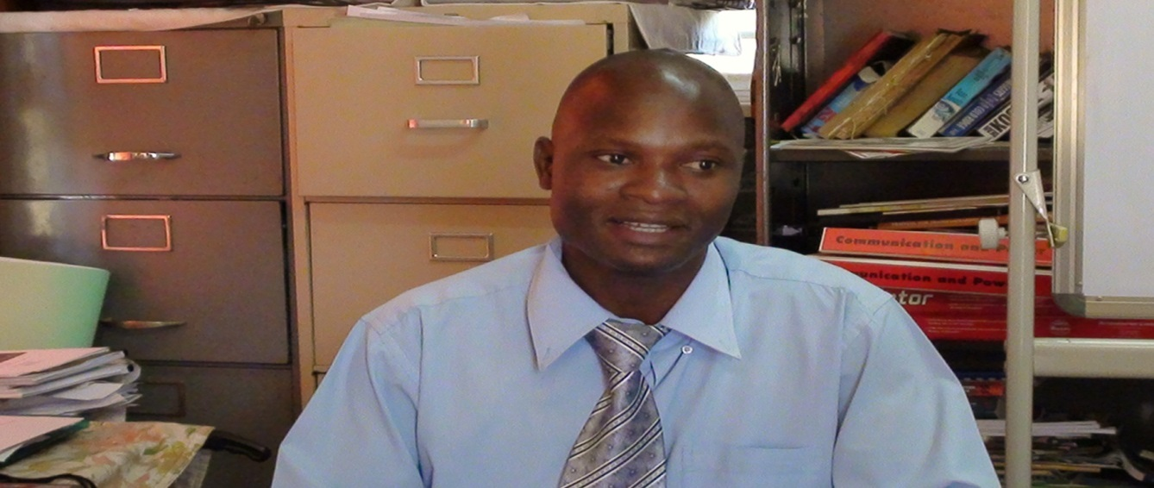
Gertrude leads literacy classes
Alisad Bonda leads Charities Board

Slide 25
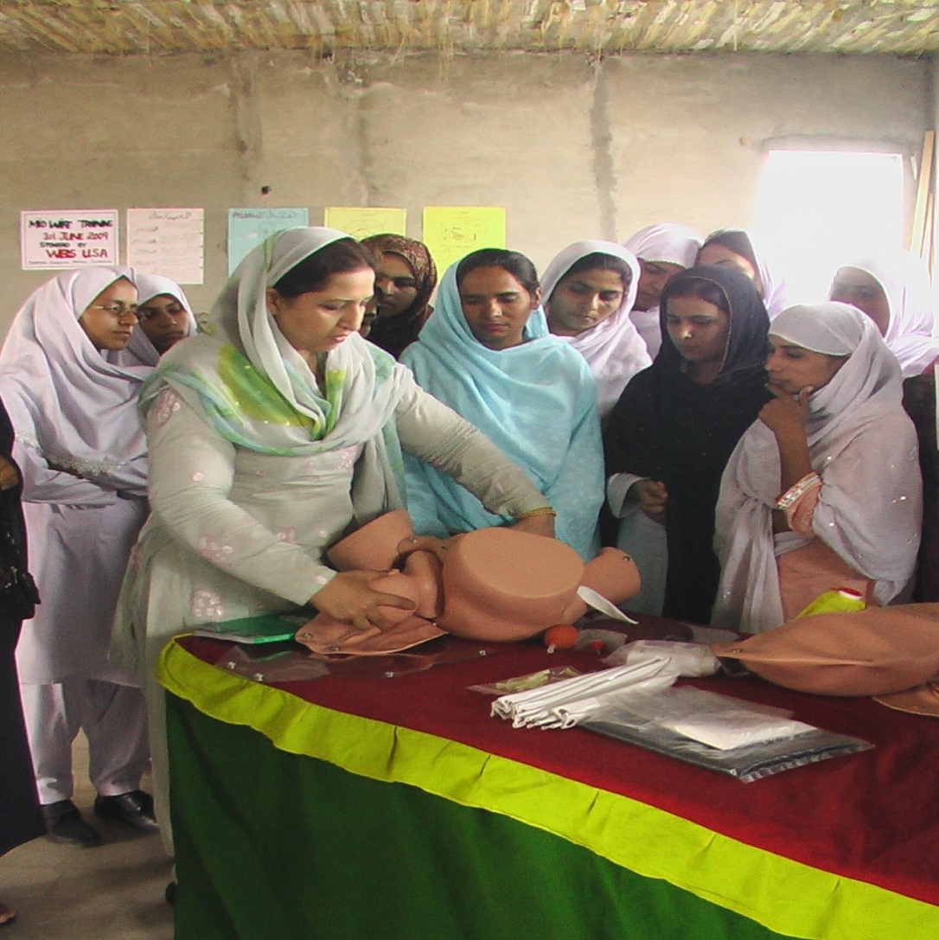
Midwife childbirth classes
In this country 1 in 58 women die in childbirth
In America 1 in 4,800 women die in childbirth

Slide 26
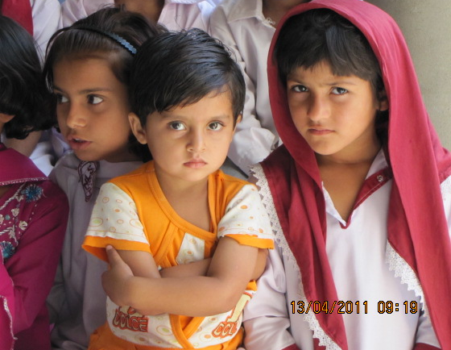
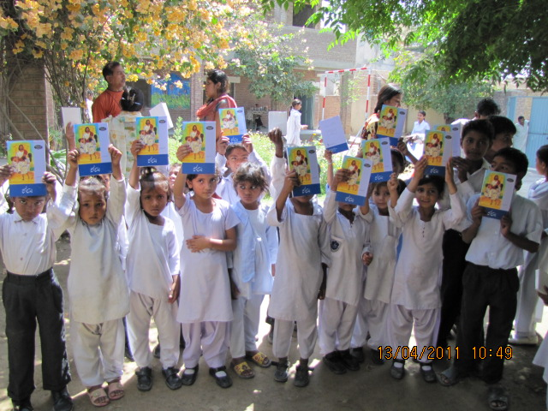
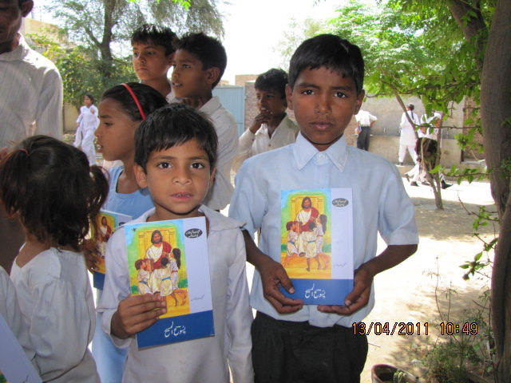
Let the little children come to me!

Slide 27
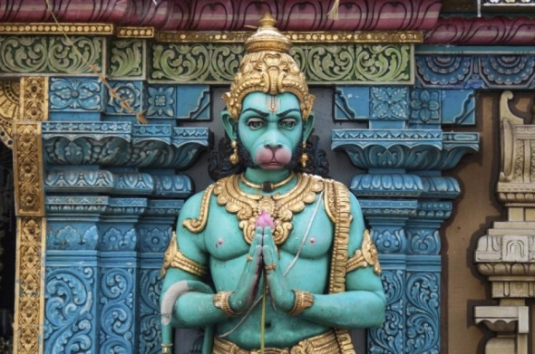
Sharing the gospel in Nepal
HINDUISM HAS OVER
300 MILLION GODS

Slide 28
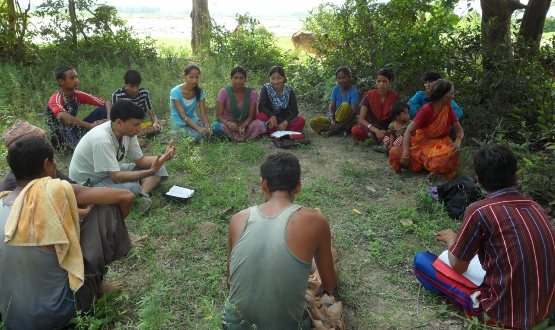
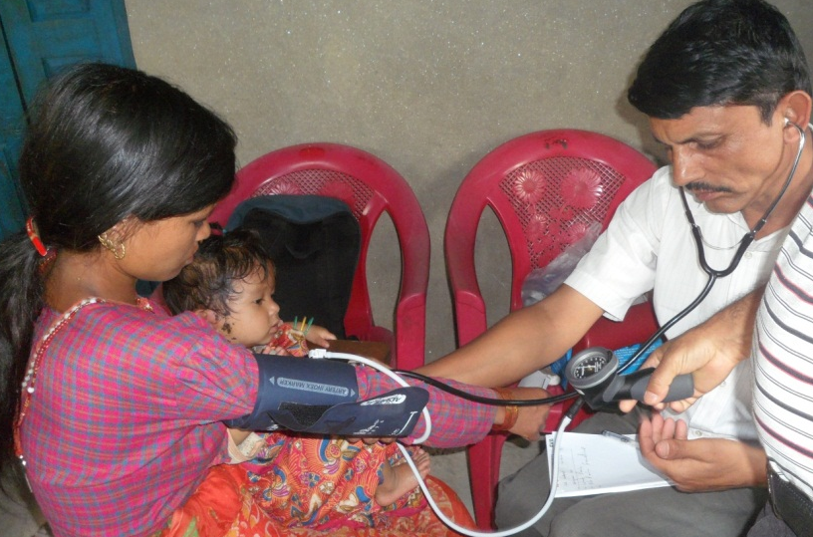
Care for the body and soul in Nepal

Slide 29
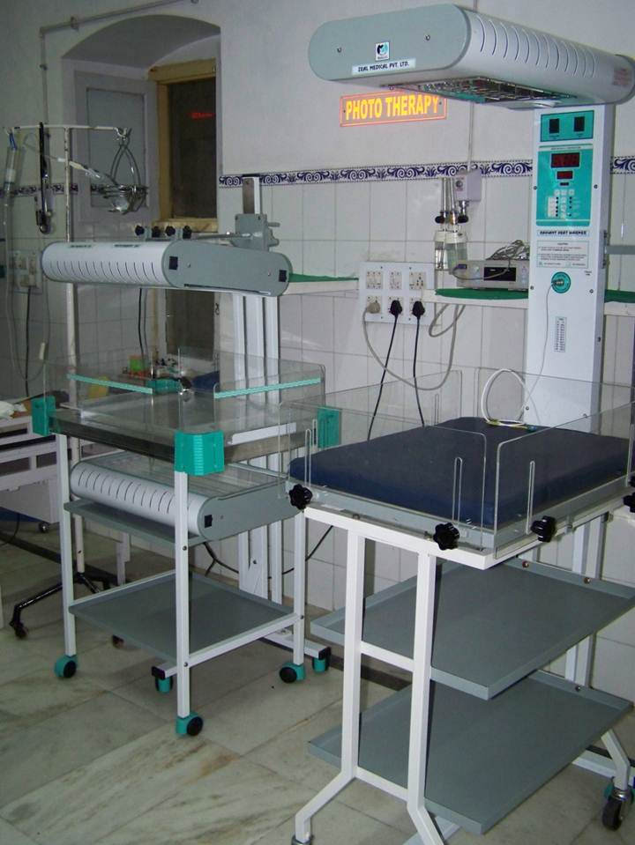
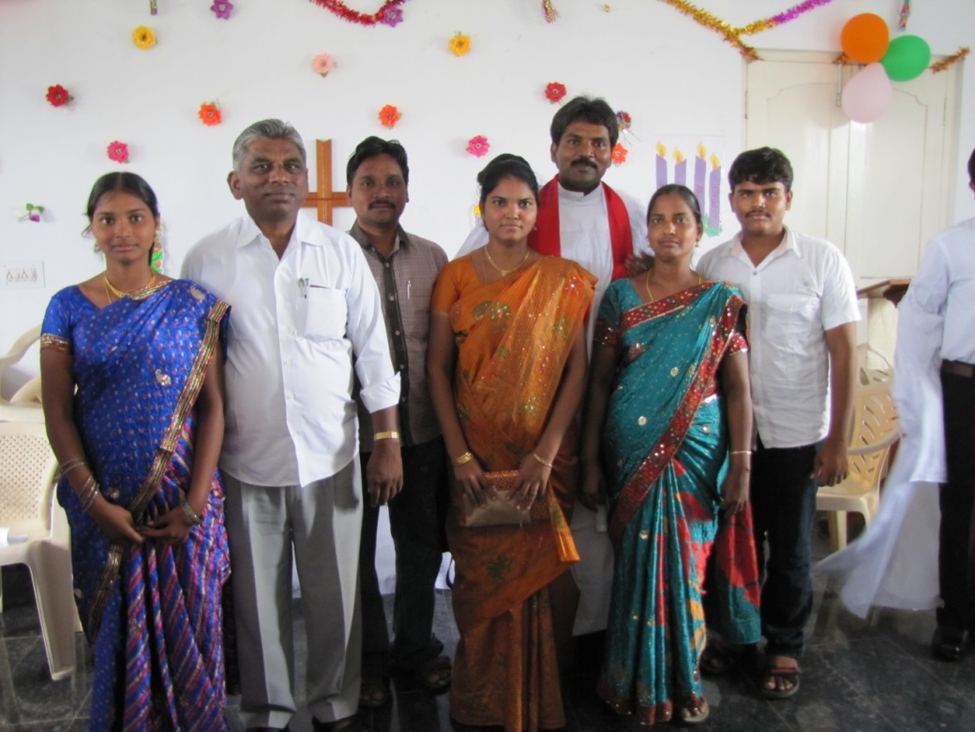
India
Pastors and their wives
Medical equipment
for hospitals

Slide 30
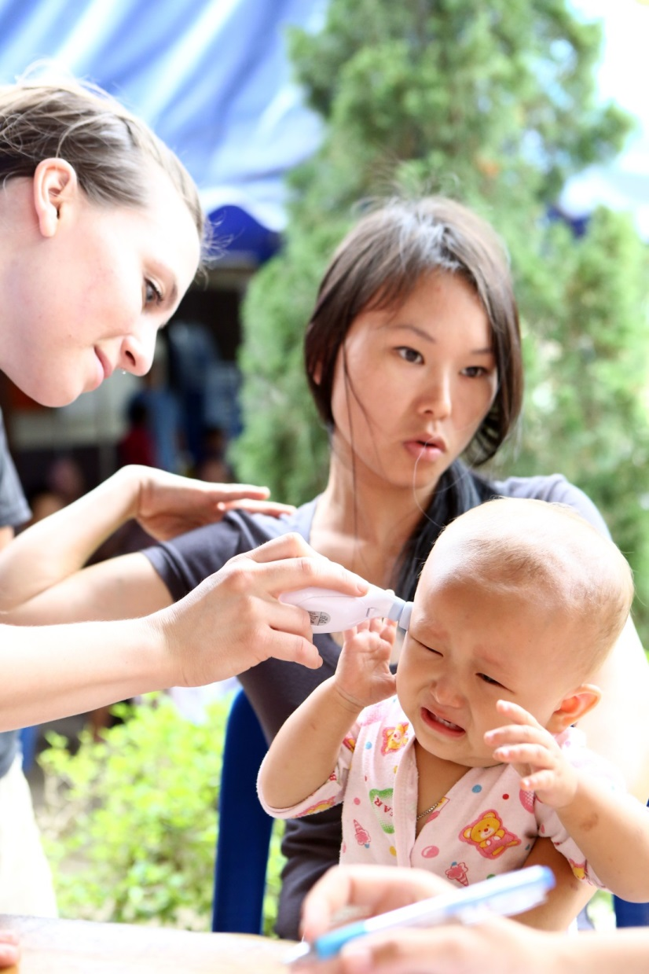
Thailand
Reaching out through medical clinics
and ESL

Slide 31
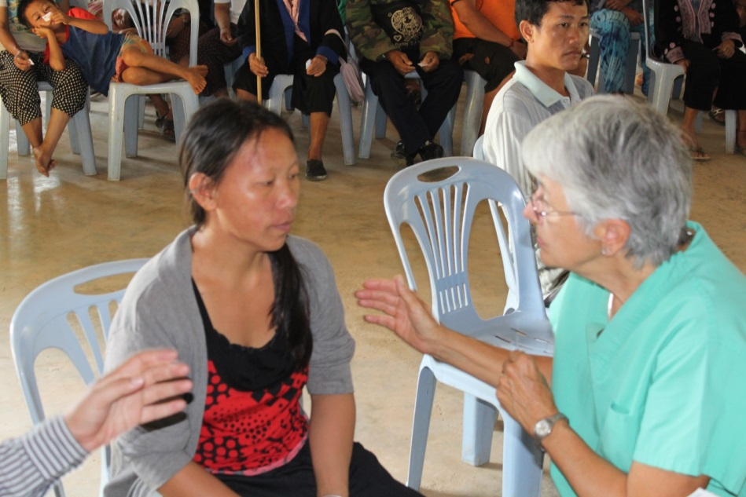
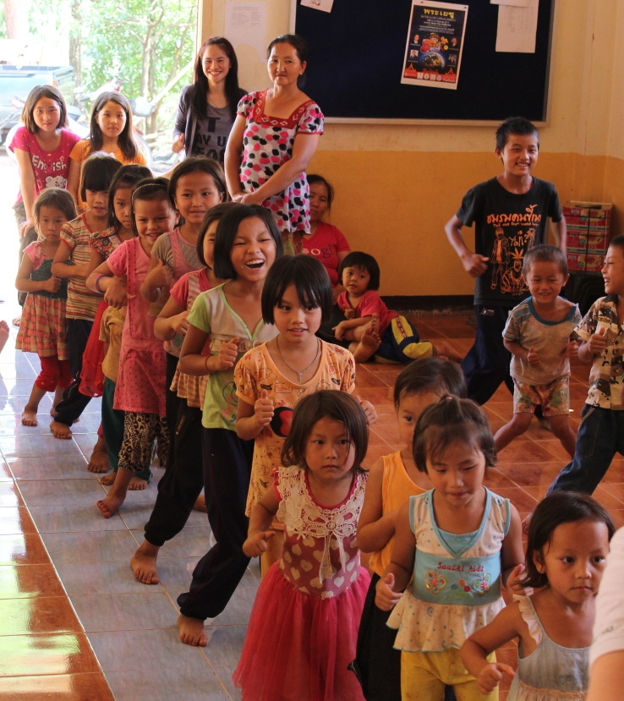
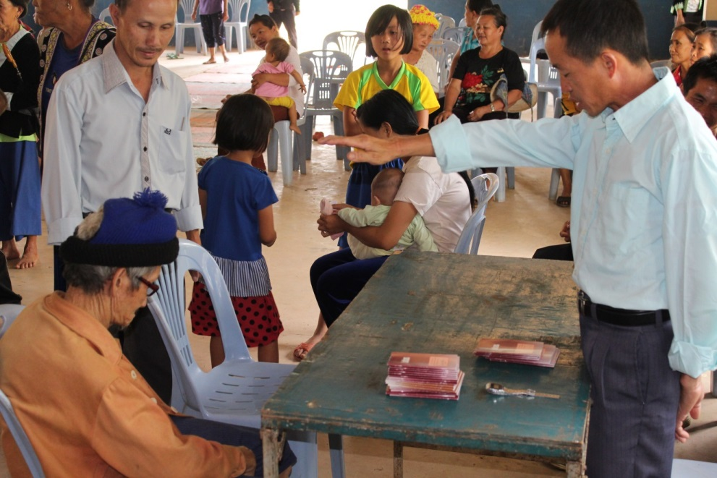
Care for the body and soul

Slide 32
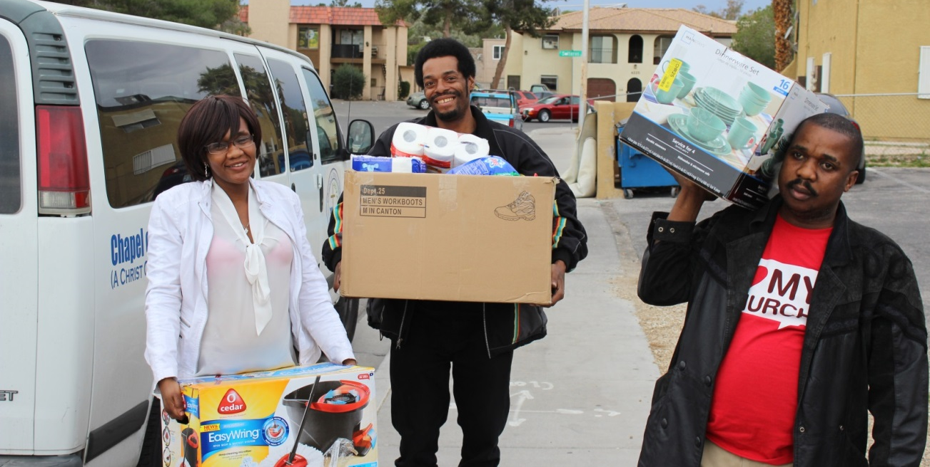
Opening doors to share the gospel
Welcoming legal African immigrants to Las Vegas

Slide 33
WELS CHRISTIAN AID & RELIEF UPDATES
wels.net/relief
“Lifeline” videos
Facebook – WELS Christian Aid & Relief
Contact us for presentations or DVDs

