Slide 1
64th Biennial Convention of the
Wisconsin Evangelical Lutheran Synod
PRESIDENT’S REPORT
WELS President Mark Schroeder

Slide 2
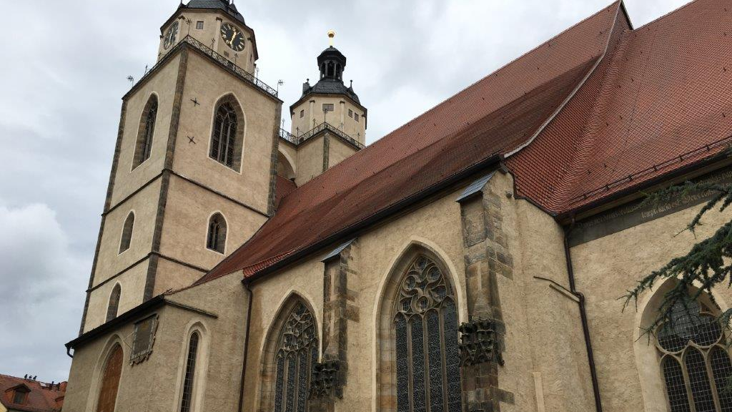
2
Unwavering commitment to the Word
“I must place the Word of God above everything. I must hazard life and limb, the world’s favor, my property, honor, and all my welfare that I may keep it and cling to Christ as to my most precious possession in heaven and on earth.”—Martin Luther

Slide 3
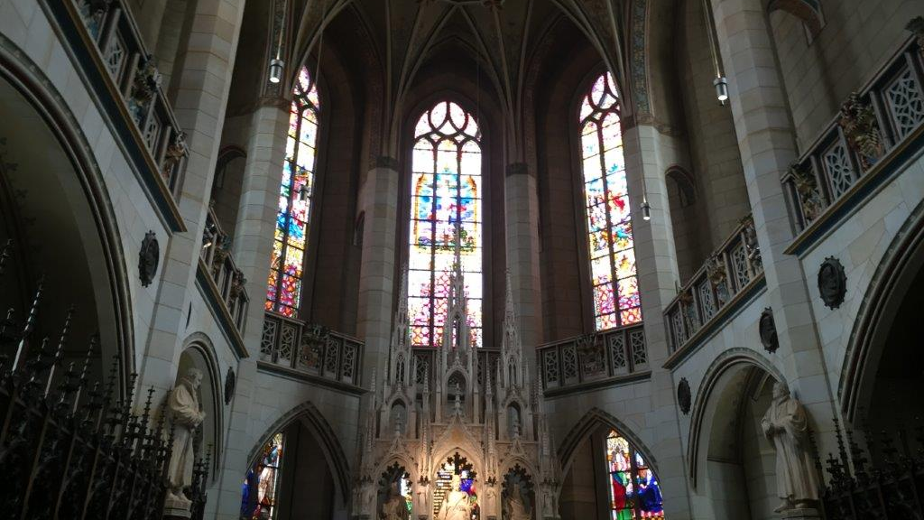
3
Trust in the power and efficacy of the Word
“I simply taught, preached, and wrote God’s Word; otherwise I did nothing. And then, while I slept, or drank Wittenberg beer with my Philip and my Amsdorf, the Word so greatly weakened the papacy that never a prince or emperor did such damage to it. I did nothing. The Word did it all.”

Slide 4
4
The centrality of the gospel
“The chief article and foundation of the gospel is that before you take Christ as an example, you accept and recognize him as a gift, as a present that God has given you and that is your own. This means that when you see or hear of Christ doing or suffering something, you do not doubt that Christ himself, with his deeds and suffering, belongs to you. On this you may depend as surely as if you had done it yourself; indeed as if you were Christ himself.”

Slide 5
5
The importance of ministerial education
“Pray that God may give us—as Christ himself commands us to pray—faithful laborers and preachers who are in earnest and who hold on to the Word.”

Slide 6
6
The blessing of corporate worship
“No more splendid work exists than receiving and hearing the Word of God.”

Slide 7
7
The need for Christian education
“Indeed, for what purpose do we older folks exist, other than to care for, instruct, and bring up the young? . . . This is why God has entrusted them to us who are older and know from experience what is best for them. And God will hold us strictly accountable for them.”

Slide 8
8
A renewed emphasis on Christian vocation
“How could the devil have more effectively led us astray than by the narrow conception that service to God takes place only in a church and by the works done therein? The whole world could abound to the service of God not only in churches but in the home, kitchen, workshop, and field.”

Slide 9
9
Showing mercy and Christian love
“Therefore, a man should be guided in all his works by this thought and contemplate this one thing alone, that he may serve and benefit others in all that he does, considering nothing except the need and advantage of his neighbor.”

Slide 10
10
The privilege of missions
“Dear Father, we pray, give us first your Word, that the gospel be preached faithfully throughout the world.”

Slide 11
11
A life of repentance
“When our Lord and Master Jesus Christ said, ‘Repent’, he willed the entire life of believers to be one of repentance.”

Slide 12
12
Other convention business

Slide 13
13
Conclusion

